Slide 1
Aristotle University of Thessaloniki
Department of European Educational Programmes

Slide 2
ERASMUS+ INTERNATIONAL

Slide 4
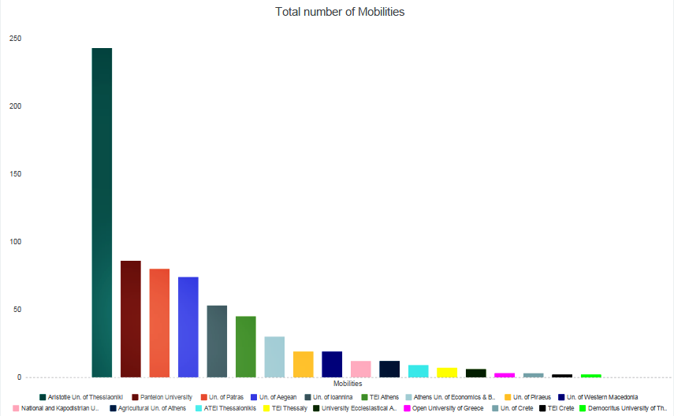
AUTh

Slide 5
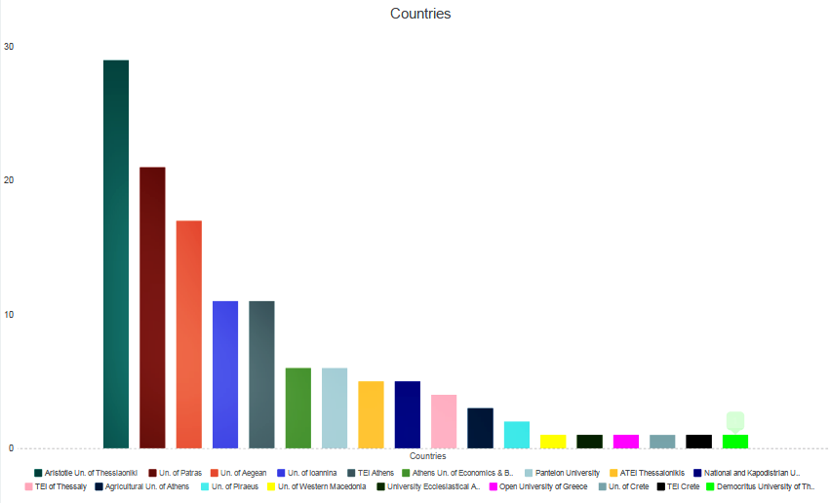
AUTh

Slide 6
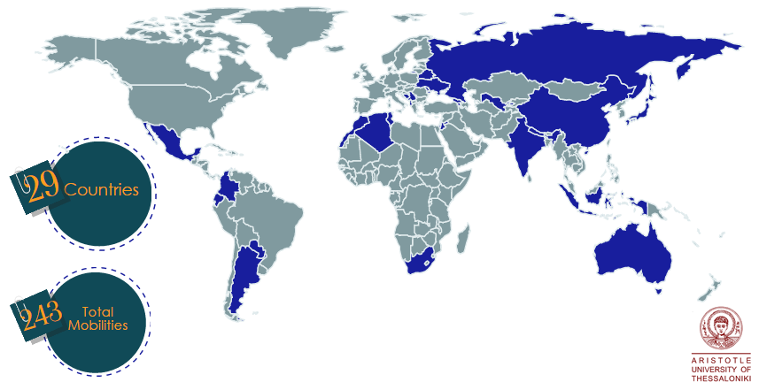
http://www.iky.gr/statistika-stoixeia-ka1/erasmus-ka1-anotati-ekpaidefsi/2015

Slide 7
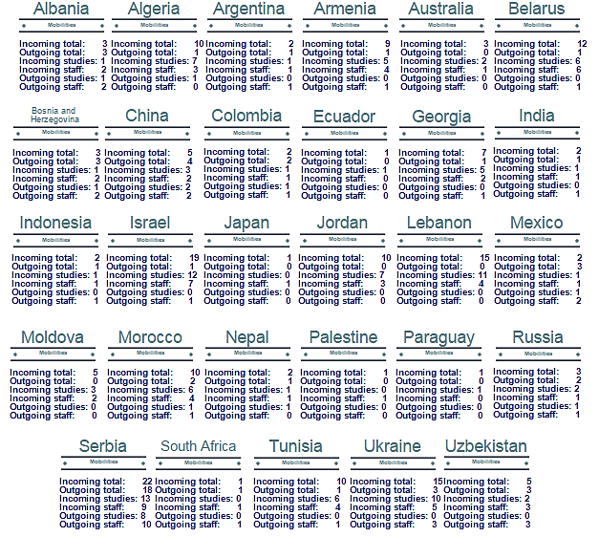

Slide 8
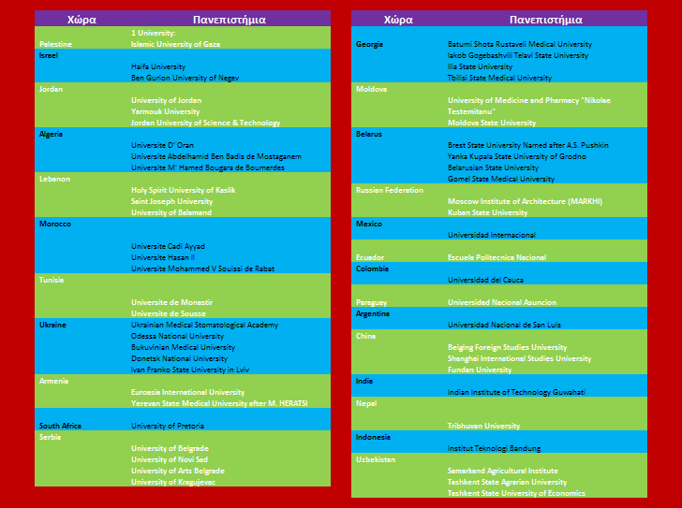
Cooperating Universities

Slide 9
Department of European Educational Programmes
Administration Building/1st Floor
Aristotle University of Thessaloniki University Campus 54124 Thessaloniki Greece
E-mail: eurep-dept@auth.gr
Web: www.eurep.auth.gr

