Slide 1
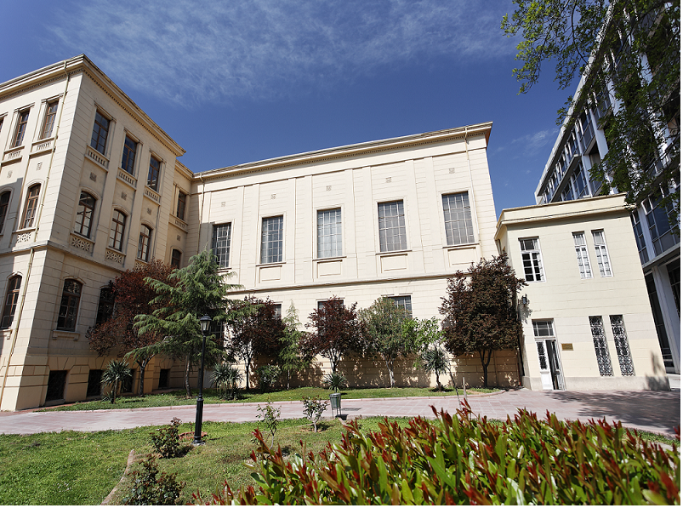
Aristotle University of Thessaloniki
School of Modern Greek Language

Slide 2
Visit us at the School (behind the Old building of Philosophy Faculty)
Check our website: www.smg.auth.gr
: School Of Modern Greek Language

Slide 3
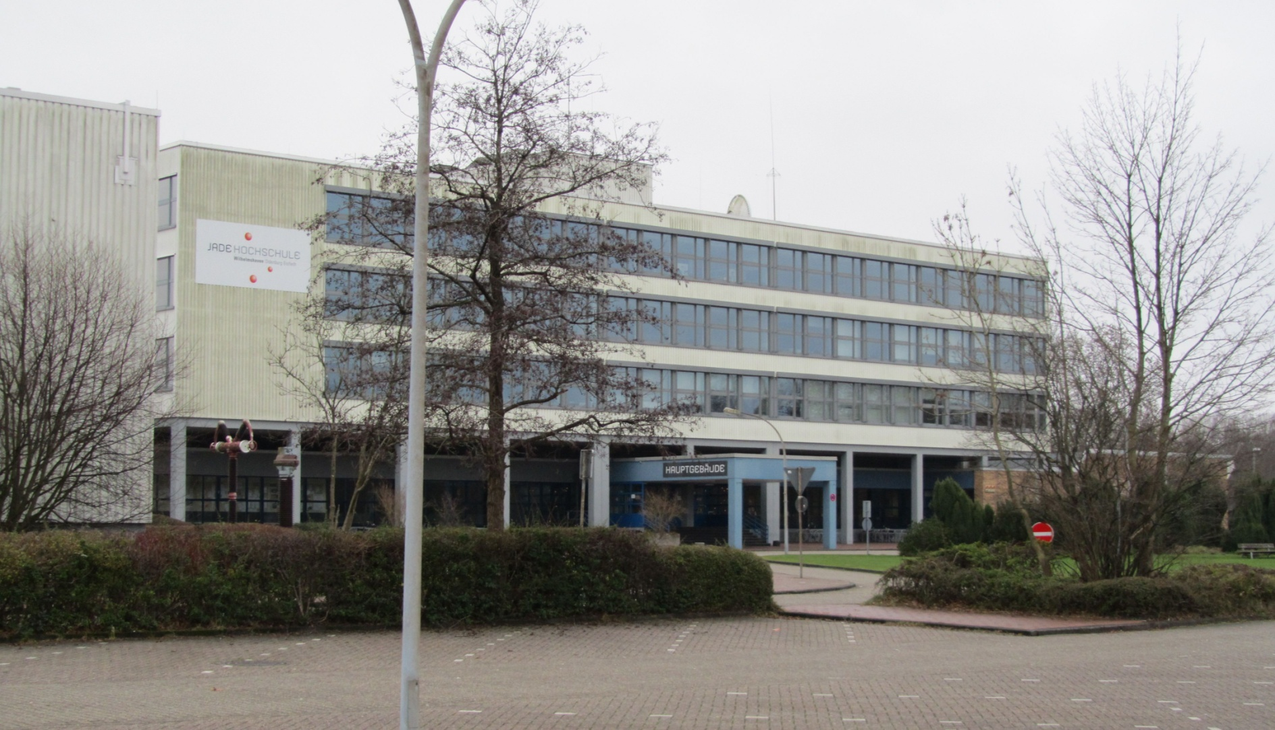
Jade University of Applied Sciences (Germany)
Participant: Uwe Weithoner

Slide 4
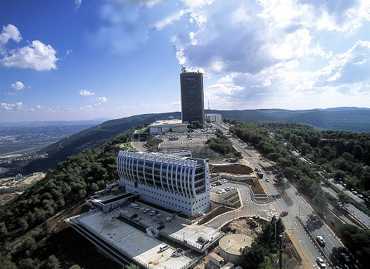
University of Haifa (Israel)
Participant: Hagit Lu

Slide 5
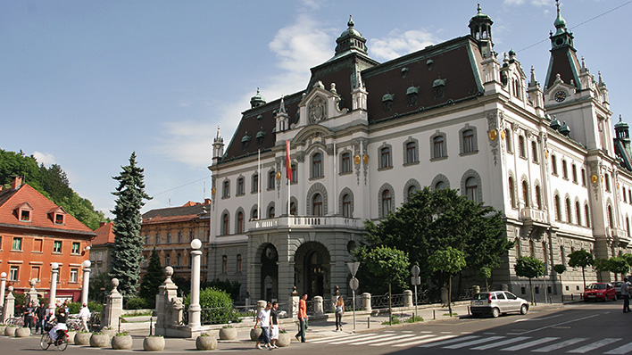
University of Ljubljana (Slovenia)
Participant: Mojca Likar & Sara Gornik

Slide 6
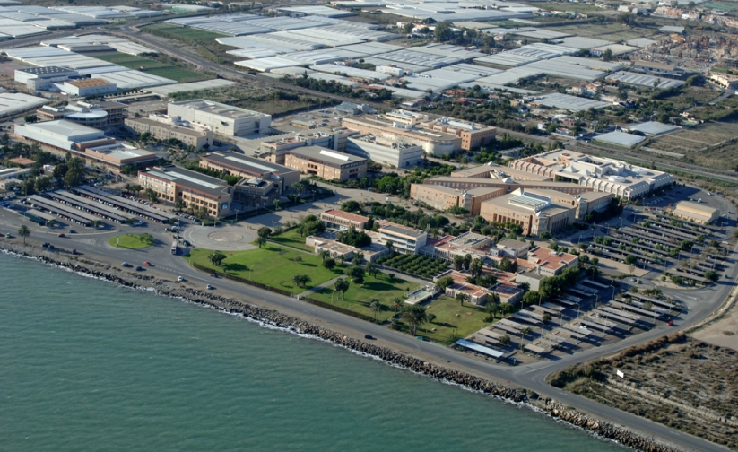
University of Almeria (Spain)
Participant: Virginia Garcia Aragones

Slide 7
Info
Short presentation by each partner about the summer schools at their Universities
Most of the summer schools are in July and August usually the duration is 3 weeks. University of Haifa has summer programs for 7 of 10 days (startup innovation programs, career development etc)
Tuition fees: various from University to University
Mainly cover the cost of the summer programme and the “profit” goes to next programs and home University students (scholarships)

Slide 8
Aspects
Recognition of ECTS by home Universities
Collaboration with new partners (MoU between Universities) (joint summer schools with partner Universities: 3 years summer school for language and culture (Greece, Germany, Israel)
Internalization at home.
Teaching staff. Encouraging to accompany their students and co-teaching at the host University
International master course. Curriculum of the summer course.

Slide 9
THANK YOU!

