Slide 1
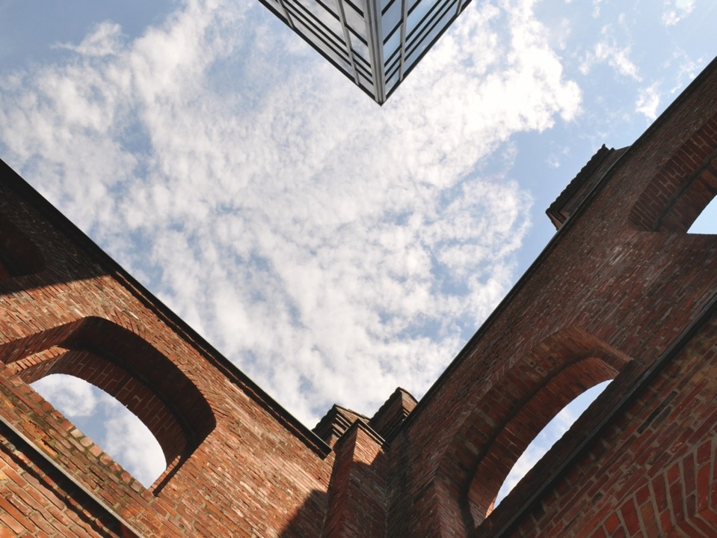
Nature Technology Culture Society
TODAY
FOR
TOMORROW

Slide 2
Some
Aspects
A broad range of expertise in natural and technological sciences, art, humanities, and social sciences
Regionally based, but part of an international network of partner universities worldwide
144 study courses including 14 International Masterprogramms, Winter- and Summer- Universities
In winter term 2016/2017 3.040 international students from 140 countries took courses at the Kassel University as part of the 25.000 enrolled students
250 bilateral agreements within the EU Mobility programme “Erasmus Plus”.

Slide 3
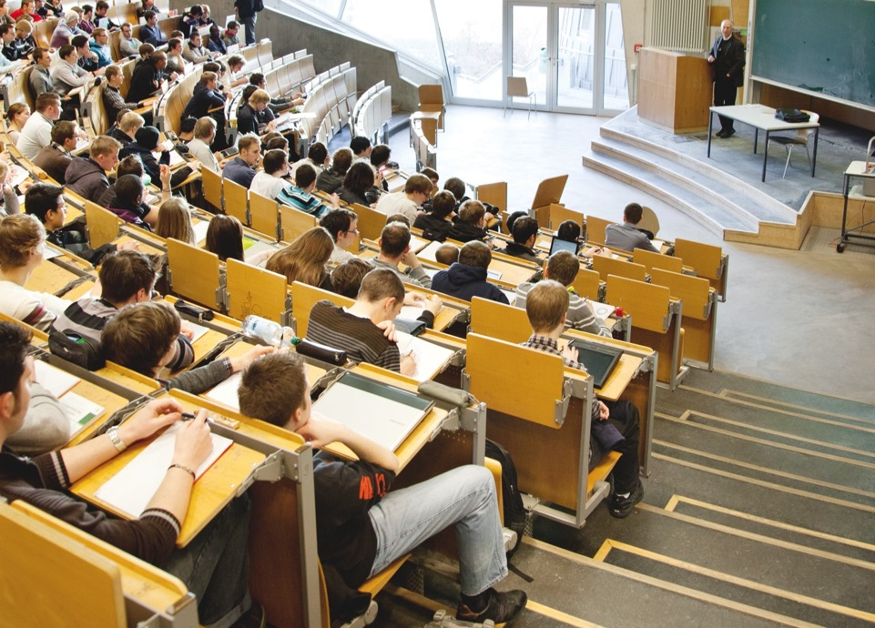
Department for Study
Student Affaires Office
International Office including Welcome Center
Student Advisory Service
Quality Assurance for Study and Teaching
Examination Regulations
and Teaching Affaires

Slide 4
Fields of
personal duties
Accreditation and Evaluation
Support for the Developement of Study Programmes
Coordinator for Teaching Reports
Till 2010: Student advisory, Support for International Students

Slide 5
In the middle of Germany and Europe
Unique blend of cultural city and outdoor lifestyles
documenta city
Green city – parks and natural landscapes
World Heritage site – Bergpark Wilhelmshöhe
Industrial, service and administrative centre for North Hesse
Contact:
boemans@uni-kassel.de

