Slide 2
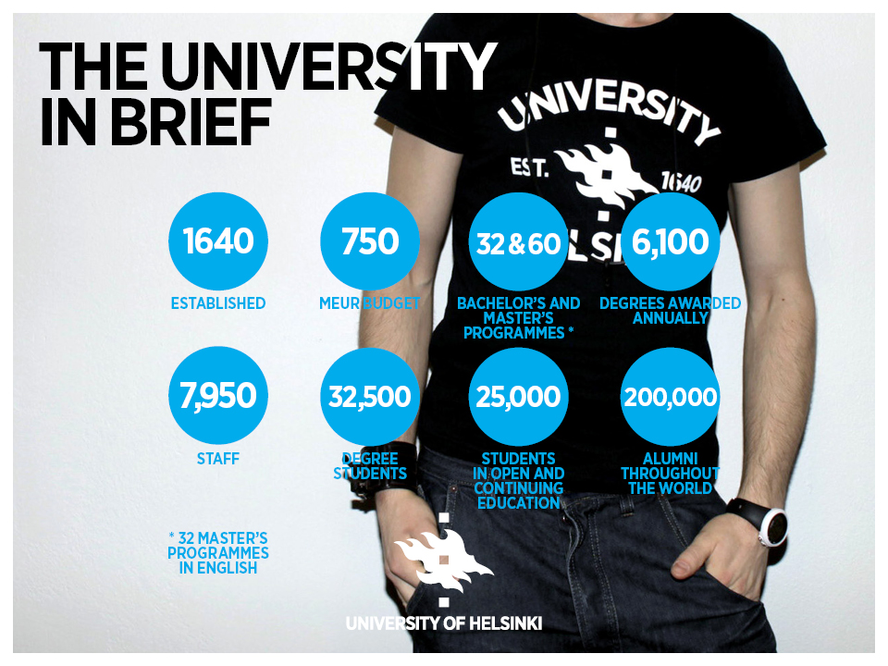

Slide 3
Notes:
Faculty of Eductional Sciences :
3000 students
Bachelors programme in education
Masters programme in education

Slide 4
Education Coordinator
Swedish speaking teacher programs (3)
Curriculum planning
Ensuring implementation of policies and practices
Student counselling
Coordinating marketing and admissions
Developing practices
Cooperation with partners

