Slide 1
The Utrecht Network Task Force
Responsible Internationalisation and Global Engagement:
Promoting Academic Freedom and Academic Responsibility in International Higher Education and Research

Slide 2
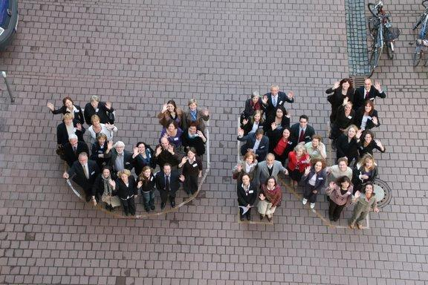
A European Network with a Global Outlook since 1987
UTRECHT NETWORK
To provide stable grounds for international cooperation and to strengthen the international profile of our member universities.
Foster internationalisation in higher education Open up to new forms of cooperation Respond actively to European HE policies Collaborate effectively within the Network Enhance internationalisation processes in member institutions Strengthen the profile and global outlook of the network
(best) practice sharing
joint initiatives
fora for cooperation in internationalisation
reaching out to partners on other continents

Slide 3
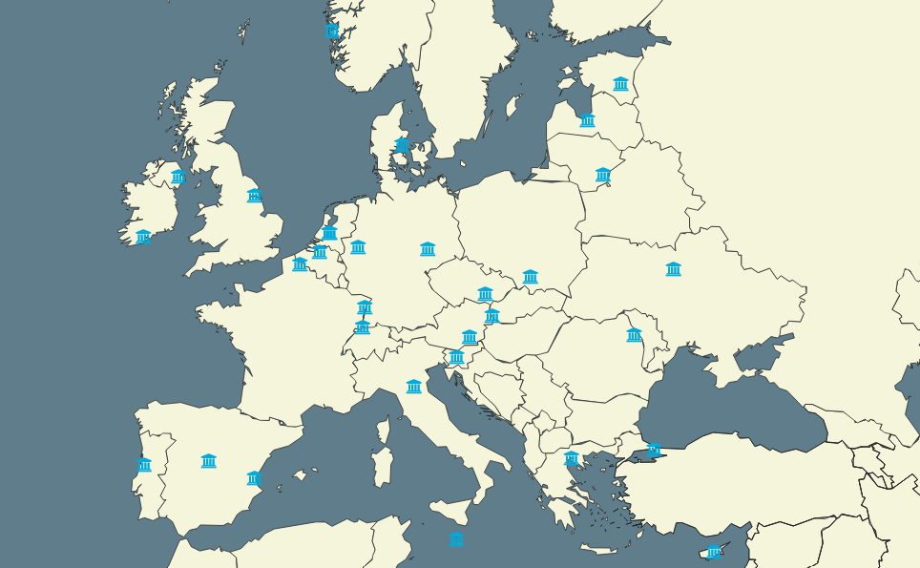
MEMBER UNIVERSITIES
30 member institutions in 24 countries
Nearly all members participate in the European University Initiative

Slide 4
JOINT ACTIVITIES
International Student and Staff Mobility/Exchange Programmes
Young Researchers Grant
International Summer Schools
International Staff Trainings
Start Up Funds for Innovative Educational Programmes
Joint European Projects
International Networking and Exchange

Slide 5
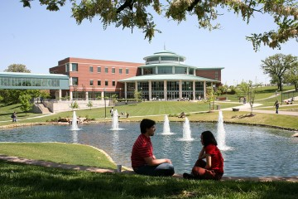
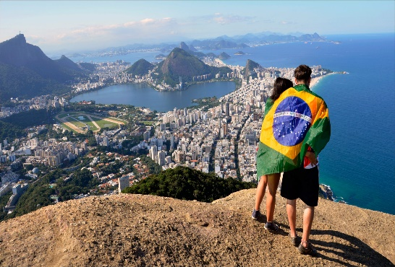
GLOBAL PARTNER NETWORKS
Australia: Australian-European Network (AEN)
USA: Mid-American Universities International (MAUI)
Brazil: Rede das Assessorias Internacionais das Instituições de Ensino Superior do Rio de Janeiro (REARI-RJ)
exchange of students/study placements
(with reciprocal waiver of tuition fees)

Slide 6
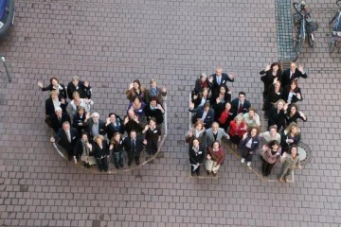
TASK FORCES
Student Mobility Task Force
Staff Mobility Task Force
Summer Schools Task Force
Research Management Task Force
Responsible Internationalisation & Global Engagement Task Force (UN TF RIGE)
https://utrecht-network.org/task-forces/

Slide 7
Rationale and Objectives
UN TF RIGE
ACADEMIC FREEDOM-ACADEMIC SOLIDARITY-ACADEMIC RESPONSIBLITY
To promote “responsible” (reflective, just and ethical) internationalisation, global engagement and knowledge diplomacy approaches and practices across the Utrecht Network and European Universities that are cognizant of the geopolitical context, prevailing power asymmetries and (global) societal challenges and critically engage with core academic values and human rights of students and scholars in global perspective.

Slide 8
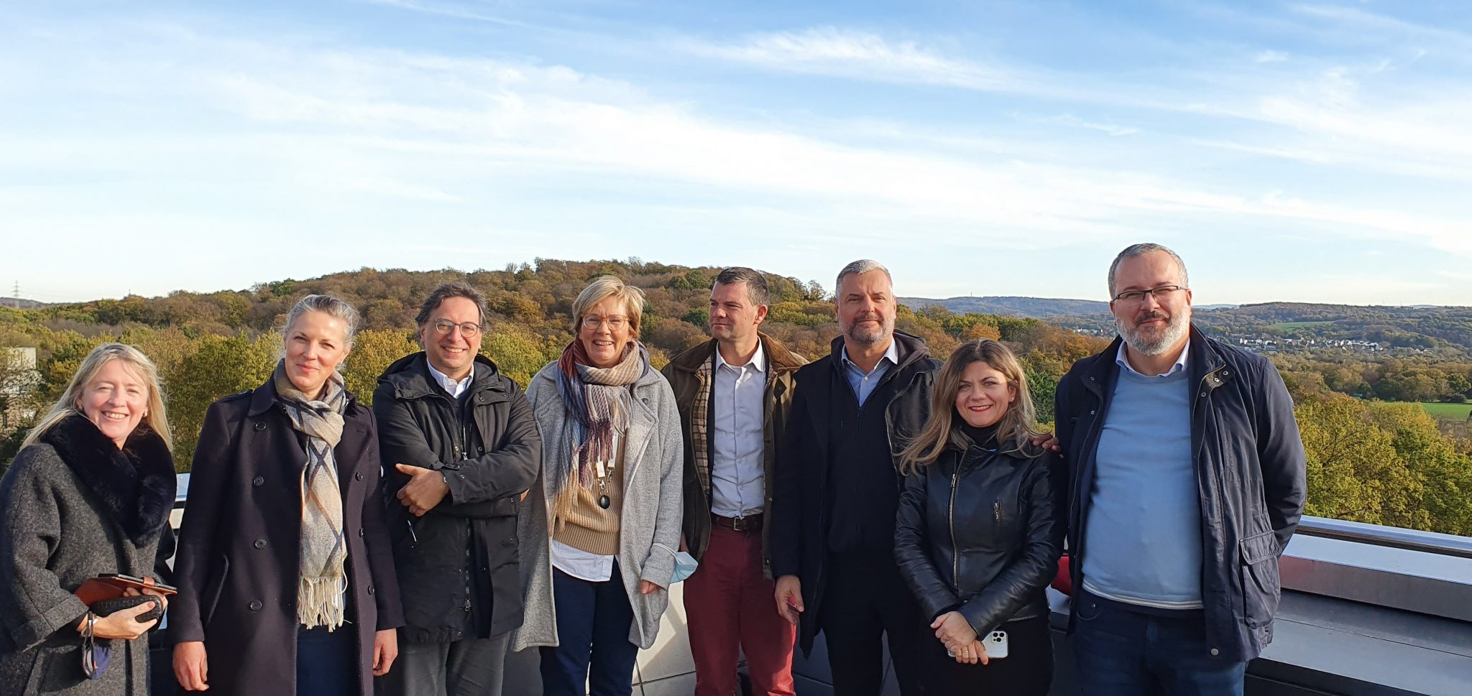
UN TF RIGE Members
Ruhr University Bochum (Germany):
Iris Vernekohl (Chair)/Monika Sprung (Co-Chair)
Aristotle University Thessaloniki (Greece): Prof. Alexandros Triantafyllidis
University of Bologna (Italy): Prof. Marco Borraccetti
University College Cork (Ireland): Dr. Claire Dorrity
Jagiellonian University Krakow (Poland): Prof. Beata Kowalska (until 2024)
University of Strasbourg (France): Prof. Mathieu Schneider
Affiliate Members:
Prof. Koller (RUB), Prof. Ioannis Papageorgiou (AUTH), Dr. Kristina Mantasasvili (AUTH)

Slide 9
UN TF RIGE ACTIVITIES
Joint UN TF RIGE Meetings to share RIGE experiences, (best) practices and for peer advise/coaching
Joint UN TF RIGE Initiatives
UN RIGE Mapping
UN RIGE Repository
UN RIGE International Staff Trainings
UN RIGE International Summer School
Joint European/International Projects
Exchanging experiences and co-creating new ideas and initiatives with scholars and institutions at risk in support of academic freedom and responsibility in Europe and beyond
(European and Global) Networking and Exchange

Slide 10
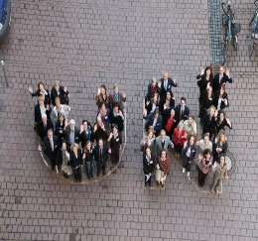
Thank YOU for being here! Let´s have an exciting, creative, and impactful week ahead! ☺ ☺ ☺
For further information, networking and exchange,
please feel free to contact:
Iris Vernekohl
Chair of the UN Task Force “Responsible Internationalization and Global Engagement”
& Senior Policy Advisory for Internationalization and Global Engagement (Ruhr University Bochum)
Iris.vernekohl@rub.de

