Slide 1
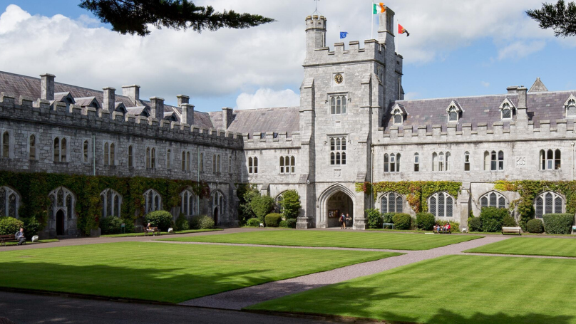
University College Cork
Global Engagement and Global Citizenship

Slide 2
Vice President for Global Engagement
In 2023 UCC appointed its first Vice President for Global Engagement, Professor Ursula Kilkelly
Launch of Global Engagement Plan in 2024 (2024-2028)
Four Pillars:
Excellence
Impact
Partnership
Global Citizenship

Slide 3
Mission
Focus on strengthening our internationalisation
To focus on establishing a human rights framework to promote a responsible approach to global engagement.
Championing Global Citizenship across education, research and engagement.
Integrate the SDGs into the curriculum
To promote UCC as a place where all identities and cultures are celebrated
Strengthening our position as a University of Sanctuary reflecting our responsibilities as global citizens both at home and abroad.

Slide 4
EDI UCC
March 2017 - The establishment of an Equality, Diversity and Inclusion (EDI) Unit - aligned with the Higher Education Authority (HEA) model of promoting a more holistic and targeted way to address equality and inclusion in education
UCC also received the Equality Challenge Unit’s Athena SWAN Bronze award in August 2016 based on the development of its 2016-2019 Action Plan – strong focus on gender equality.
An EDI Unit director was appointed in 2018.
Equality Diversity and Inclusion are prioritised in the University’s current Strategic Plan 2023-2028
University of Sanctuary Award in 2018
Through involvement in the Talloires Network, UCC wins McJannet Prize for Global Citizenship in 2019
Higher Education Access Routes (HEAR) (DARE) Sanctuary Scholars
Student Ambassador Initiative

Slide 5
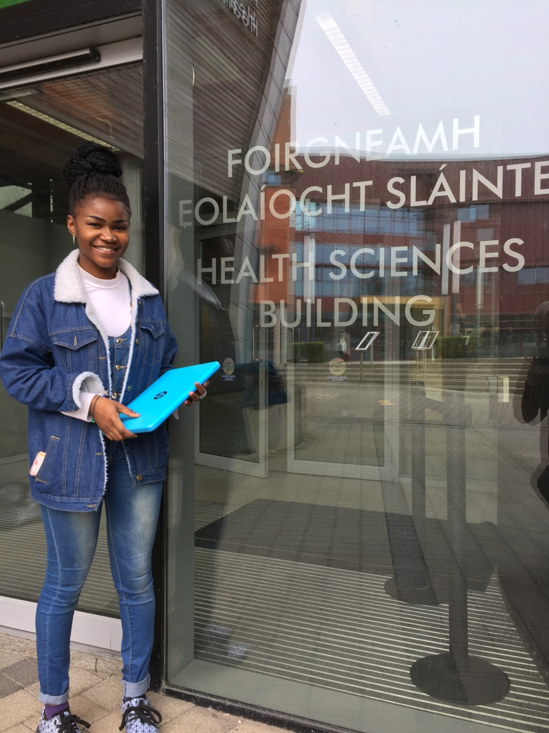
University of Sanctuary
The University of Sanctuary initiative grew organically out of the Places of Sanctuary initiative which first began in Sheffield University in 2005 and involves a strategic process of promoting partnerships with migrants, migrant NGOs and establishing more inclusive and committed responses to building a united voice to advocate for and with people seeking asylum and refuge locally, nationally, and globally.
Key Aim: Developing a culture and practice of welcome within university institutions, the wider community and across the Higher Education Sector
UCC currently provides over 40 scholarships yearly at diploma and degree level.
Strong working relationships with migrant community organisations.

Slide 6
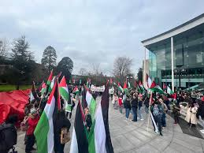
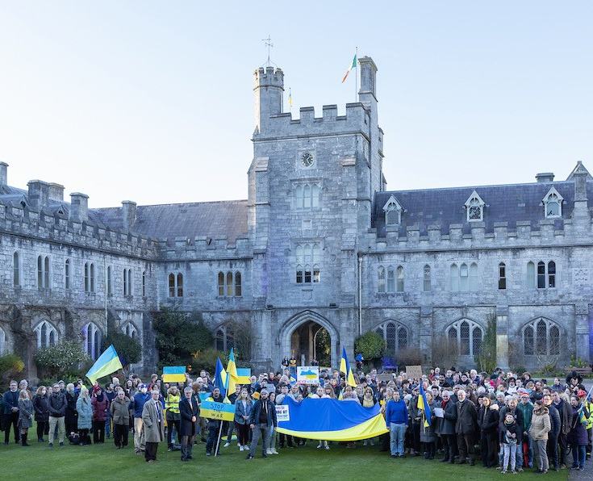
University of Sanctuary and Failte Refugees
Images: University of Sanctuary, UCC

Slide 7
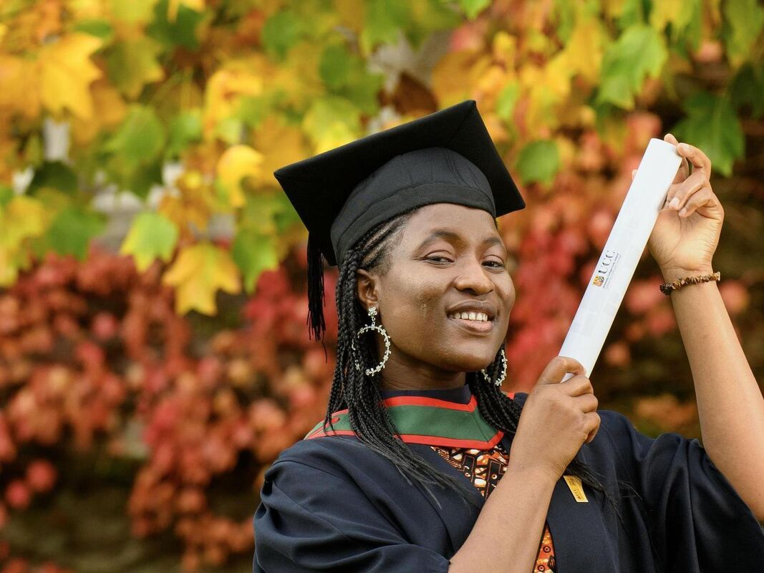
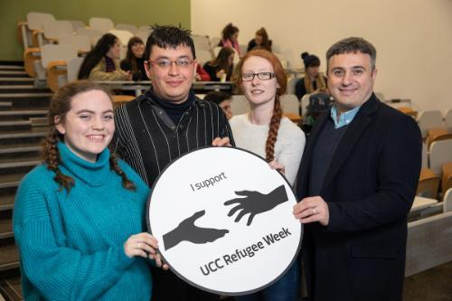
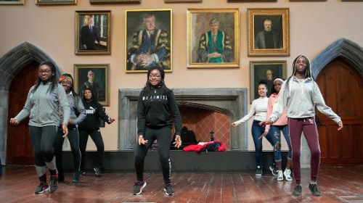
Annual Refugee Week (Feb)
Week-long events including scholarly contributions, community engagement events, workshops, artistic contributions and live performance and film and documentary events and open discussion.
Focus on identity and belonging and opening up the university to the community as a space of social action and visibility
Images: University of Sanctuary UCC

Slide 8
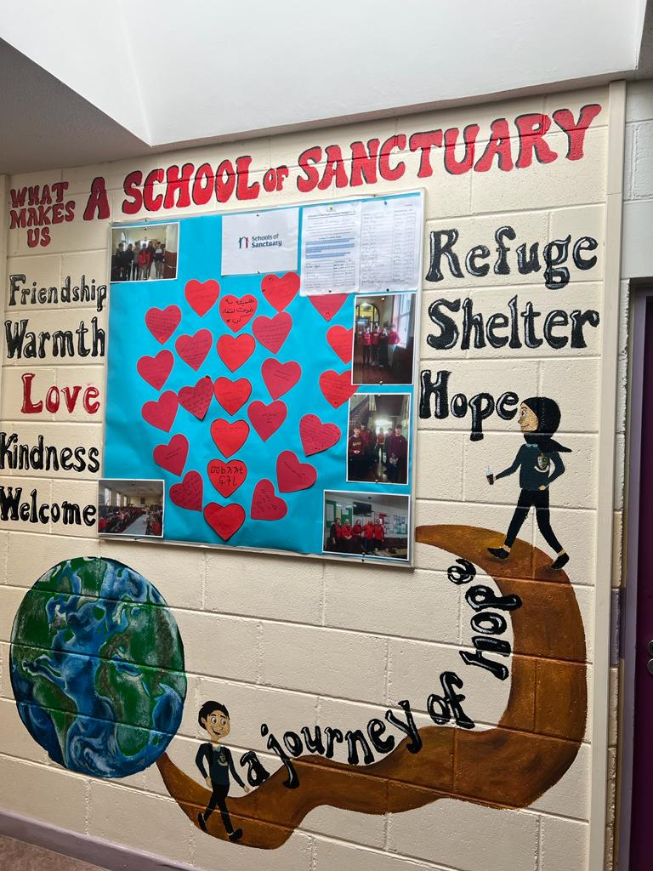
Connecting with the City and Schools of Sanctuary
Creating opportunities for relationships of friendship and solidarity between local people and migrants, refugees and protection applicants
Involving family members in decision-making processes.
Celebrating and promoting the welcome and contribution of migrants
Engaging people seeking sanctuary in decision making processes at all levels and in all activities across Schools, HEIs and Cities
Promoting an understanding of asylum and refugee issues, especially by enabling refugee voices to be heard directly through participatory frameworks.
Image: Claire Dorrity

Slide 9
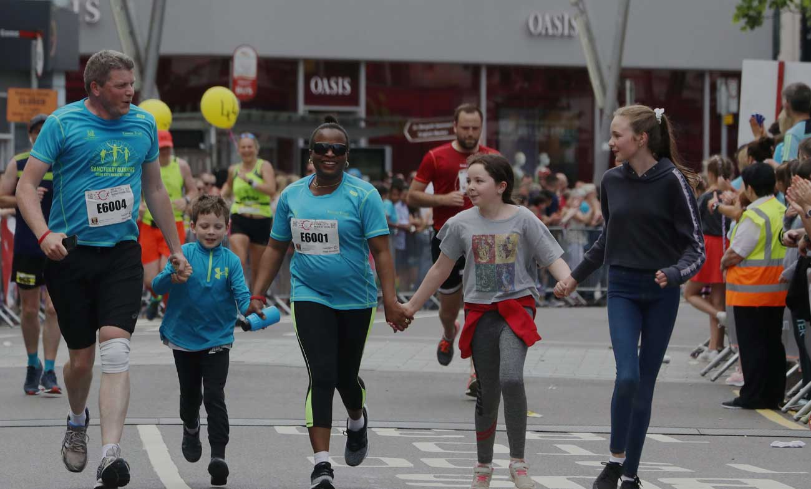
Sanctuary Runners
An initiative involving Staff , University staff and students join with members of local communities
Feeds into the National Platform for Sanctuary Runners
The Sanctuary Runners enables solidarity with migrants asylum protection applicants refugees
Aim is to foster friendship, positivity, solidarity and respect while bringing greater awareness to the challenges faced by migrants in our communities
Image: Cork Independent
Image: Sanctuary Runners Ireland
Image: Clare Keogh, The Avondhu

Slide 10
Scholars at Risk
Sub group of the University of Sanctuary
Open process for Ukrainian Scholars – 6 posts made available in UCC for Ukrainians (Under the Sanctuary Process).
Currently have an open process for people from Palestine - Four scholars expected in the next few months

Slide 11
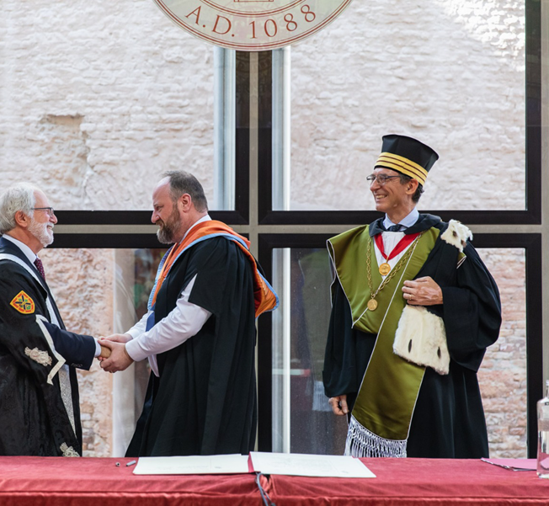
Magna Charta Universitatum.
On 16 September 2022, UCC became a signatory of Magna Charta Universitatum.
This confirmed its commitment to the principles of academic freedom and institutional autonomy and acknowledged the university’s responsibility to engage with and to respond to the aspirations and challenges of the world and to the communities it serves.

