Slide 1
Tashkent State University of Economics Uzbekistan
Nargiza Nosirova
Specialist of International Relations Department

Slide 2
Tashkent State University of Economics
Make Effective Presentations
Using Awesome Backgrounds
Engage your Audience
Capture Audience Attention

Slide 3
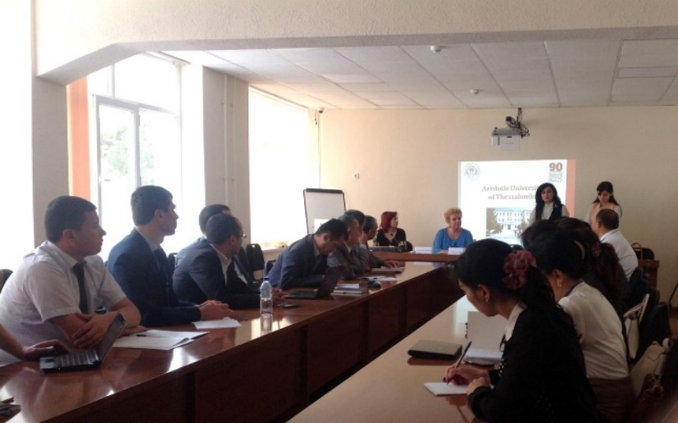
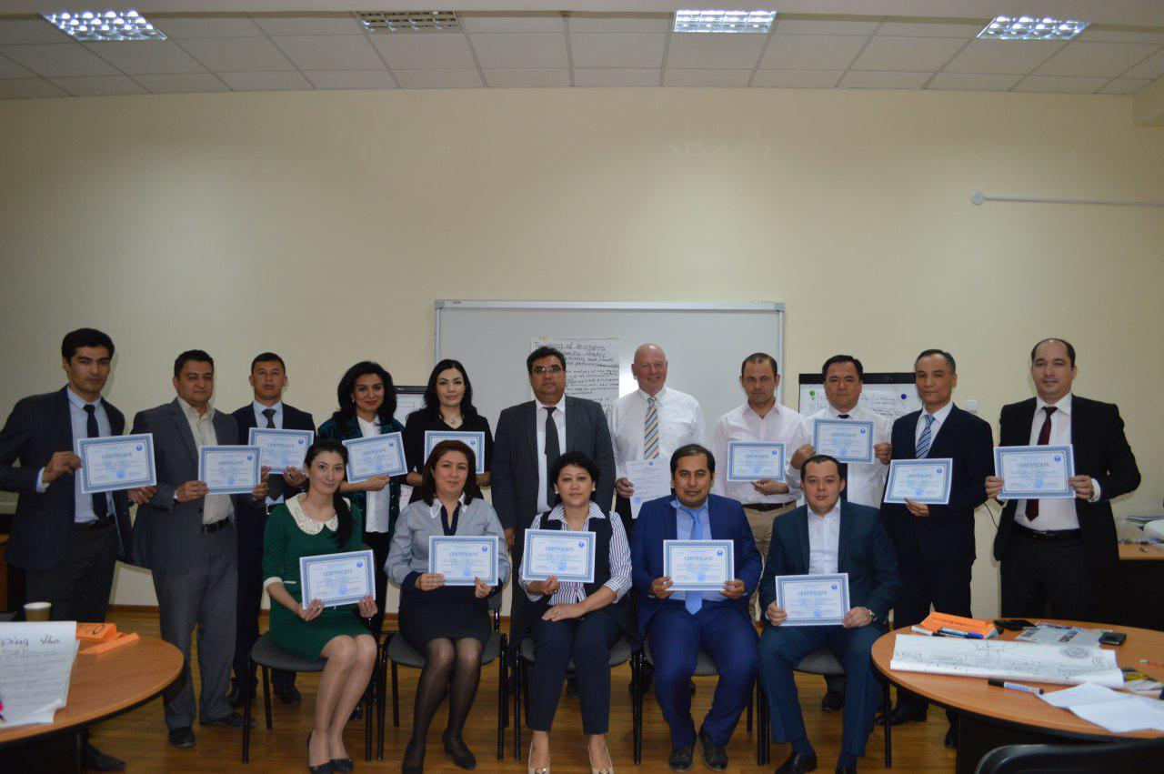
International Relations Department
From the first days of the university's existence (1931), great importance was attached to its International relations in the field of education, science and culture.
The establishment of the International Relations Department (IRD) marked the beginning of coordination of the International activities of the university.
Since the formation, and especially since the mid-20th century, the university has collaborated with more than 80 countries in Asia, Europe, Latin America, as well as with Canada and the United States

Slide 4
International Relations Department
The main activities of the IRD are:
• Cooperation with foreign educational institutions, scientific centers, international organizations
• Admission of foreign citizens for training.
• holding international events (meetings, seminars, conferences, symposiums, anniversary dates)
• the opening and functioning of international educational centers.
• Participation in international programs (projects, grants, scholarships)
• sending TSUE representatives abroad for various purposes with the aim of improving their skills, acquaintance with the general system of training, directions of scientific research in priority areas
• Invitation of foreign teachers, specialists for lecturing, joint research, etc.

Slide 5
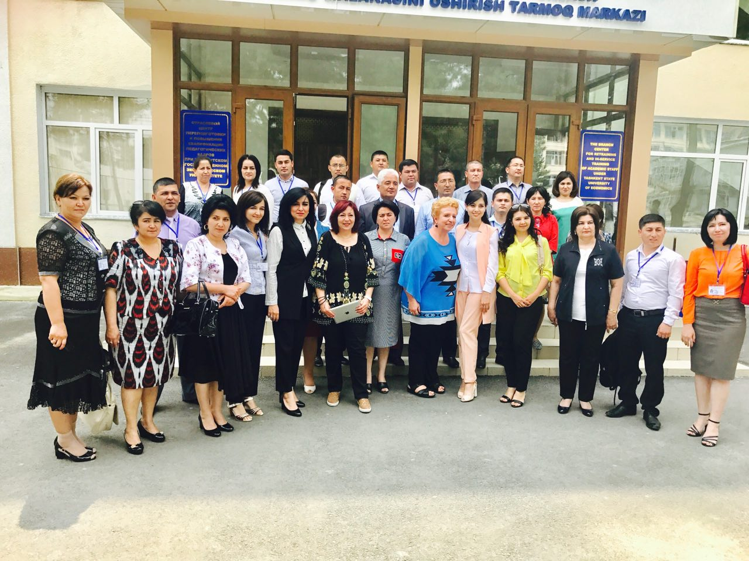
DUTIES of Specialist of International Relations Department
conducting International Conferences
correspondences with partners
organizing events with participation of professors from abroad
be in charge of for all the incoming students and outgoing students.

Slide 6
Thank you for your attention!

