Slide 1
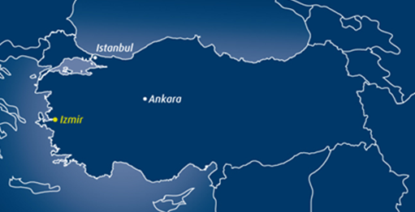
Yaşar University
Izmir, Turkey
Year of foundation→ 2001
Total number of students→ 7452
Total number of staff → 618
Total number of UG and PG programmes → 60 +
Total number of International Partners → 300 +
Hosted Model United Nations → 2009
Cambridge Exams Centre established → 2009
Site centre for TOEFL established → 2010
Internationally recognised degree programmes
CEA Accreditation achieved in 2011
The ‘Erasmus Success Story,’ ‘Diploma Supplement Label,’ and ‘ECTS Label’ awarded by the European Commission
Teaching given by leading Turkish and international academic staff
Member of IUA, EAIE, UK NARIC and NAFSA
‘Study in Izmir’ consortium member
Academic Units
Faculties: 7 Faculties, 29 Programmes
Faculty of Science and Letters
Faculty of Law
Faculty of Communication
Faculty of Economics and Administrative Sciences
Faculty of Architecture
Faculty of Art and Design
Faculty of Engineering
Vocational School: 11 Programmes
School of Foreign Languages
2 Institutes, 21 Masters and 6 PhD Programmes
Graduate School of Social Sciences
Graduate School of Natural and Applied Sciences

Slide 2
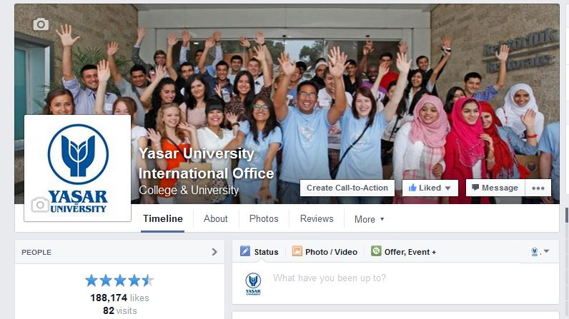
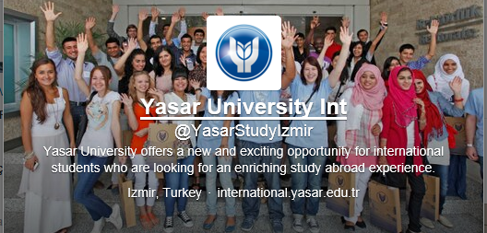
International Office
220 Erasmus Partners from 26 European Countries
Over 300 ISEP global partners
International Community / International student profile United Kingdom, Germany, Iran, Pakistan, Morrocco, Korea, Nigeria, Ghana, Bulgaria, Spain, Italy, Belgium, United States, Lithuania, Serbia, Georgia, Poland, Canada, Turkmenistan, Malaysia, Croatia, Kenya, Azerbaijan, Kazakhstan, Uzbekistan, Egypt, Canada, Chile, Lebanon, Syria, Australia etc.
300 International Students
130 Erasmus Incoming Students
Visit websites for more information
http://international.yasar.edu.tr
http://erasmus.yasar.edu.tr
Yasar University International Office
Yasar University Int
Yasar University International

Slide 3
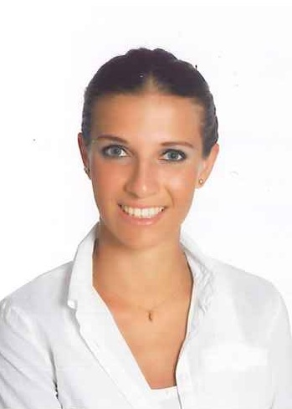
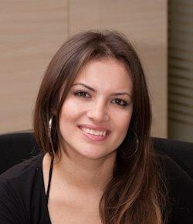
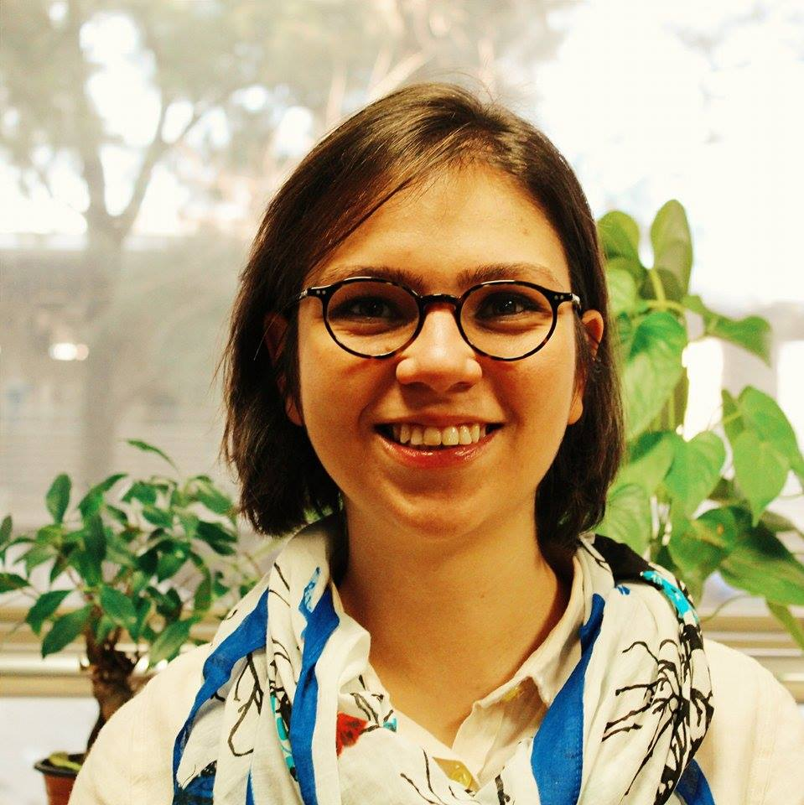
Professional Duties
Merve Ürkmeyen, Erasmus Institutional Coordinator / International Education Expert
Erasmus Outgoing Study Students
Erasmus Incoming Staff
Erasmus Partnerships
Melike Olcaytürk, International Education Officer
Erasmus Outgoing Placement Students
Erasmus Outgoing Staff
Beti Barki, International Education Officer
Erasmus Incoming Study Students
Erasmus Incoming Placement Students

