Slide 1
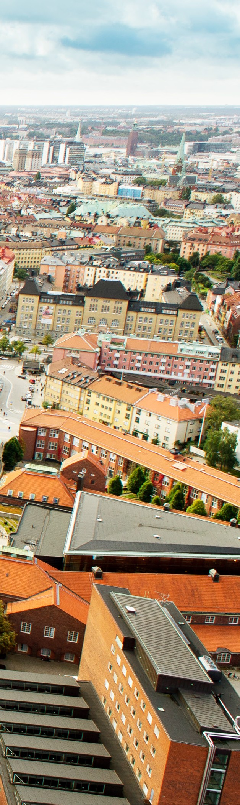

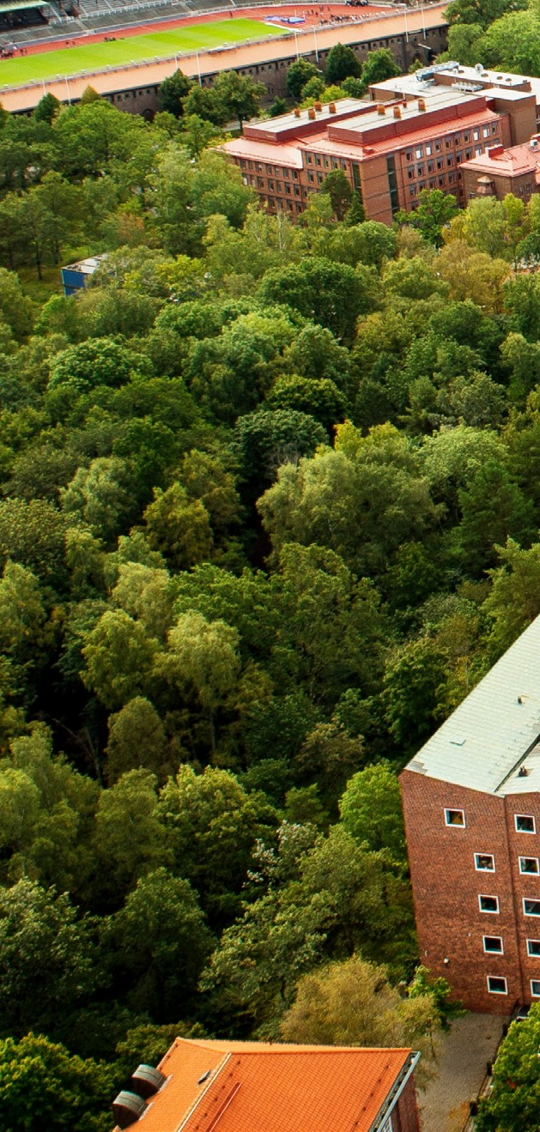
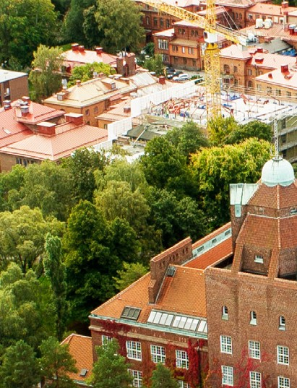
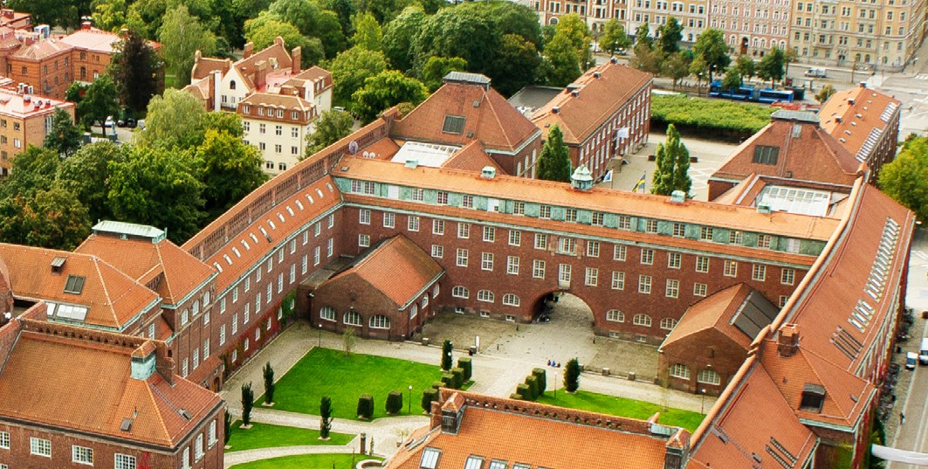
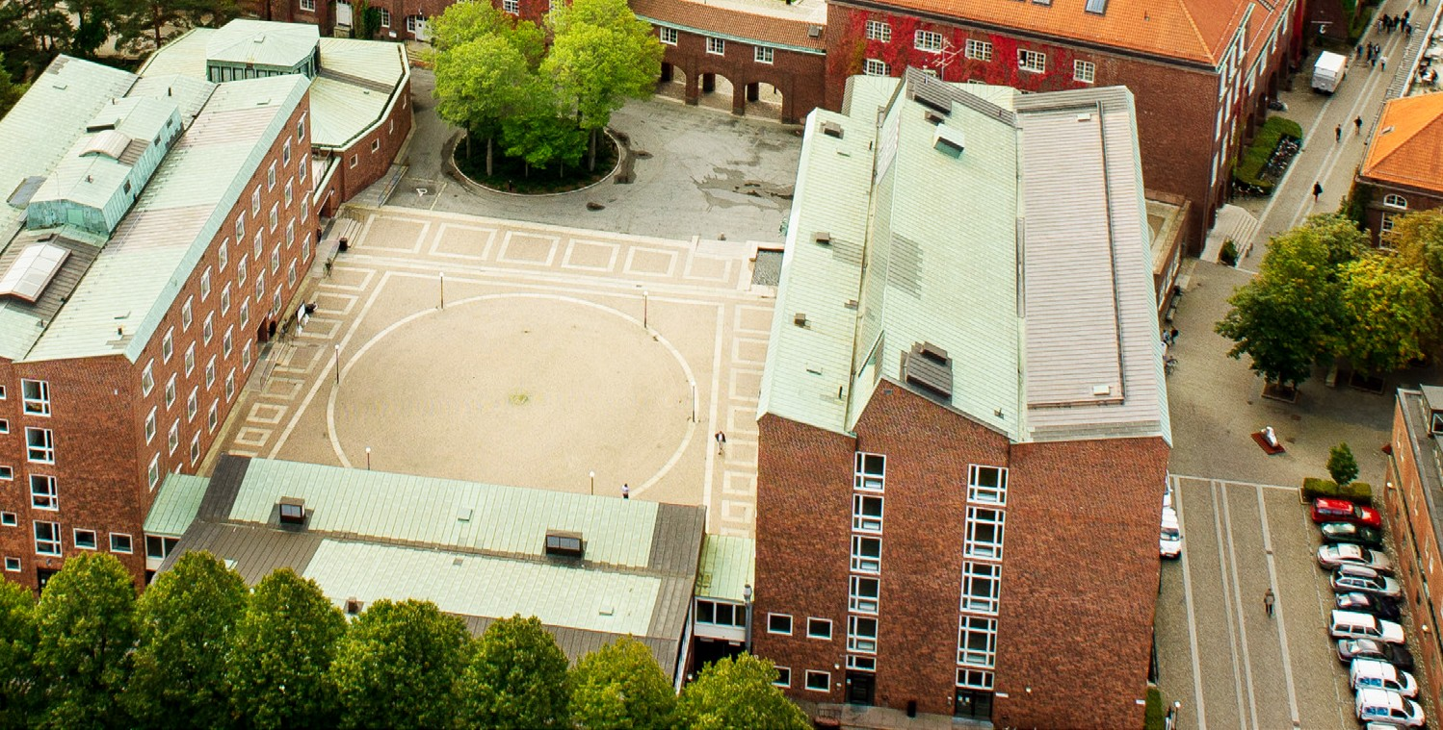
Exchange studies at KTH Royal Institute of Technology

Slide 2
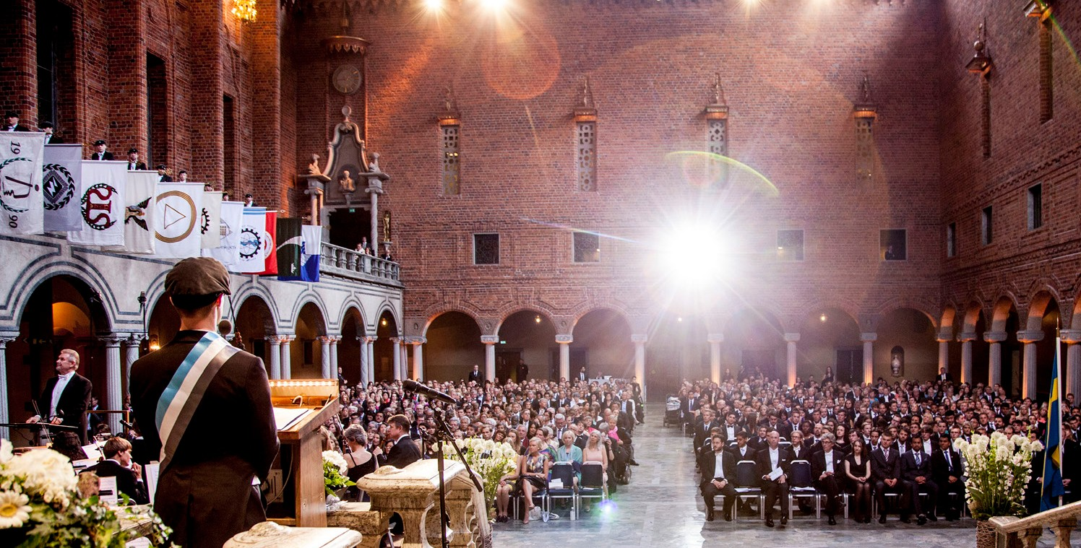
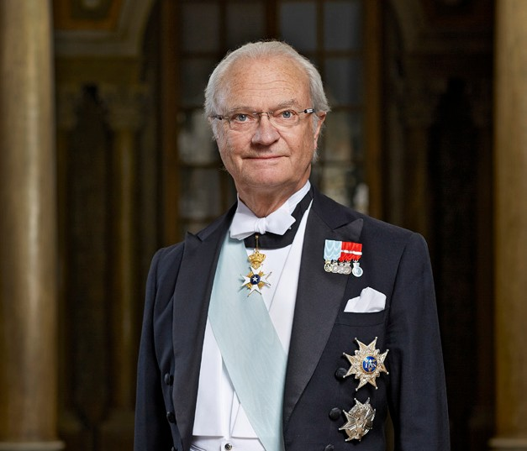
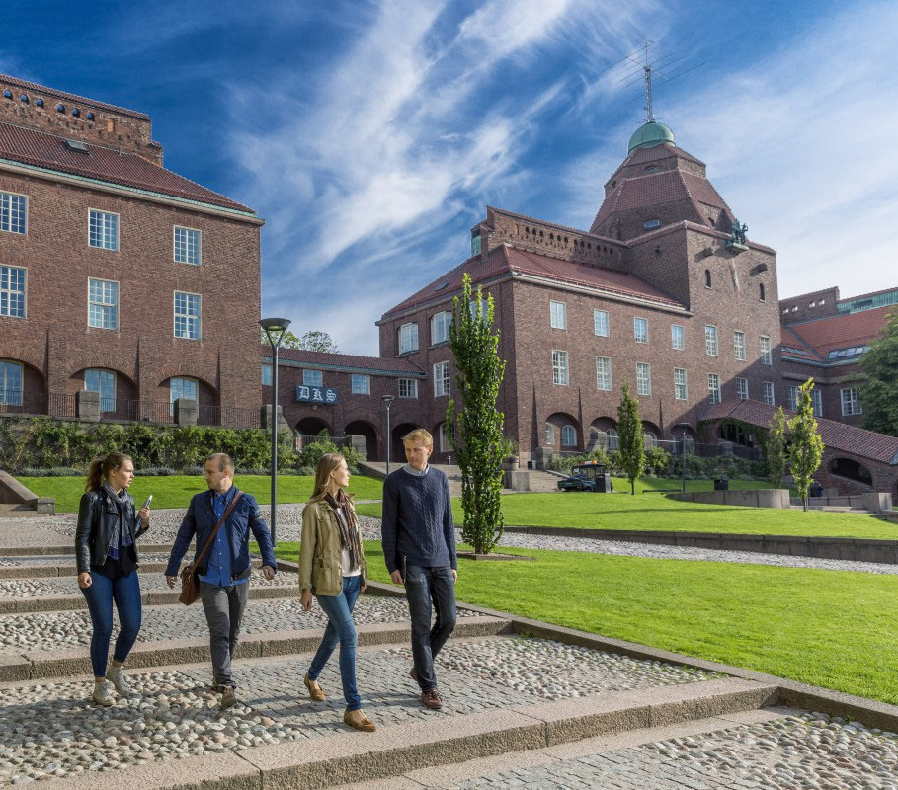
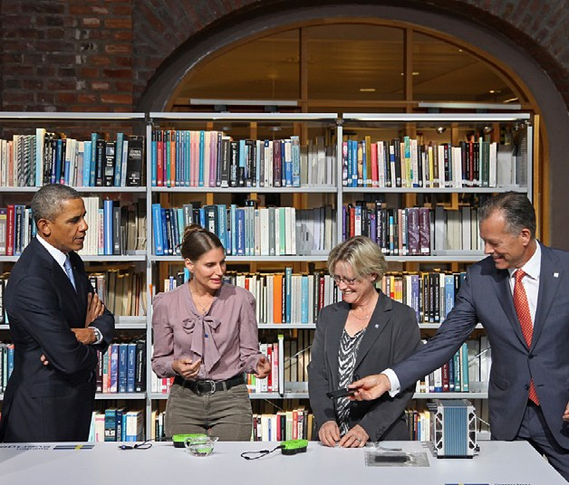

Rich history Established 1826, King Carl XVI Gustaf is guardian of the university
Ranked 19 in the world
among technical universities in latest THE world university ranking
KTH in numbers
12,000 students
2,000 PhD
311 professors
4,000 staff

Slide 3

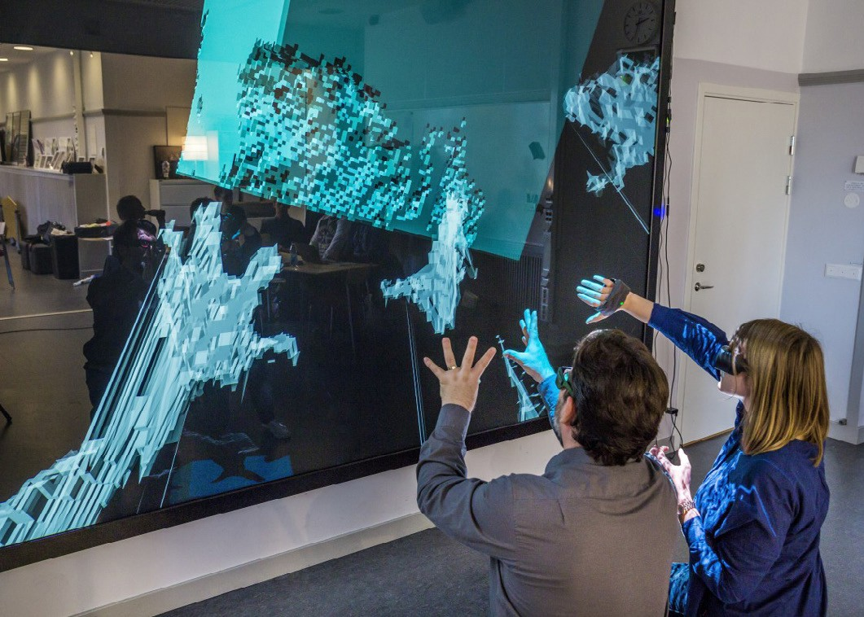
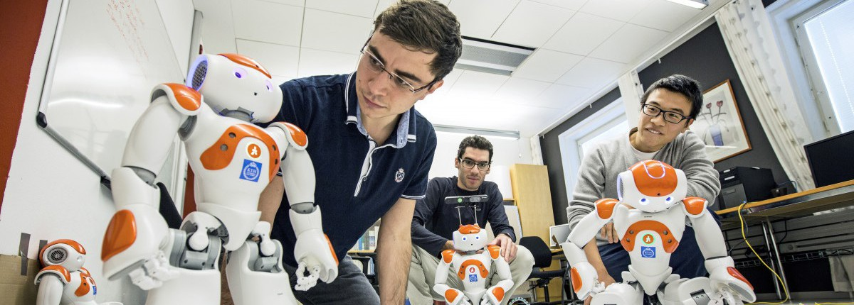
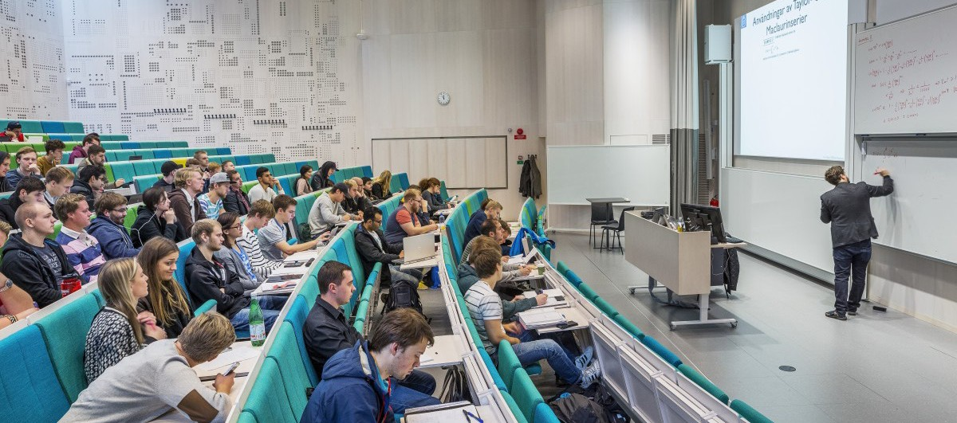

Studies at KTH Courses consist of lectures, seminars, laboratory work and individual studies
A personal approach to education and an entrepreneurial spirit
Together with industry

