Slide 1
Marian y Alberto Budgeting and Finance Department

Slide 2

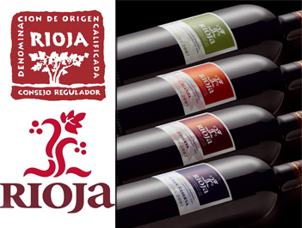
University of…what did you say?
La Rioja…
Isn’t it a wine?
The land with the name of a wine..
1st Spanish wine region, renowned worldwide: 250 millions litres annually
Hundreds of wineries and wine cellars
Many wine related activities: tastings, museums, vinoteraphy…
Perfect pairings: tapas bars and restaurants
2 | Universidad de La Rioja | 11/11/2016

Slide 3
And…where it is?

Slide 4
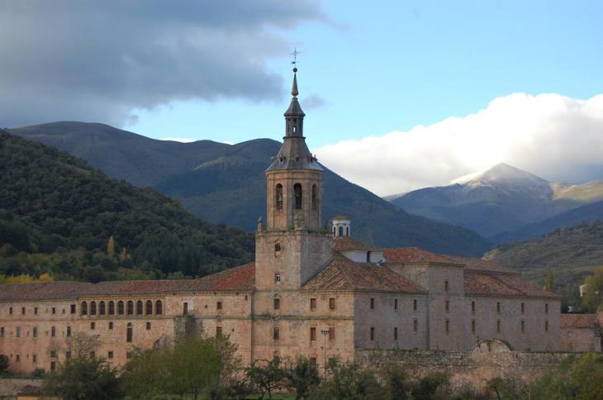
Anything else we should know about La Rioja?
      Birthplace of the Spanish language
      Rich in history and cultural legacy: Monasteries, castles…
      Part of St. James’s way
      Biodiversity and landscapes
Monastery of San Millan de la Cogolla
Castle of Clavijo

Slide 5
Culture and tradition

Slide 6
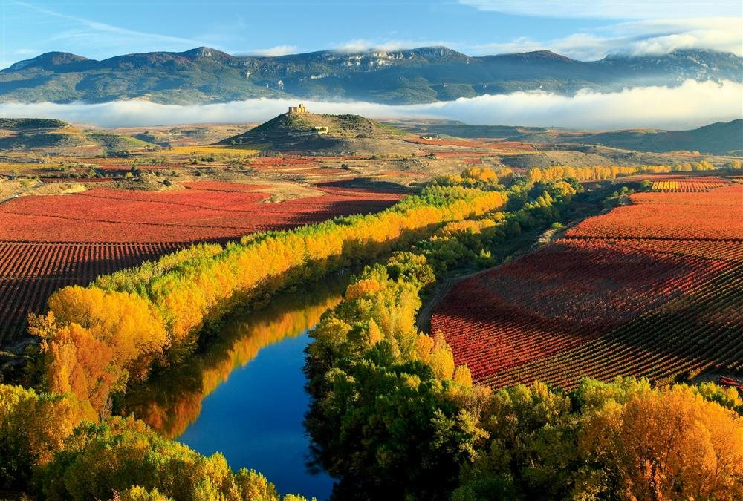
River Ebro…surrounded by vineyards

Slide 7
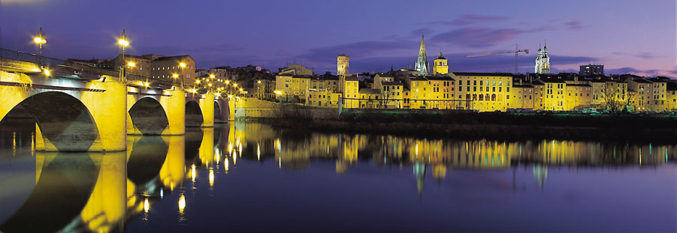
Logroño. Capital of La Rioja
Notes:
You’ll be able to taste wine, food, and more wine, and more food..

Slide 8
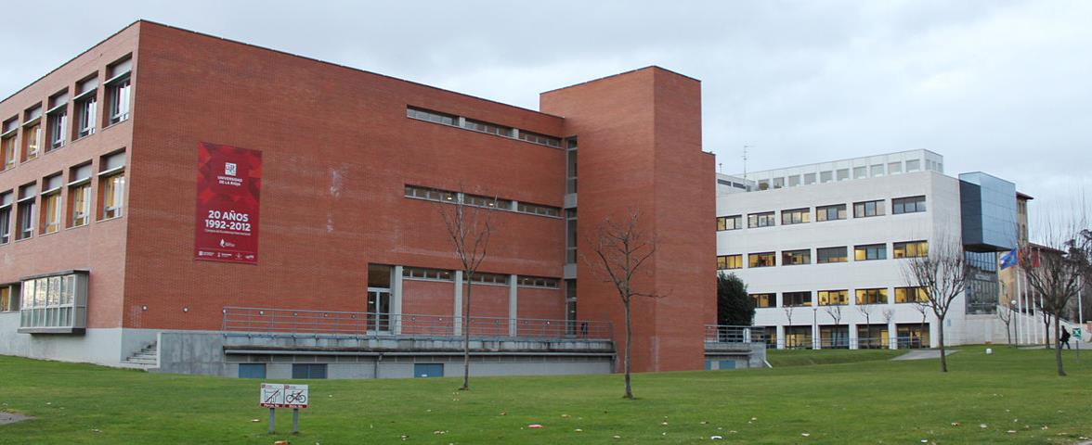
…and of course, our University
    University of La Rioja
        Founded in 1992
        Based in Logroño
        4 Faculties, 2 University Schools
        19 Undergraduate degrees, 11 master degrees
        19,000 Graduates up to now
        5,000 students per year

Slide 9
Main focus
Wine studies:
  University of La Rioja contributes to this sector by means of training, research and cultural circulation.
  ICVV: Research Centre of Vine and Wine related Science
  First Spanish campus that offered a Degree in Enology
Spanish courses:
  Degree in Spanish language and Literature
  Spanish langage and culture courses for foreigners
  Online Master for Teaching Methods for Spanish as a Second Language
Dialnet: First Internet scientific article database in Europe: 4 million documents
Campus of International Excellence

Slide 10
International relations
Over 220 bilateral agreements
100 outgoing students
7% of the students from University of La Rioja come from 40 different countries
350 international students come every year to study Spanish
Buddy program
Staff Week

Slide 11
Research & Project management department
8 People working
64 competitive projects
  Funded by national administration: 15
  U.E. funded: 4
  Private funding: 1
  Funded by the University: 44
How projects are managed?
Notes:
Cannot give you an insight of how products are managed, I can only explain the budgetary / finantial part of it.

Slide 12
Budgeting & Finance Department
  Main tasks performed: Budget preparation and execution, accounting, taxes, cash-management, financial statements, cost accounting
  About us: Marian y Alberto
    Working in UR since 2006
    My main responsibilities:
      Preparing the annual budget for the University
      Supervising budget execution
      Preparing financial statements
      Reporting information

Slide 13
University of La Rioja - Budget
Comparison with other participant universities:

Slide 14
Main challenges
Challenges for the near future: Electronic administration (paperless office), cost accounting…
More general objectives:
  Long term financial sustainability
    Dependence on regional governments for funding
      Posibilty to make long-term investments

Slide 15
Thank you!
Paldies
Paldies!

