Slide 2
Comenius University in Bratislava,
Slovakia

Slide 3
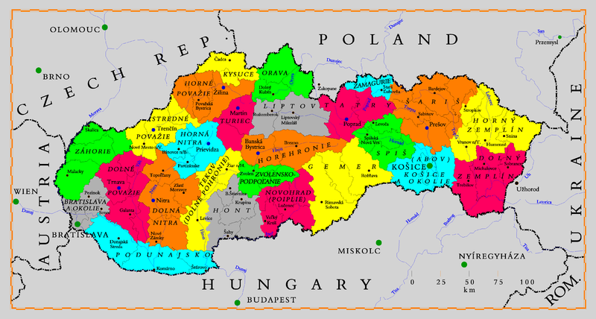
Slovakia

Slide 4
General Info
Population: 5.5 million inhabitants
Main rivers: Danube, Váh, Hron, Hornád, Nitra, Poprad
Topography: The North is mostly mountainous, the South of the country is mainly flat
Temperate climate zone, four seasons, average temperature 10°C
The capital city of Slovakia: Bratislava pop. 500 000
convenient location: the river Danube
part of "three capitals triangle„:
Bratislava
Vienna 60km Budapest 200km

Slide 5
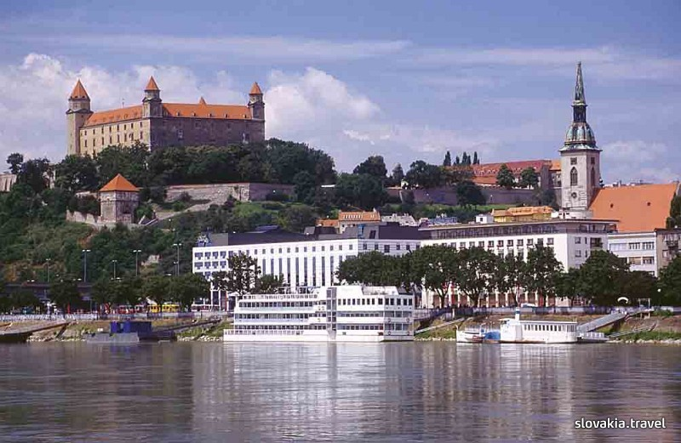
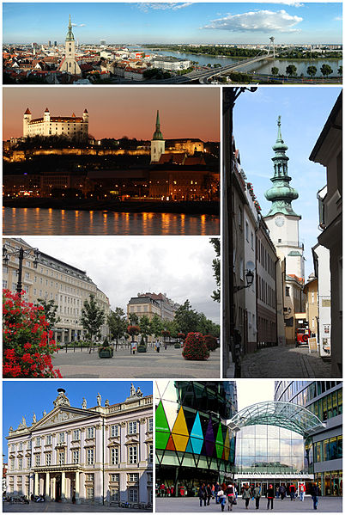
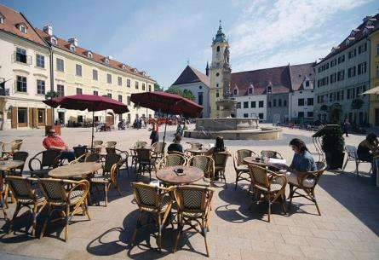
Bratislava - Capital of Slovakia

Slide 6





Slovak national gastronomy

Slide 7
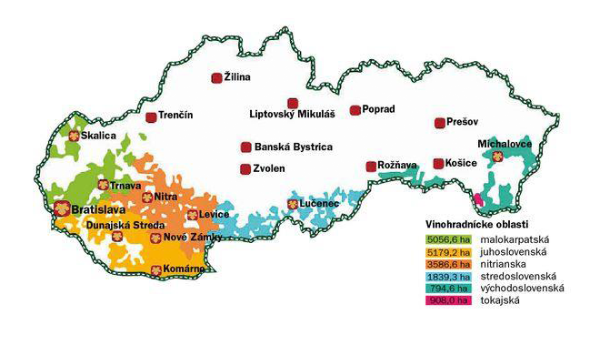


Tokay Wine – Liquid Diamond from the Sout-East of Slovakia

Slide 8
Comenius University in Bratislava
Universitas Comeniana Bratislavensis
Established: 1919 (the oldest and largest in Slovakia)
Type: Public
Location: Bratislava - capital city of Slovakia
Nickname: UK

Slide 9
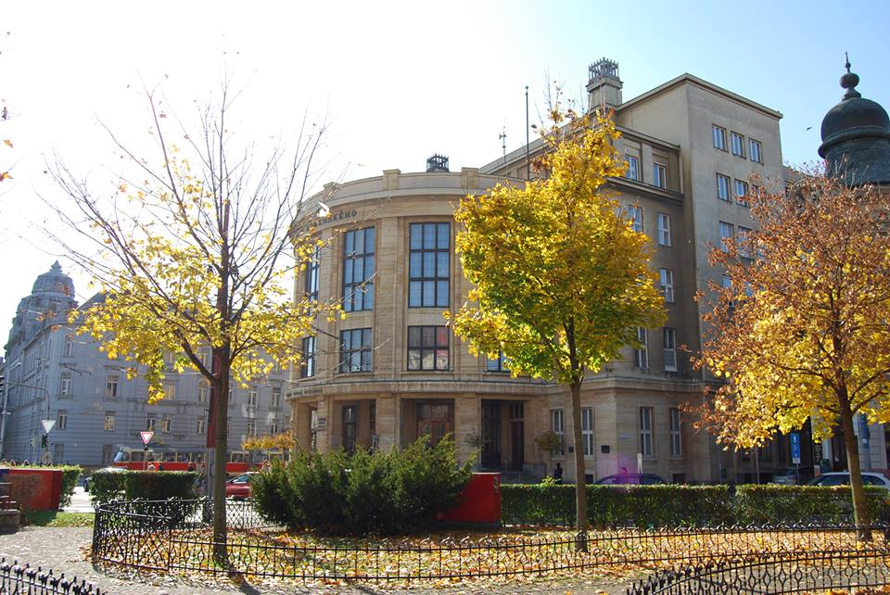
Comenius University in Bratislava
Main Univertsity building

Slide 10
STUDENTS
Number of students: 32 545
Number of student per degree
  13 100 Bachelor students
  12 989 Master & Medical Doctor students
  2 455 Philosophae Doctor students
  4 001 external students
  3 290 Long Life Learning students
  Accredited study programmes
  Bachelor's study 419
  Master's study 359
  Doctor's study 315

Slide 11
Constituents
Center of Long Life Learning
  University of the Third Age
  Language Center of CU
  Career Center
  Institute of Jewish Studies of CU
  Institute for Language and Academic Preparation for Foreign Students
Studia Academica Slovaca
Centre for Students with special needs
Psychology Center
Academic Library
Canadian Studies Centre
2 Botanical Gardens
UNESCO Department of Translation and Interpretation and UNESCO Department for Human Rights
Children Comenius University
IT Center
Center for Excellence for Biotechnology and Biomedicine
Observatory
University Pharmacy and Faculty Hospitals
Publisher
Hostels (own University Dormitory Družba – Erasmus students, teachers, lectors)

Slide 12
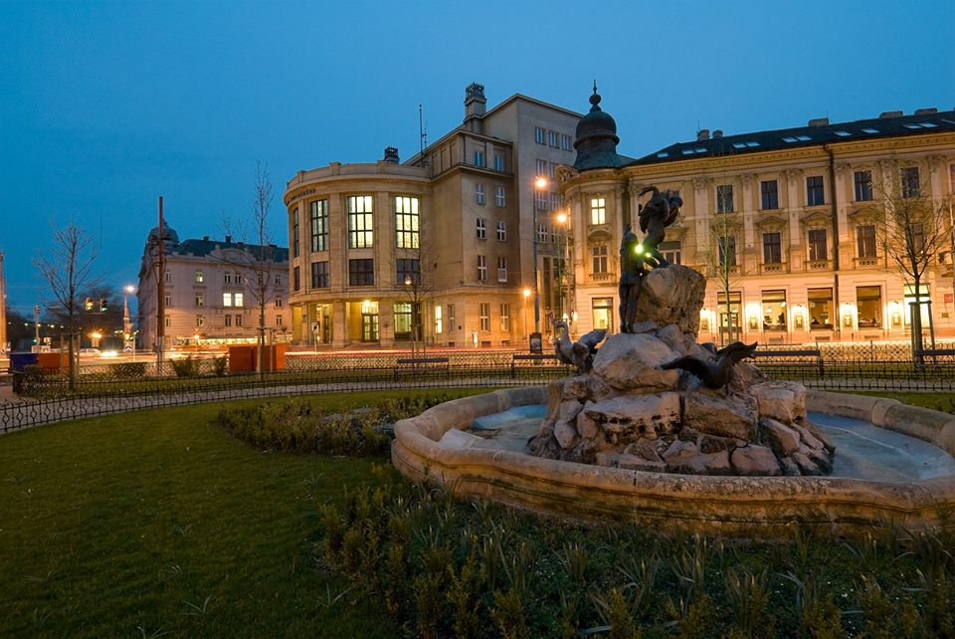
CU in Bratislava consists of 13 faculties

Slide 13
International Relations Office IRO CU
IRO
F
F
F
F
F
F
F
F
F
F
F
F
F
Vice-
Recto
Director of the International Relations Office
Administrative officers

Slide 14
International Relations Office (IRO)
Erasmus unit: 3 officers + 2 part-time officers
Bilateral Unit: 3 officers
IT: 1 part-time officer
Economic officer: 1

Slide 15
PROGRAM ERASMUS PLUS AT
COMENIUS UNIVERSITY IN BRATISLAVA
Program Socrates at CU: since 1998
Program LLP Erasmus at CU: since 2007-2014
Erasmus+ : 1. 6 . 2014 -
SK BRATISL02
Erasmus mobility 2013/2014:
Outgoing students to study: 581
Incoming students to study: 289
Outgoing students to placement: 81
Outgoing teachers: 3 / Incoming teachers: 85
Outgoing other staff: 44 / Incoming other staff: 21

Slide 16
IRO
Bilateral Unit – Responsibilities:
Support for Vice-Rector for International Relations
(correspondence, travel services, organisation of international visits, events etc.)
Support for Rector (same as above, Doctor honoris causa etc.)
Cooperation with Public Relations Office: uni web site (www.uniba.sk), uni magazine „Naša Univerzita“
Carrying General and Bilateral Agreements with Uni Partnerships (renewal, specification of financing and target groups etc.)
Teachers Mobility (GA) + Student Mobility (GA)
Other Mobility (SYLFF, UTRECHT NETWORK, UNICA Student Conference, SAS etc.)

Slide 17
IRO
Bilateral Unit :
Other mobilities
  Program ERASMUS-Mundus
  Ryoichi Sasakawa Young Leaders Fellowship Fund (SYLFF)
  Mobility for students at Universities in USA, Canada, Japan, Taiwan, Georgia
  Mobility for students and postdocs in Austria UTRECHT Network

Slide 18
IRO
Bilateral Unit:
Other Student Mobility:
INCOMING:
Studia Academica Slovaca – Summer school (48th year) organised by Faculty of Philosophy
OUTGOING:
Program SYLFF (Sasakawa Young Leaders Fellowship Foundation) for FM, FSES, FEDU, FPHIL - 2 students scholarships, 2 doctoral scholarships
Utrecht Network:
Exchange between UN and USA/Australia
(3 students per year – outcoming only)

Slide 19
Mobility within our partnerships with other universities
Partner Institutions:
Austria: Universität Wien; Karl-Franzes Universität, Graz; Leopold-Franzens Universität, Innsbruck
Belgium: Gent University
Bulgaria : St. Kliment Ohridski University, Sophia
Canada: Carleton University, Ontario; University of Ottawa, Ontario
Croatia: University of Zagreb
Czech Republic: Univerzita Karlova, Praha; Masarykova univerzita, Brno; Slezská univerzita Opava
France: Université Blaise Pascal, Clermont Ferrand; Université Sciences et Technologie, Bordeaux 1; Université Victor Segalen, Bordeaux 2; Université Michel de Montaigne, Bordeaux 3; Université Marc Bloch, Strasbourg; Université Paris-Sud XI
Germany: Universität Bremen; Martin Luther Universität, Halle-Wittenberg; Universität Regensburg
Greece: Aristotle University, Thessaloniki; National Kapodistrian University of Athens
Hungary: Eötvös Loránd University, Budapest
Israel: Tel Aviv University

Slide 20
Mobility within our partnerships with other universities
Italy: University of Bari; University of Padova; University of Trieste; University of Udine
Japan: Waseda University; Shizuoka University; Tokyo International University
Netherlands: University of Groningen
Poland: Jagiellonian University, Kraków; University of Silesia, Katowice; University of Lodz; Warsaw University
Romania: Lucian Blaga University, Sibiu
Russia: M. V. Lomonosov State University, Moscow
Slovenia: University of Ljubljana
Spain: Complutense University of Madrid
Turkey: Bogazici University
Ukraine: National Taras Shevchenko University of Kyiv
USA: Covenant College, Georgia; University of Georgia; University of Northern Iowa; University of New Orleans, Louisiana; Montclair State University, New Jersey; New York University; Lake Erie College, Ohio; Indiana University of Pennsylvania; Slippery Rock University, Pennsylvania; City University Bellevue, Washington (a special agreement)

Slide 21
Thank you! 

