Slide 1
Frameworks of reference for freedoms and responsibilities in higher education: what place for international cooperation?
Liviu Matei
King’s College London
School of Education, Communication and Society/
Global Observatory on Academic Freedom

Slide 2
Academic Freedom -and the other Fundamental Values of Higher Education: How do we know what they are? How do we know what to do about them? (in general) Do fundamental apply in international cooperation? Can they help? How do we know what to do about them?

Slide 3
Examples (I)
Application for external grant not approved internally because it does not fit with Faculty priorities
National parliament adopts law stipulating that gender studies programs cannot be offered in the country.
State legislature adopts legislation resulting in books by Dostoyevsky being forbidden as educational material.
European Court of Justice verdict against Hungary in the Lex CEU case
National excellence initiatives; national competitive/priorities-based funding
Head of national higher education council arrested

Slide 4
Examples (II) – international cooperation
UK university – research officer refuses to help prepare Horizon Europe application involving cooperation with academic from Israel
Cooperation with Russian universities suspended in the wake of Russian rectors’ signing a letter of support for the war in Ukraine (“special operation”!).
National defense/security legislation adopted that regulates/restrict international cooperation; need to obtain clearance from security apparatus (secret services?)
EU research and educational cooperation funding suspended for Hungarian universities
European Universities initiative

Slide 5
In concrete situations: teaching and learning, research, governance, third mission activities, campus life, etc.
IF WE ARE:
Students
Academics
Full time (tenured), part-time/limited-term contracts
Administrative staff members
OR MAYBE:
- Public authorities
Politicians
International organizations representatives
Professional association representatives
Editorial boards
Academics
Students
Other “stakeholders”

Slide 6
How do WE know how to analyise a situation? What do WE do? In general in HE/in international cooperation situations/contexts

Slide 7
We position ourselves within given frameworks of reference –if available, if known
Examples – for academic freedom
1. EC vs Hungary, European Court of Justice 2017-2020 (regional/transnational). EHEA fundamental values of higher education, 2018-2024
2. UK Higher Education (Freedom of Speech Law) 2023-2024 (national)
3. Stanford Law School, 2023 (institutional)
4. Magna Charta Universitatum 1988, 2020 (global) – practice examples
5… and many more (overlapping frameworks) –back to previous examples

Slide 8
Frameworks of reference and conceptual refences for academic freedom
Frameworks of reference include (variably):
a conceptual reference (shared)
guidelines for the practice and protection of academic freedom
elements of codification (legislative norms but not necessarily, regulations, codes of conduct, etc.)
provisions about institutions and/or institutional mechanisms that should or could be utilised to implement the respective understanding and codification of academic freedom.
Conceptual reference points:
not only a definition or a link to an existing definition;
a sufficiently long conceptual elaboration available in a written format that serves as a common reference, go-to conceptual source (or “anchor”) for actors inside and outside the university, which they use in sync for the understanding, codification and practice of academic freedom.
E.g. : Rome Ministerial Communiqué: Statement on Academic Freedom (2020).
L. Matei and G. D’Aquila 2025
L. Matei 2024: https://www.universityworldnews.com/post.php?story=20240827182451588

Slide 9
A taxonomy of frameworks of reference and conceptual refences for academic freedom
Institutional
National
Regional
Global

Slide 10
Which ones work
The further the distance- the more difficult to use?
What when we don’t have neaby/proxi farmewrk
The imprtatce of insitutokjal franmewkr s and education
Should academic cooeration officers be specialists on acadec freedom” yes/ call on experts. Traniong like here

Slide 11
Existing global frameworks (variable)
UNESCO's 1997 and 2017 recommendations on academic freedom and freedom of scientific research
Universal Declaration of Human Rights (1948) –Principles for the implementation of the right to academic freedom 2024
AAUP Statement (1915, 1940) - contested in the US (e.g. Florida 2023-2024)
International Covenant on Economic, Social and Cultural Rights (1966) and the other covernant
Magna Charta Universitatum (1988, 2020)
Academic Freedom Index (global conceptual reference or just a monitoring tool?)

Slide 12
European frameworks of reference (regional)
EHEA: 2018-2024 Conceptual references (interrelated statements on the fundamental values of higher education), detailed governmental-level commitments to protect and promote the fundamental values, implementation mechanisms (monitoring framework).
EU:
Jurisprudence: ECJ - European Commission vs Hungary 2020
Conceptual reference followed by monitoring attempts: (Ministerial) Bonn Declaration on Freedom of Scientific Research in 2020
European legislation for academic freedom: EU Parliament
EU Commission: Guidelines for the protection and promotion of the fundamental academic values

Slide 13
National frameworks of reference
UK: Higher Education (Freedom of Speech) Act (2023)
South Africa: Higher Education Council - conceptual references and national regulations for academic freedom, university autonomy, and public accountability.
Every country?

Slide 14
Institutional/inter-institutional (UK)
King’s College London 2022-2023 King’s presidential series on academic freedom published Principles for re-imagining academic freedom
Academic Freedom and Internationalisation Working Group in the UK published Model Code of Conduct
Autonomy scorecard – European University Association (or rater regional?)
Guidelines from other university associations: the Guild

Slide 15
Frameworks of reference at work -observations
Overlapping (“if I am an Italian doctoral student in Germany”…)
Contradictions, tensions (e.g. UK, Hungary-EU, Florida-USA, UK)
Epistemic status: human rights, legal/fundamental rights, values governance principles
Clusters of values or principles (AF, autonomy, integrity, responsibility, etc.-freedoms and responsibilities)

Slide 16
Which frameworks are relevant?
Can we select? How? Advantages and dangers
Can we propose new frameworks? (ad-hoc and standing)
Relevant for us in Europe: EHEA, EU, national, institutional?
The closer to the field/exact situation, the more helpful?
Need for institutional guidelines?
Type of frameworks/conceptual reference?
Level of responsibility?

Slide 17
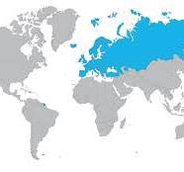
For us in Europe/EHEA

Slide 19
EHEA fundamental values of higher education, 2018-2024 and going forward - academic freedom - institutional autonomy - academic integrity - students and staff participation in governance - public responsibility for and of higher education
Values –fundamental values (not legal principles); institutional values
Cluster of values; rights and responsibilities
Shared conceptual references
Commitments; guidelines for “protection” and “promotion”
Implementation mechanism/monitoring

Slide 20
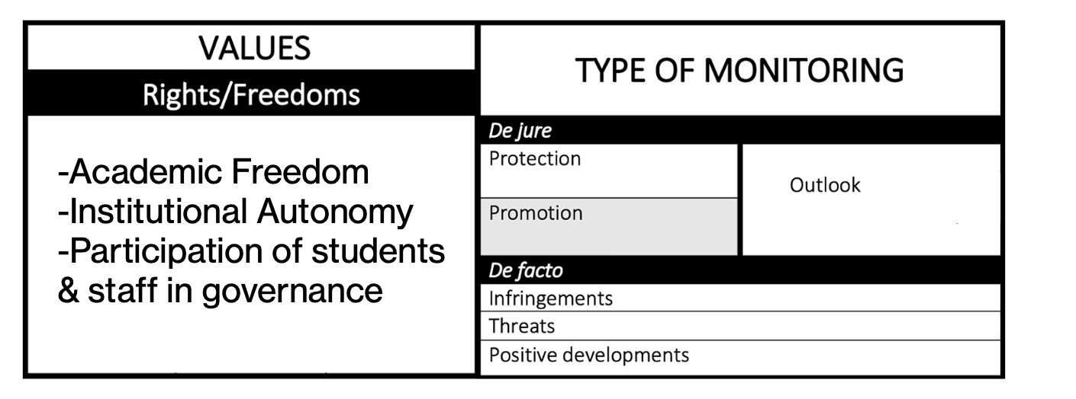
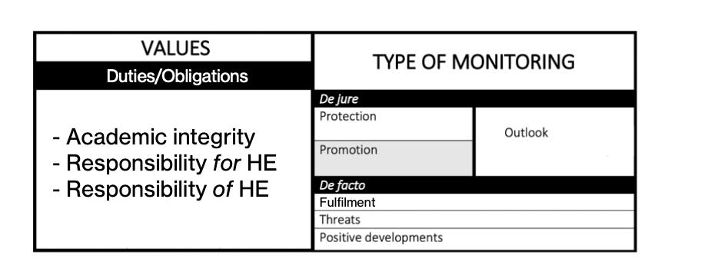
Monitoring rights and
duties/responsibilities; 2025

Slide 21
Monitoring rights and
duties/responsibilities; 2025 =>

Slide 22
Obligations/duties
“Rights” are not absolute; E.g. academic freedom is limited by:
- law; principle of public good, obligation to adhere to academic and ethical standards
Values/principles in HE and research that are intrinsically duties/obligations
Integrity; public responsibility of of higher education; responsibility of researchers

Slide 24
Public responsibility of higher education
Through its own actions, internal regulation and policies, the higher education community should ensure that the fundamental values of higher education are respected, furthered, and implemented. It should pursue truth and the production, transmission, dissemination, curation, and use of knowledge as a public good by upholding and developing the standards of teaching, learning, and research within and across academic disciplines.
The higher education community should seek to foster and disseminate, and should itself be guided by, a culture of democracy, solidarity, and ethics.

Slide 25
2017

Slide 26
Member States should establish and substantially strengthen human and institutional capacities, including by:
establishing suitable means to address the ethics of science and of the use of scientific knowledge and its applications, specifically through establishing, promoting and supporting independent, multidisciplinary and pluralist ethics committees in order to assess the relevant ethical, legal, scientific and social issues related to research projects involving human beings, to provide ethical advice on ethical questions in research and development, to assess scientific and techno-logical developments and to foster debate, education and public awareness and engagement of ethics related to research and development;

Slide 27
Academic integrity
denotes a set of behaviours and attitudes in the academic community internalizing and furthering compliance with ethical and professional principles and standards in learning, teaching, research, governance, outreach and any other tasks related to the missions of higher education. The duties and rights associated with the fulfilment and protection of academic integrity apply to all members of the academic community, who should develop a shared understanding of the concept and be guided by it. This also requires the engagement and development of a culture of collegiality and solidarity, in particular support and encouragement of early career researchers.

Slide 28
Freedom and responsibility in research
Bonn Declaration on Freedom of Scientific Research
We encourage and support high standards of good scientific practice, guidelines and advisory structures for safeguarding integrity, responsible research and ethical boundaries, including transparent, fair and excellence-based procedures for academic advancement and the competitive allocation of funding. This includes creating incentive and reward systems that promote independence, integrity and transparency of research, as well as implementing support and guidance for the professional development of researchers.

Slide 29
Internationalisation/Responsible inyternationalisation and Academic Freedom: How do we know what they are? How do we know what to do about them?

Slide 30
Explicit vs implicit references to international cooperation
“The freedom to research includes the right, consistent with professional standards of the respective discipline, to determine: what shall (or shall not) be researched; how it shall be researched; who shall research, with whom and for what purpose research shall be pursued; the methods by which, and avenues through which, research findings shall be disseminated.”
Rome Statement on Academic Freedom

Slide 31
Regulations about fundamental values vs regulations about responsible internationalization
Which ones come first?
External regulations vs self-generated regulations for responsible internationalization –with/without reference to the fundamental values

Slide 32
EUTOPIA –issuing own guidelines

Slide 33
What to do (at the institutional level)?
Adopt institutional guidelines, policies regarding academic freedom and other key/fundamental academic values/values of higher education
Train all – keep in mind the cluster of values (freedoms and responsibilities), including ethical aspects
Map of frameworks of reference?

Slide 34
What would you do? In what framework? Discussion of challenges and solutions

Slide 35
Application for external grant not approved internally because it does not fit with Faculty priorities

Slide 36
National parliament adopts law stipulating that gender studies programs cannot be offered in the country.

Slide 37
Examples (I)
European Court of Justice verdict against Hungary in the Lex CEU case

Slide 38
Examples (I)
State legislature adopts legislation resulting in books by Dostoyevsky being forbidden as educational material.
National excellence initiatives; national competitive/priorities-based funding
Head of national higher education council arrested

Slide 39
UK university – research officer refuses to help prepare Horizon Europe application involving cooperation with academic from Israel

Slide 40
Cooperation with Russian universities suspended in the wake of Russian rectors’ signing a letter of support for the war in Ukraine.

Slide 41
EU research and educational cooperation funding suspended for Hungarian universities

