Slide 1

Upholding academic freedom, international partnership and friendship in times of crisis
11 March 2025
Kristin Günther

Slide 2
Agenda
Address risks – Reduce uncertainty – Maintain openness
Planning Secure International Cooperation
Case Study
In-depth review
Debates & challenges

Slide 3
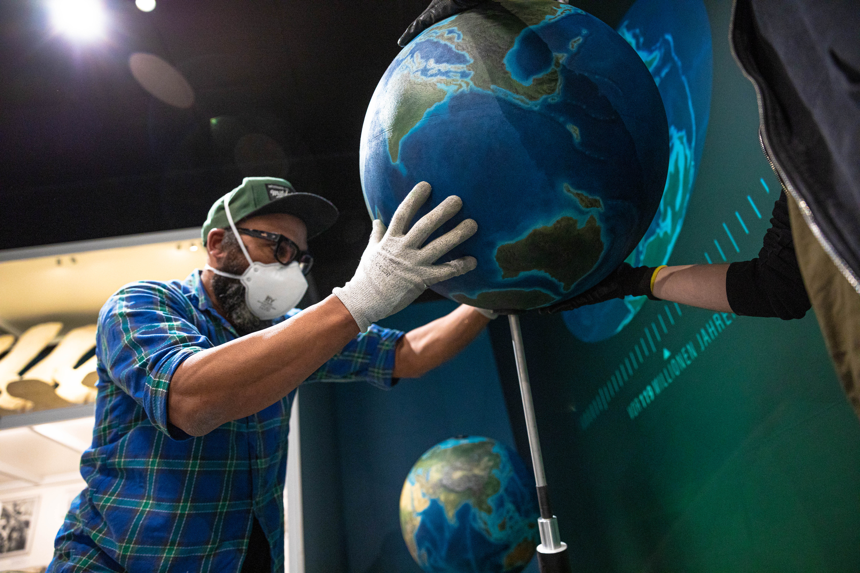
Address risks –
Reduce uncertainty –
Maintain openness
1
Foto: UHH/Hansen
Notes:
Our world is characterized by crises
Disasters, conflicts and open war
New potentially disruptive and technological innovations
AI, gene manipulation, mRNA-based medical treatments …
Open-ended application potential
Hard to regulate
Potential implications for national security
Link between national security and universities grows stronger
Rising debate on research security and due diligence encompasses:
Cybersecurity,
travel risks,
preventing unwanted knowledge outflow,
export control laws,
and other legal issues (patents, copyrights) etc.
Wake up call at University of Hamburg
Series of press articles: Chinese military institutions + German universities
Need for due diligence → working group
Prompted debate on the limits to academic freedom, role and responsibilities of universities and individual researchers

Slide 4

Guiding framework
no legal framework in Germany
BMBF: Position Paper on Research Security
DAAD Centre for International Academic Cooperation (KIWi)
Notes:
Federal Ministry of Education and Research → position paper on research security
Inhalte:
Awareness for potential risks → knowing how to handle them
Research security:
Measures that save our research from actions and behaviors that pose a economic, strategic and/or national and international risk
Risks of influence, non-legit use of research, stealing ideas, research results and intellectual property by states, military, etc.
Academic freedom, research integrity, open science, transparency, trustful cooperations can be improved using risk-oriented measures
No list of countries we do not cooperate with at all
Lots of institutions refer to the rules of export control when determining if a research topic is relevant for dual use (we do that too)
EU: European Strategy for economic security: contains list of technologies that are of importance for the economic security → does not have to be the same research fields that are important for innovation in Germany
KIWi
Since 2019
Guidance for universities regarding secure international cooperations
Publish guidelines „Kiwi Compass – no red lines“
Event series: dual-use in international research coperations

Slide 5
Laying the foundation …
Guiding framework
Risk awareness, sensitization
Service and support
Build expertise
Participative and science adequate
Within our legal and guiding framework
Beyond ideology and oriented to universal values
Notes:
Working group on how to design international cooperation was formed
- administrative departments, members of the executive board → no faculties at first
Focussed on risks at first
Working Group 2 tasks: guidelines, screening
Setting up a Guiding framework for UHH → addressing formalized and non-formalized cooperations
Risk awareness, mitigation
Sensitization
Provide support and point out services we offer
Review process for „risky“ countries
For formalized cooperations
Speaking to faculty (working group did not want to exclude them): participative process
No country focus: would further prejudices and prejudgement / stigmatization / hostile atmosphere
No red lines
Careful language (values, difficult country)
Adjusted their task and way of work (also name of the working group)
First: working group for difficult countries – now working group for secure cooperations
Still focussed on risk – but not to refrain from cooperations but to find a way to cooperate despite potential risks
Individual assessment of projects
Politically neutral – beyond ideology – oriented to universal values (academic freedom, human rights, etc.)
Focus shifted: from fear-based approach to empowering approach
Build expertise and empower academics to engage internationally
HNC3
Support academic freedom through enabling collaborations and having robust due diligence processes in place

Slide 6
… concrete outcomes
Guidelines: Planning Secure International Cooperation
In-depth review
Case Study
Notes:
Case study, seminars, workshops, HNC³
Hamburg Network on Compliance in Cooperation with China
9 institutions in Hamburg
Increasing China-competence – cooperate securely with China
Panel discussions, workshops, etc.

Slide 7

Planning Secure International Cooperation
2

Slide 8

Guidelines containing…
types of cooperations
types of agreements
regulations and recommendations in international cooperation
risks and minimizing risks in international cooperation
Notes:
Guidelines
Addressing risks + recommendations on how to minimize them
Updated regularly
Especially for non-formalized cooperations
Principles for acting responsibly
Drived from selected UNESCO and UN conventions, Charter of Fundamental Rights of the EU (Right to Education) and societal statements on academic freedom
SAR guide „Promoting Higher Education Values“
Equal participation
Institutional autonomy
Personal safety
Accountability
Obligation to be truthful
Academic freedom
Legal conditions
Export control regulations
General law of Germany
Export control and export control legislation

Slide 9


Case Study
3

Slide 10
Case study
Identify potential risks for either institution and third parties in the proposed collaboration.
How can leadership and researchers from RU and UoM maintain academic freedom and safeguard universal values and ethical principles?
Should RU and UoM enter into an agreement?
Notes:
30 Min
With careful approach, we have written a fictional case study
Take 20 min to read it and discuss in working groups the following questions:
Identify potential risks for either institution and third parties in the proposed collaboration.
How can leadership and researchers from RU and UoM maintain academic freedom and safeguard universal values and ethical principles?
Should RU and UoM enter into an agreement?
Keep answers to 2-3 min
Vote

Slide 11

In-depth review
4

Slide 12
In-depth review
Due diligence
Creating a secure framework for all involved
Enable collaboration
Prevent dual use and unwanted loss of knowledge and intellectual property
Fact-based analysis
No red lines
Notes:
In-depth review
Formalized cooperations (e.g. before an MoU or when doing a project application)
Main goal: to prevent dual use and loss of knowledge
Transparent process – good exchange/communication with the Pis
Identify risks and addressing them in the contracts
Contradiction between academic freedom and the review process
Addressed openly towards the faculties
We are aware of it but we have to do the process in order to cooperate safely

Slide 13
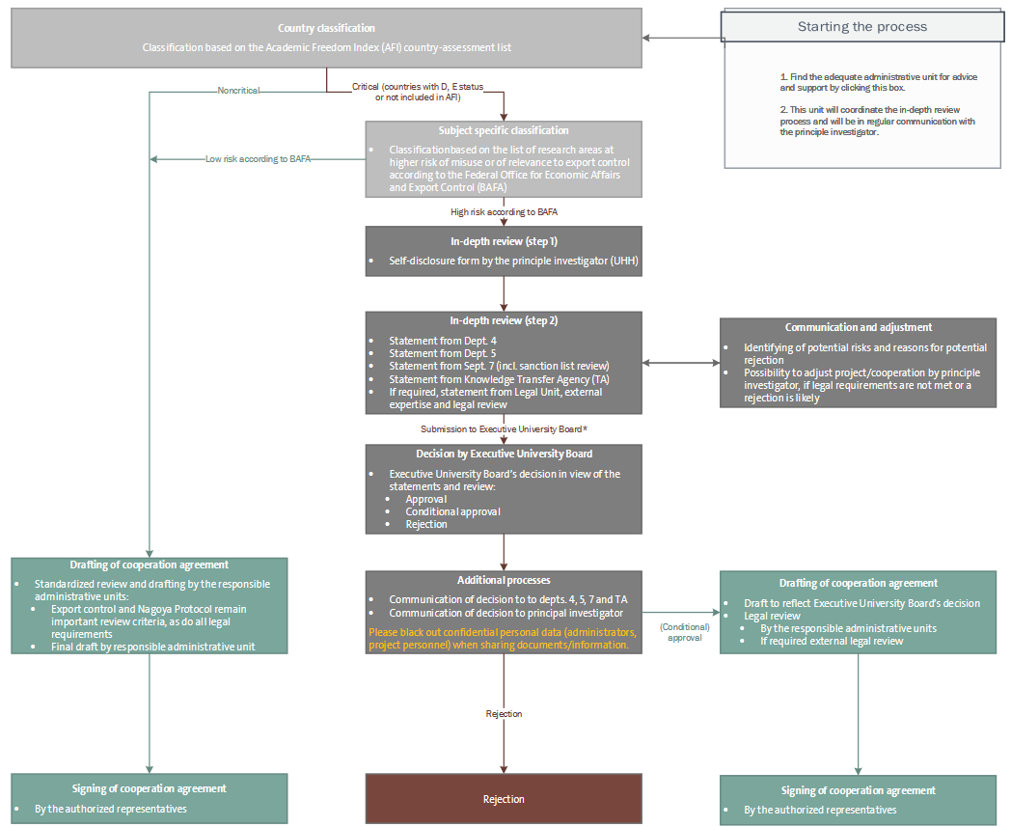
Notes:
Academic freedom index and its updates
Federal Office for Economic Affairs and Export Control (BAFA)
Physics,
Biology
Chemistry
Nuclear technology
Engineering
20-25 review processes
2 got rejected (in one of them the risk of dual use was too high)

Slide 14

Debates and challenges
5
Foto: UHH/Denstorf

Slide 15
Debates & challenges
academic freedom vs. due diligence
civil clauses vs. defense and military research
Individual vs. institutional responsibility
no legal national framework vs. autonomy of HEIs
geopolitical conflicts and volatility
screening of individuals
faculty outreach
Notes:
Civil clause: not existing in Bavaria anymore – in Hamburg still there → research only contributes to peaceful goals and civil purposes
Screening of individuals: in discussion at UHH

Slide 16
Knowledge Sharing
What role does academic freedom play at your institution and in collaborations?
What measures does your institution have in place to guarantee the upholding of academic freedom and ethical principles, especially in international collaborations?
How does your institution handle due diligence and risk mitigation in international collaborations?

Slide 17

Contact
Kristin Günther
Team Head; External Funding Acquisition
+49 40 42838-8361
kristin.guenther@uni-hamburg.de

