Slide 1
Université Saint-Joseph of Beirut - Lebanon
Presented by Carole Moukawam Dib

Slide 2
Mission of Saint-Joseph University of Beirut
Saint-Joseph University of Beirut is a private Lebanese university, founded in 1875 by the Society of Jesus with French aid. Since 1976, the University has been separately incorporated as a private Lebanese University under a Jesuit Rector. It enjoys financial and technical autonomy under the University Council as stipulated in the Charter and Statutes.
Its mission, spelled out in the Charter, can be resumed under the following points.
Provide quality academic formation to students, without discrimination or regard for their situation.
Form highly qualified graduates capable of contributing to the development of the country and the region.
Allow students to develop into free, autonomous persons, capable of reflection, synthesis, and critical judgment, with a spirit of initiative and enterprise, well integrated into the society and open to spiritual questioning.
Promote the culture of Arabic language and that of French while assuring the mastery of other languages including English.
Be an active member of the international university community.
Develop research, both basic and applied.
Reflect on the problems of society with a concern for national unity.
Participate in public service through higher education.
Serve as a pole of reference nationally and in the region.
Perdure and develop.

Slide 3
Vision USJ 2007
In the next five years the University has decided to:
former the best students of the country and the region and give them a passport for work,
become a pole of excellence for research and innovation,
favor dialogue by biculturalism and plurilinguism,
continue to be a place for reflection and the integral formation of the person.

Slide 4
USJ in numbers
1 rectorat
5 campus at Beirut
4 regional center (North, South, Zahlé, Dubai)
1 hospital (HDF)

Slide 5
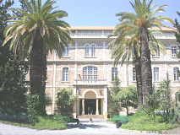
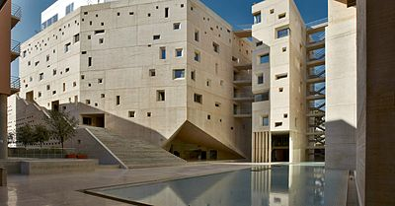
Medical Sciences Campus Innovation and Sports Campus

Slide 6
Human Sciences Campus Sciences and Technologies Campus Social Sciences Campus

Slide 7
Thank you

