Slide 1

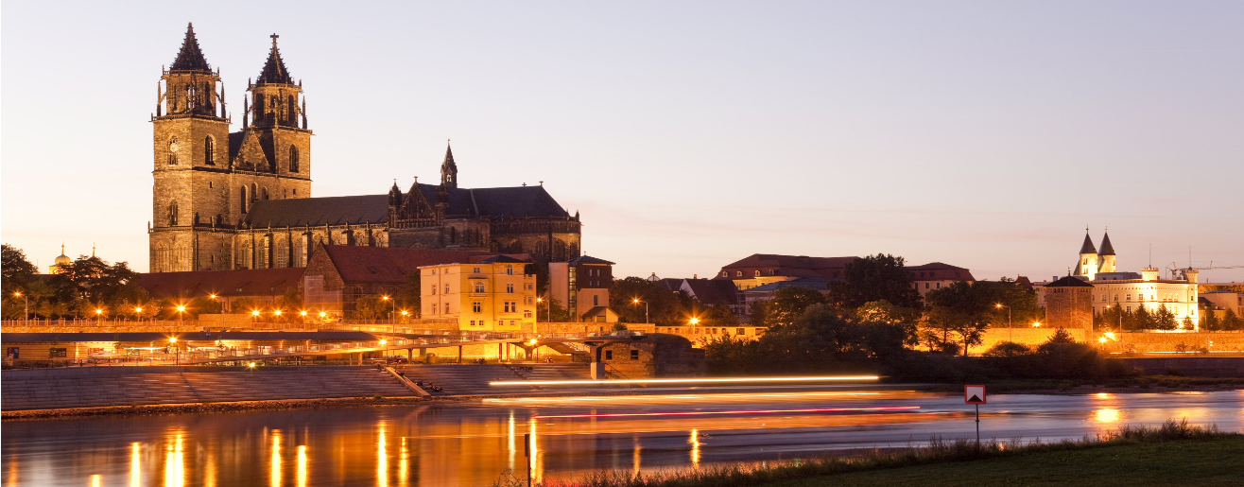
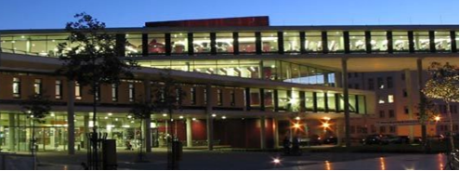
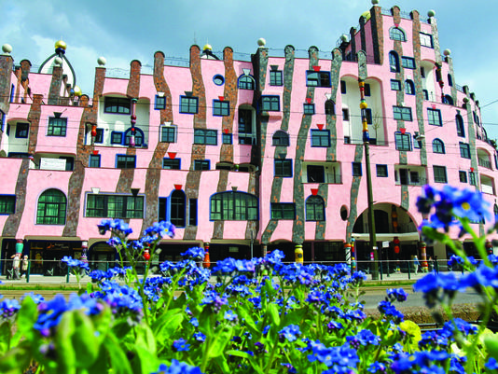
founded in 1993, in Magdeburg / Germany
named after Otto von Guericke (1602-1686)
14,427 students of which 2,297 international
201 professors
1,021 other academic staff
847 non-academic staff
140 million EUR state funding
52 million EUR third-party funding
research cooperation: Max-Plack Institute, Frauenhofer Institute
9 faculties: Electrical Engineering & Information Technology, Humanities, Social Science & Education, Computer Science, Mechanical Engineering, Mathematics, Medicine, Natural Sciences, Process & Systems Engineering, Economics & Management
79 degree courses
Notes:
http://www.magdeburg-tourist.de/media/custom/557_31_1_g.JPG?1340894975
http://www.skyline-panorama.de/images/panoramas/staedte/magdeburg/p_00783_stadtansicht-magdeburg-panorama.jpg

Slide 2
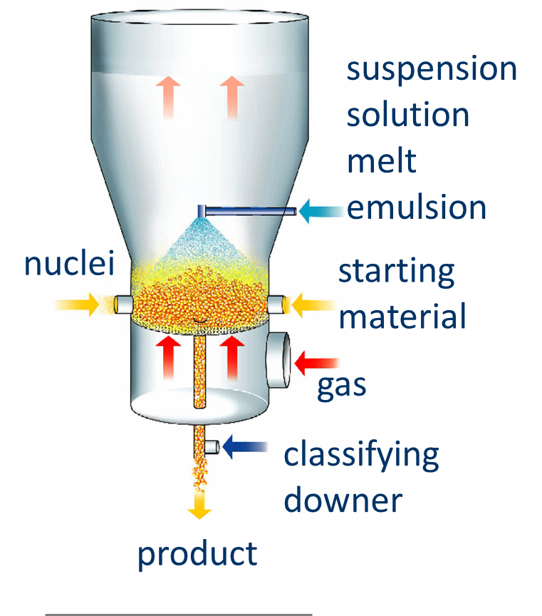
Process & Systems Engineering
Institutes and Departments
Institutes
Departments
Process Engineering (IVT)
Instrumental & Environmental Technology (IAUT)
Fluid Dynamics & Thermodynamics (ISUT)
Chemistry (ICH)
Chemical Engineering (CE)
Thermal Process Engineering (TVT)
Mechanical Process Engineering (MVT)
Bioprocess Engineering (BE)
Process Systems Engineering (PSE)
Chair of IVT / TVT
Particle Formulation in
Fluidized Beds
Pore Networks
Population Dynamics
Regenerative Energies

Slide 3
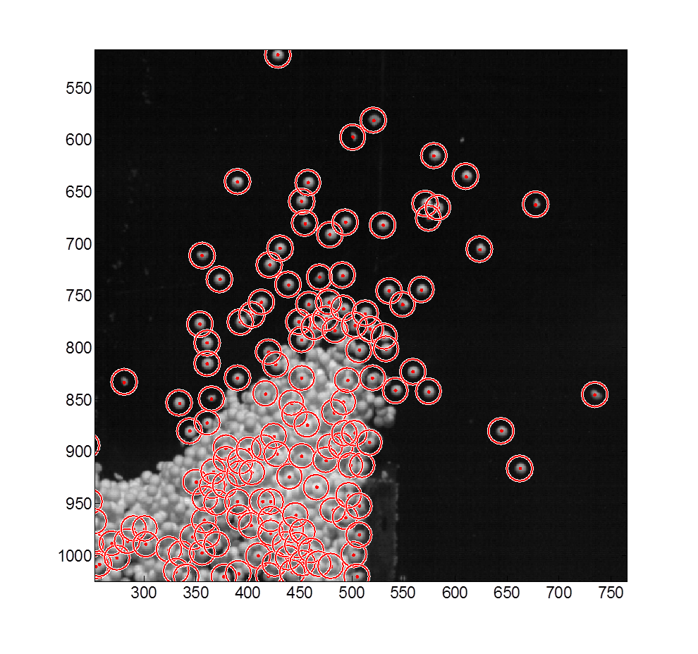

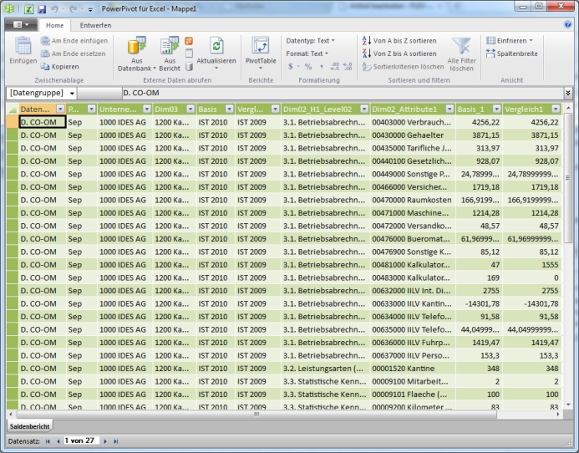
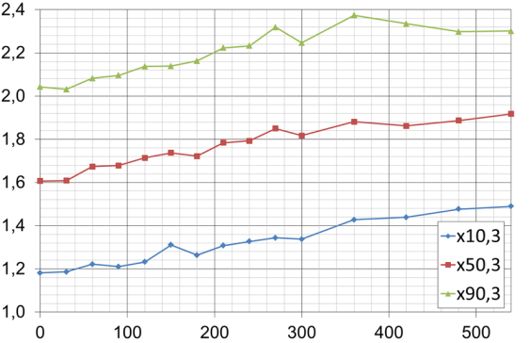
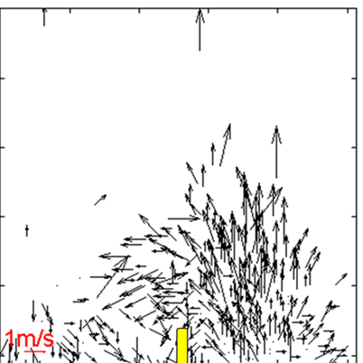

Research Assistant
M.Sc. Katja Meyer
‘‘Dynamic Population Model of Particle Formulation‘‘
Characterising of Product Quality
Experimental Work with Particle Tracking Velocimetry
Data Evaluation
& Process Assessment
Contact Information:
Prof. Dr.-Ing. habil. E. Tsotsas
katja.meyer@ovgu.de
www.dynsimfp.de

Slide 4

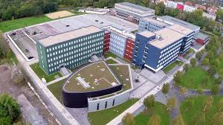
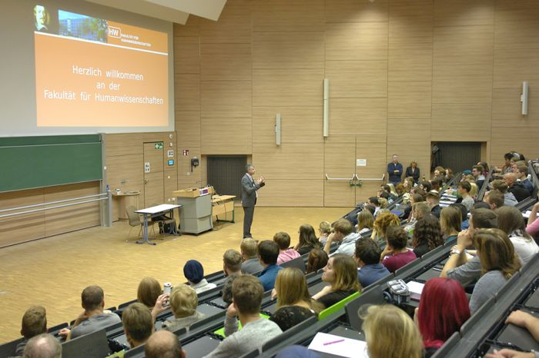
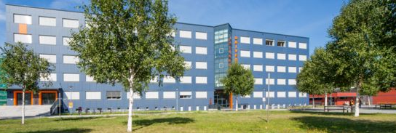
FACULTY OF HUMANITIES, SOCIAL SCIENCES & EDUCATION
Institutes
Institute I: Education, Vocation and Media
Institute II: Society, Politics and Transformation
Institute III: Philology, Philosophy and Sport Science
Departments, Institute III
German Studies
Foreign Philologies:
English & Slavonic Studies
Philosophy
Sport Science

Slide 5
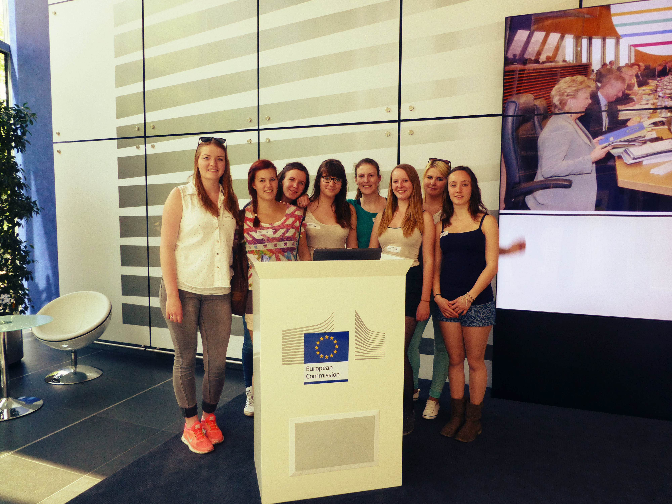
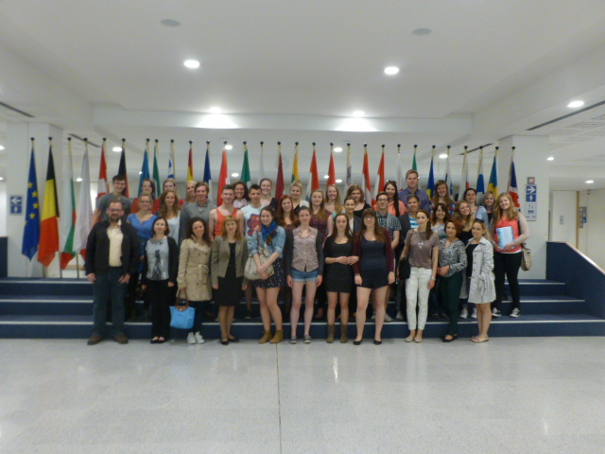
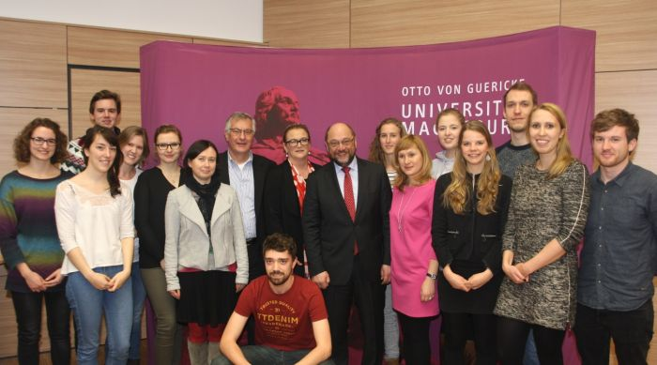
European Studies Programmes
European Studies
Tasks & Responsibilities
interdisciplinary study programmes BA (Extended), MA, Joint Degree (Cluj-Napoca / Romania)
focus on Central and Eastern Europe
cooperation between Faculty of Humanities, Social Science and Education, Faculty of Economics & Management and Centre for Language Ressources
courses in politics, sociology, law, economicc and cultural studies
obligatory (BA) or optional (MA) semester abroad (Erasmus+, DAAD or other funding)
one (MA) or two (BA) foreign languages
internship / practical work placement

Slide 6
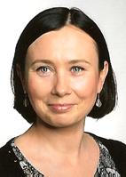
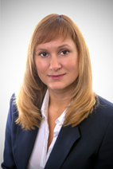
European Studies
Tasks & Responsibilities
Agnieszka
Zawadzka M.E.S.
Dr. phil. Tatjana
Samostyan
Academic Coordinator of
Erasmus+ and DAAD exchange programs
Inter-Institutional Agreements (IIAs), student/staff exchanges
liaising with current and potential future partner institutions
organization of the obligatory study abroad in BA&MA European Studies Programs
providing advice and guidance to students within the exchange programs
selecting students for outward exchange mobility
teaching undergraduate and post-graduate courses in Cultural Studies and Russian as a Foreign Language
Member of Institute Council
tetyana.samostyan@ovgu.de
Coordinator of European Studies programmes (BA, MA)
advice and support for students and applicants
cooperations with partner universities in Poland within Erasmus+ and other exchange programmes: support for outgoing and incoming students, as well as incoming teaching staff
teaching Polish language and culture
organization of educational trips and workshops (e.g. Poland, Brussels)
agnieszka.zawadzka@ovgu.de

