Slide 1

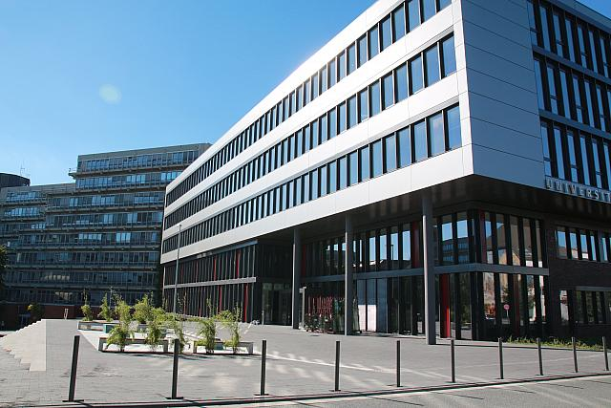
… in Profile

Slide 2
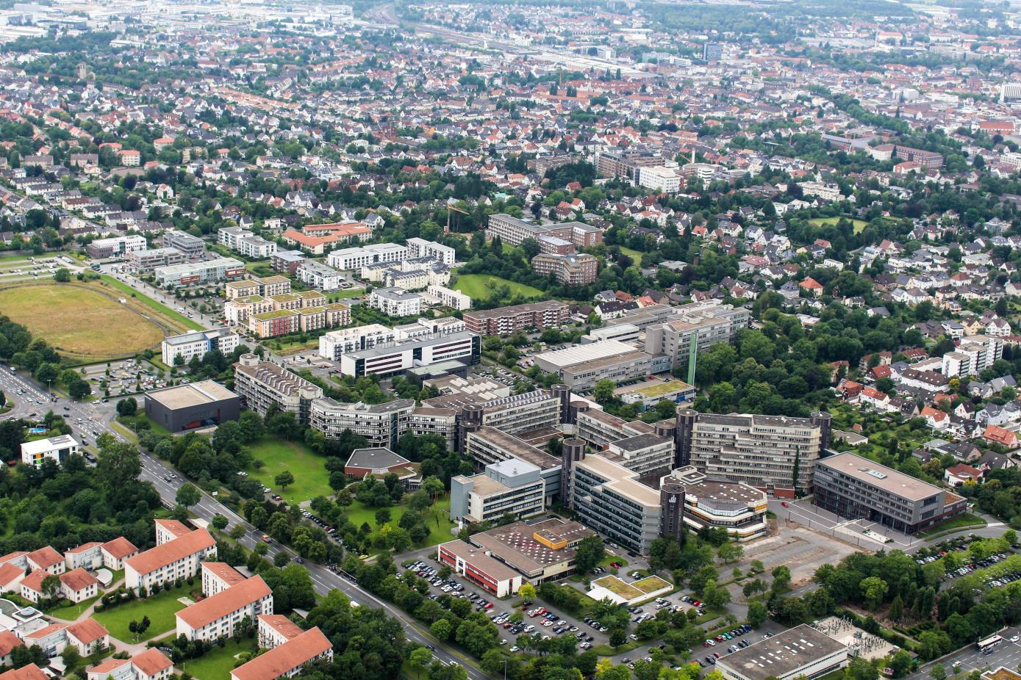

Slide 3

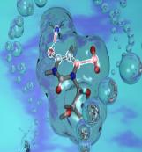

PLAZ
Arts and Humanities
Business Administration and
Economics
Science
Mechanical
Engineering
Computer Science
Electrical Engineering
Mathematics
Paderborn Teaching Training Centre

Slide 4
19,900 Students in Winter Semester 2015/162014/2015

Slide 5








Faculties at Paderborn University
I Faculty of Arts and Humanities
II Faculty of Business Administration and Economics
III Faculty of Science
IV Faculty of Mechanical Engineering
V Faculty of Computer Science, Electrical Engineering and Mathematics

Slide 6
The University 2016 in Numbers
  Staff: 2,344
    247 Professors
    122 Academics staff with civil servant status
    63 Research assistants
    1,178 Other academic staff
    583 Externally-funded staff
    671 Non-academic staff
    63 Trainees/Apprentices
  19,900 students in winter semester 2015/2016
  Externally-funded expenditures: 44,2 million euros in 2015
  (including other external funds, such as NRW research funding or funding for
  large-scale facilities by the DFG)

Slide 7

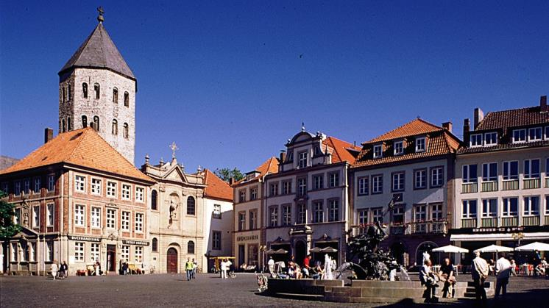
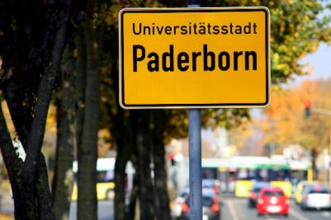
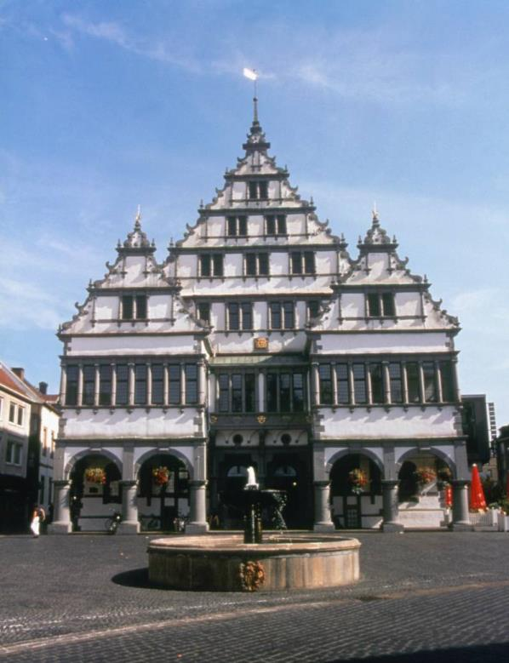
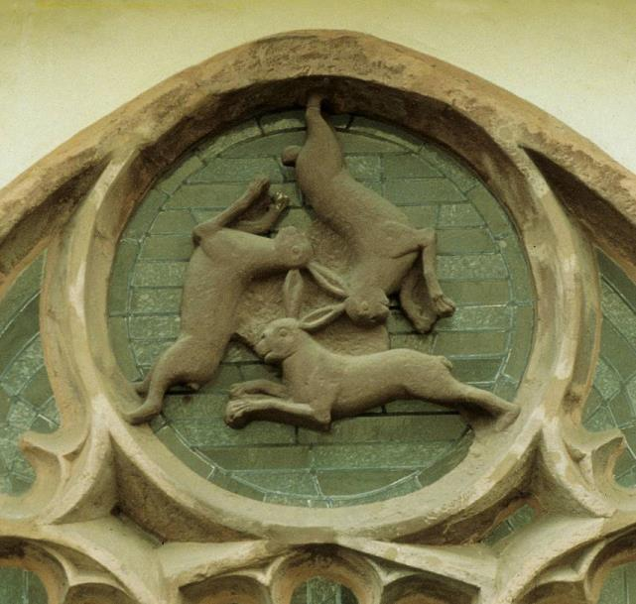

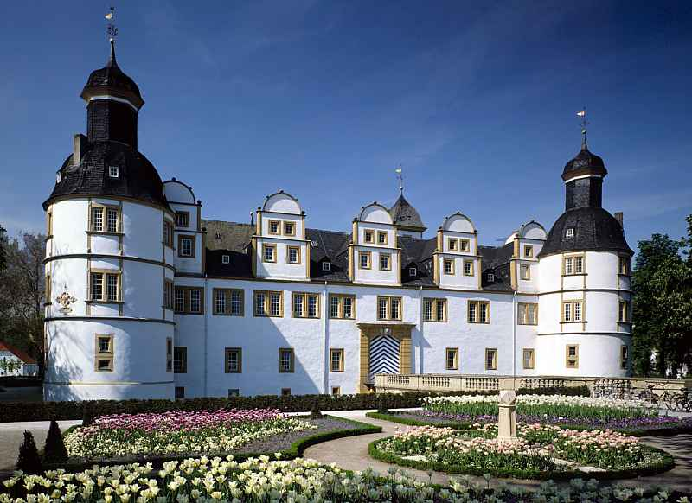
University Town of Paderborn

