Slide 1
OpenCourses @ AUTh. Today's possibilities, tomorrow's prospects.
Pinelopi Giovanitsa
Savvas Anastasiades
Academic Support
IT Center

Slide 2
contents
what is an open course
national depository
opencourses.auth.gr
views and statistics

Slide 3
what is an open course?
Notes:
What is an open course? A course that is taught in universities and technological institutes and it’s freely accessible and available to everyone over the Internet. The main aspects of open courses include the development and the creation of digital courses through live streaming, video recording, editing and publishing of the lectures.
Opencourses at AUTh began, as an institutional project on February of 2013 and ended on October of 2015 and it was funded from both the European Union and national resources. A learning platform called “Opencourses” was developed to host all the digital courses and although the project is now finished it is available for all the academic staff of the university to create new courses or to update the ones that already exist.

Slide 4
national depository of Open Courses http://opecourses.gr
Notes:
There is a national depository of OpenCourses that hosts the digital courses of 26 institutes.
Someone can search through 3,776 courses for one particular subject that he is interested in. The search can be done either by browsing courses by subject or by institute.

Slide 5
browse by institute
Notes:
If someone browses the courses by institute, he will see that there are hundreds of available courses from AUTh.

Slide 6
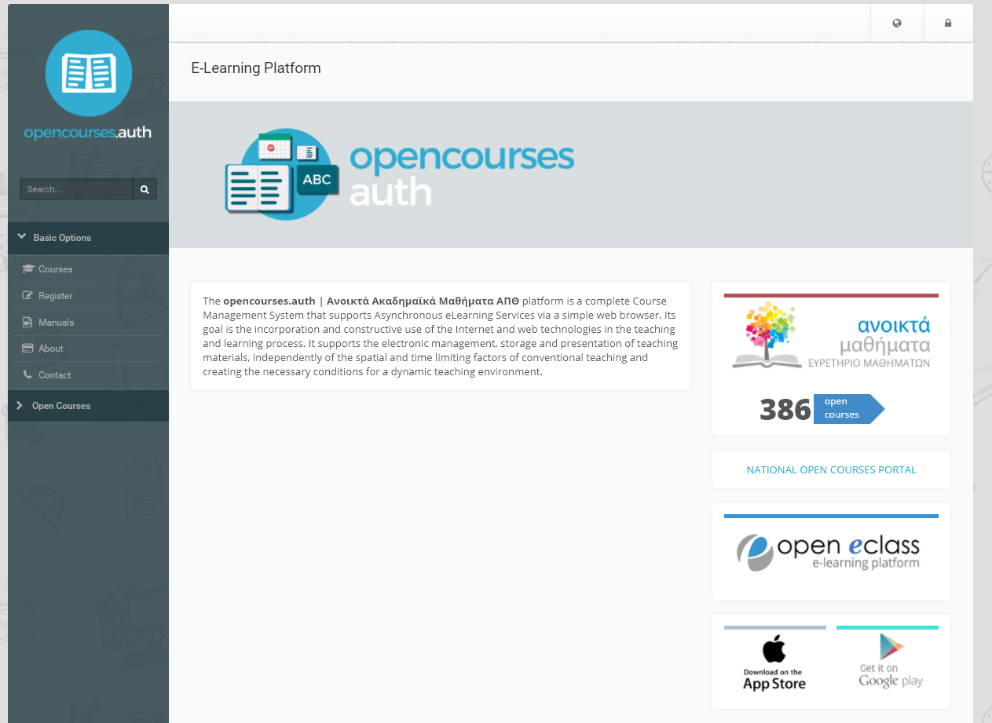
opencourses.auth.gr
Notes:
This is our platform for the open courses. Here you can find 386 available courses from all the departments of the university. There is no need for login unless you are the instructor of a course and you want to update you educational material.

Slide 7
categories
A+
A
A-
presentations, synchronized video lectures
presentations, podcasts
presentations
Notes:
Almost half of the courses in our platform belong to category A+. In this category, there is a presentation along with the synchronized video in each section of the course.
The other half belongs to A- category, where all the sections of the course include only presentations as their course material.
Around 19 courses belong to the second category where the instructor has to record his narration of the lecture and synchronize it with the presentation.

Slide 8
greek for refugees
Notes:
This is an open course that School of Modern Greek developed in order to help refugees who live in Greece. It includes a welcome guide and support material which will help the learners to get to know the city of Thessalonikι. The primary learning objective of this course is to help the learners develop basic communicational skills, useful for everyday life in Greece.

Slide 9
awarded course
Notes:
One of the Greek awarded open courses is “Travel journalism, communication and social media”. This course belongs to category A+ which means that pdfs, notes and synchronized video lectures are included. Each course is divided into sections and each section includes educational material such as presentations and multimedia. Also, there is a number of available exercises that the instructors chose to add in order to help students understand the aspects of the course.

Slide 10
section material
presentation
template
Notes:
When creating the presentations of a course, a certain powerpoint template is used. Its settings help people with special needs who use a specific software to hear the contents of each slide exactly as it was meant to.

Slide 11
creative commons
Notes:
A complicated issue according to the creation of the course presentations was the copyright law. Teachers may use photographs, texts, music files or diagrams and show them to their classroom even though they belong to someone else. When talking for the web, things are different. We had to consider and eliminate every possibility of using material without permission in every of the 386 courses. That’s why we turned into creative commons, a legally shareable database of files, when we searched for the course material.
Of course, all of our courses are published with the same creative commons licenses so that everyone can use our material only if its not for commercial causes.

Slide 12
section material
multimedia
synchronization
Notes:
This is an example of a synchronized video lecture in a course section. As you can see, on the left hand there is the slide of the presentation and on the right hand the specific part of the video lecture is being played.

Slide 13
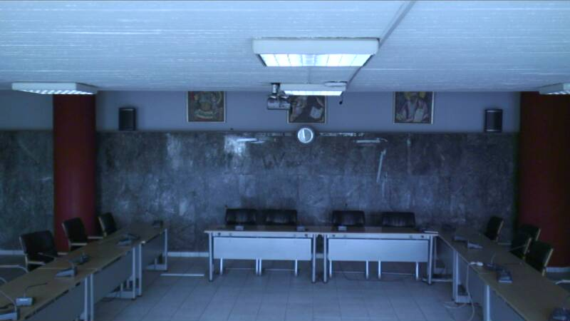
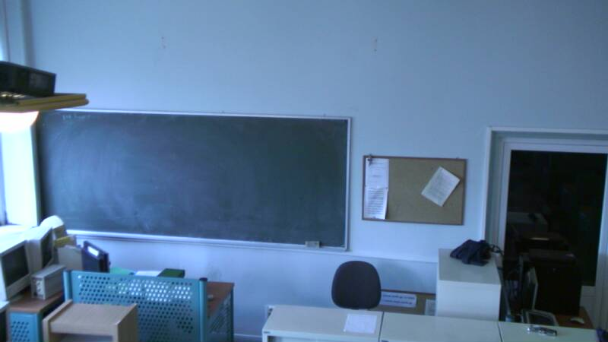
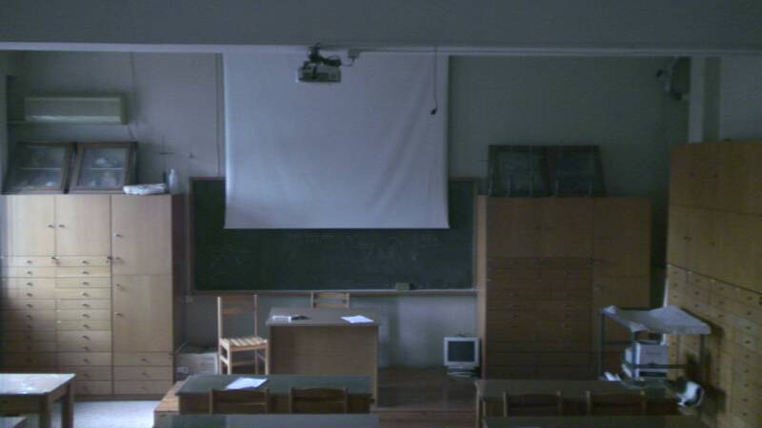
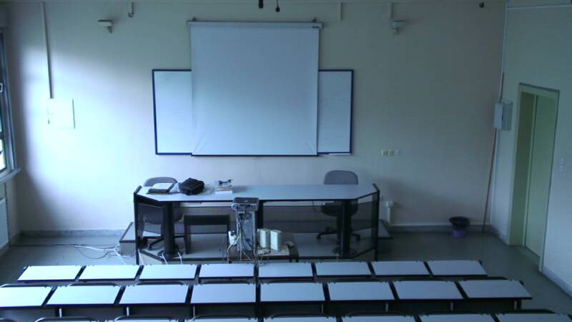
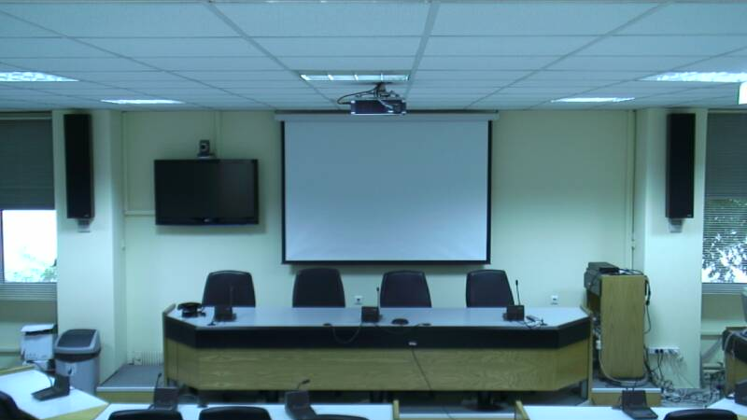
equipment
Notes:
Along with the OpenCourses project, 42 ip cameras were installed in all the departments of the university to record the lectures of the teachers. They are fully functioned and can also be used for live streaming.

Slide 14
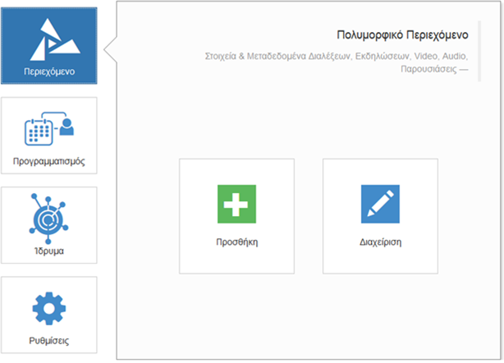
Open Delos
Notes:
Open Delos is the video editing platform for all the courses that belong to category A+. This open source platform was created by greek developers including some of the AUTh.
The main aspect of this platform is the synchronization of the parts of the video lectures with the matching slide of the presentation. Some of its basic features is the capability of live streaming through the ip cameras that are installed all over the campus, and the scheduled recording of the lectures.

Slide 15
OpenCourses in each department
Notes:
Here you can see the total number of open courses distributed in 38 of 42 departments.
There are four departments that do not have any open courses in our platform. These are the Drama, the Film Studies, the fine Arts and the Spatial Planning and Development of the polytechnic school. Unfortunately although the teachers of those departments where very interested in creating open courses, a lot of copyright issues raised and the courses could not be included to the project.

Slide 16
statistics
Notes:
Here you can see the statistics of total views and logins of the users to the courses for the past six months. Most of the views are on June and on September where the exams of the semesters take place. Thus it is easily understood that the majority of the viewers belong to the university. They search for the courses educational material in the periods that it is most needed.

Slide 17
worldwide views
Notes:
But!!! We have also a respectful number of viewers from all over the world.
Greece, United States, Cyprus, United Kingdom, Germany, France, Austria, Netherlands, Austria, Russia, Romania
Countries of Africa, Asia, Australia, South America, Canada

Slide 18
conditions and benefits
courses included in department curriculum
promotion of knowledge
insurance of copyrights
Notes:
The only condition that exists in order to create an open course is that this particular course comes from either the undergraduate or postgraduate curriculum of the department.
And what are the benefits of a teacher creating an open course? He can now be heard all over the world and promote his knowledge to all those people who are interested in that field and can not physically attend to the classroom. Furthermore, the educational material is now under the creative commons license which means that someone could use or edit, if allowed, this material with the obligation to mention the name of the creator rather than stealing it.

Slide 19
contact
opencourses-support@auth.gr
+30 2310 99 8678
Notes:
If you are interested in creating new open courses please do not hesitate to contact via email to opencourses-support@auth.gr or by calling at +2310 99 8678.

Slide 20
Thank you!
Thessaloniki, 10 October 2017

