Slide 1


SAR Slovakia Activities
Ingrid Borárosová

Slide 2
Introduction
SAR Slovakia was established to address growing concerns about academic freedom in Eastern Europe.
Launched in 2019, it unites 6 universities and associations across Slovakia.
The Bratislava Policy Institute (BPI) coordinates SAR Slovakia as its secretariat during a three-year pilot phase.

Slide 3
Key Universities Involved
Matej Bel University, Banska Bystrica
University of Cyril and Metodius, Trnava
Pavol Safarik University, Kosice
Paneuropean University, Bratislava
Bratislava International School of Liberal Arts
We are looking for the way how to spread the network to other Universities

Slide 4
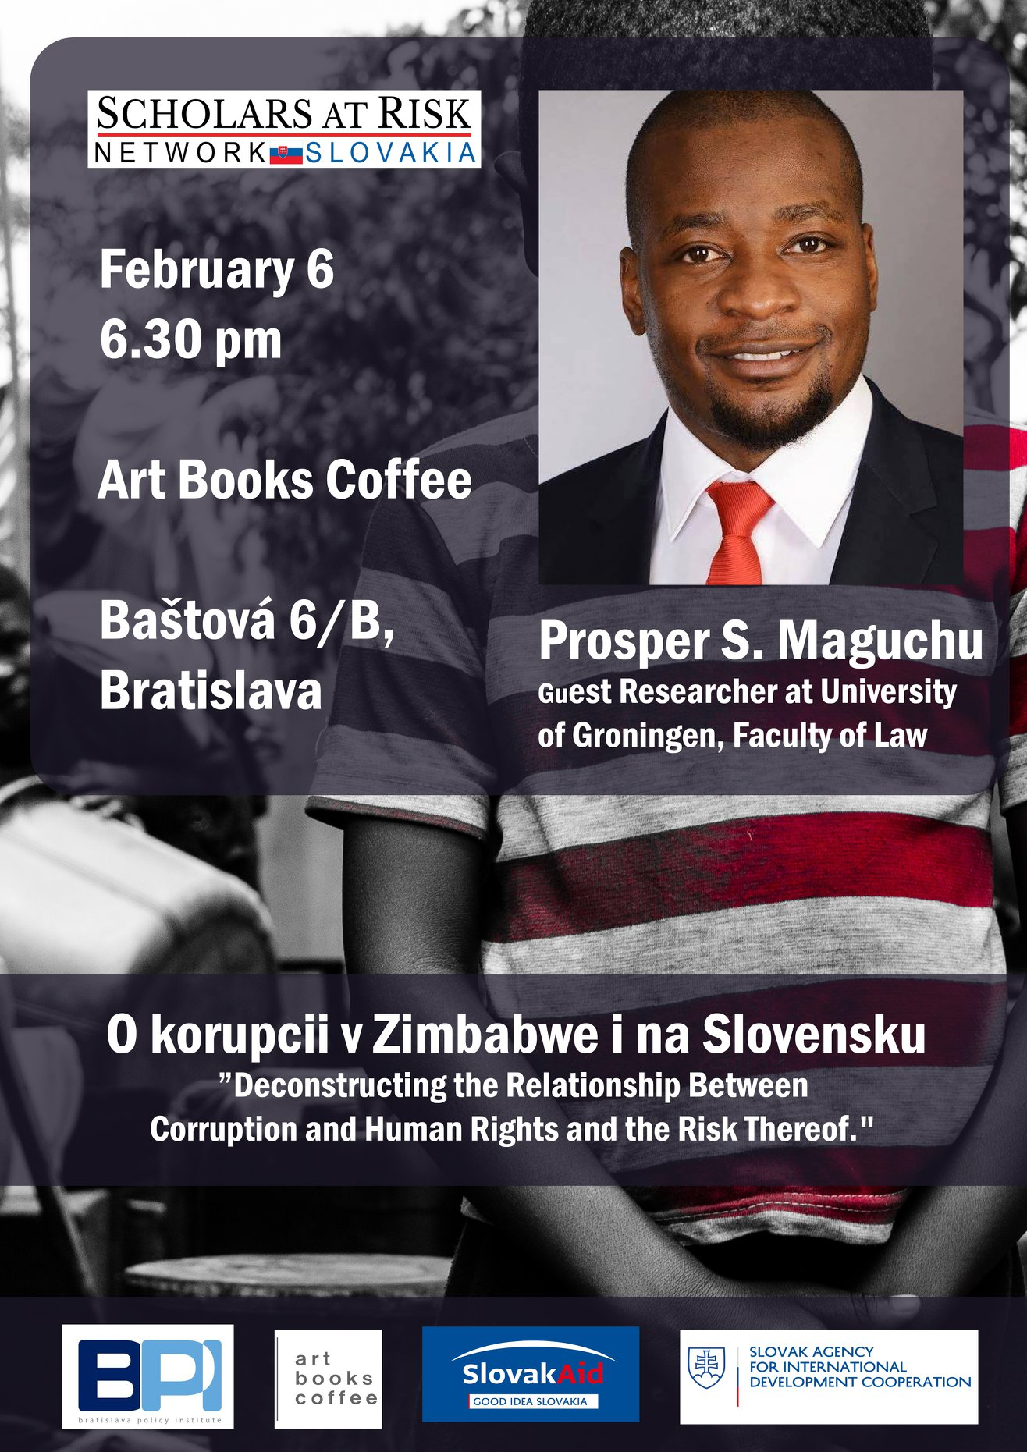
Preparatory Phase Activities
Presentation by SAR expert Lauren Crain at Trnava University (October 11, 2018)
Lectures by SAR scholars:
  Prof. Nil Mutluer from Turkey (October 10, 2018)
  Prof. Prosper S. Maguchu from Zimbabwe (February 6, 2019)

Slide 5
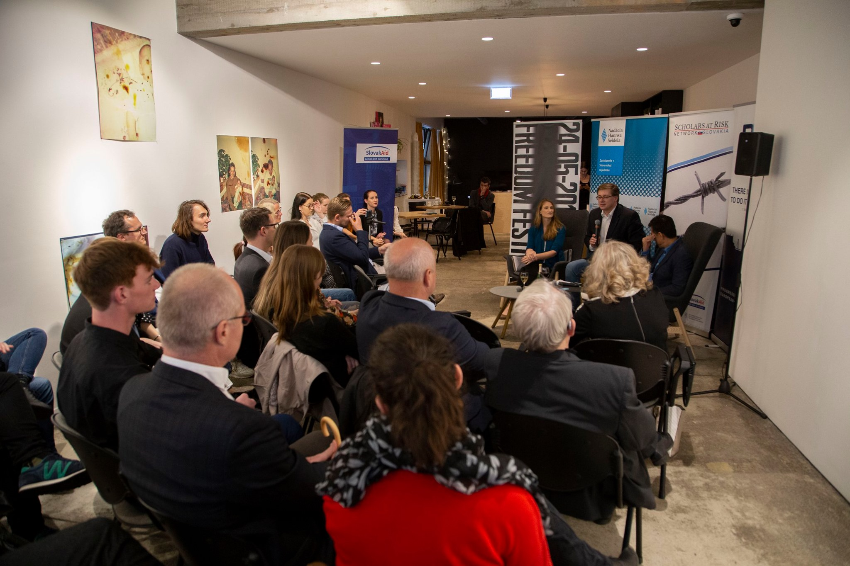

Official Launch
Launch Date: May 23, 2019, in Bratislava
Accompanied by the Academic Freedom Festival

Slide 6
Awareness and Advocacy Campaigns
Advocacy campaigns target Slovak scholars, media, and civil society
Supported by the Ministry of Foreign Affairs and European relations, however support was only for 10 months
Focuses on improving awareness about academic freedom and the benefits of supporting at-risk researchers

Slide 7
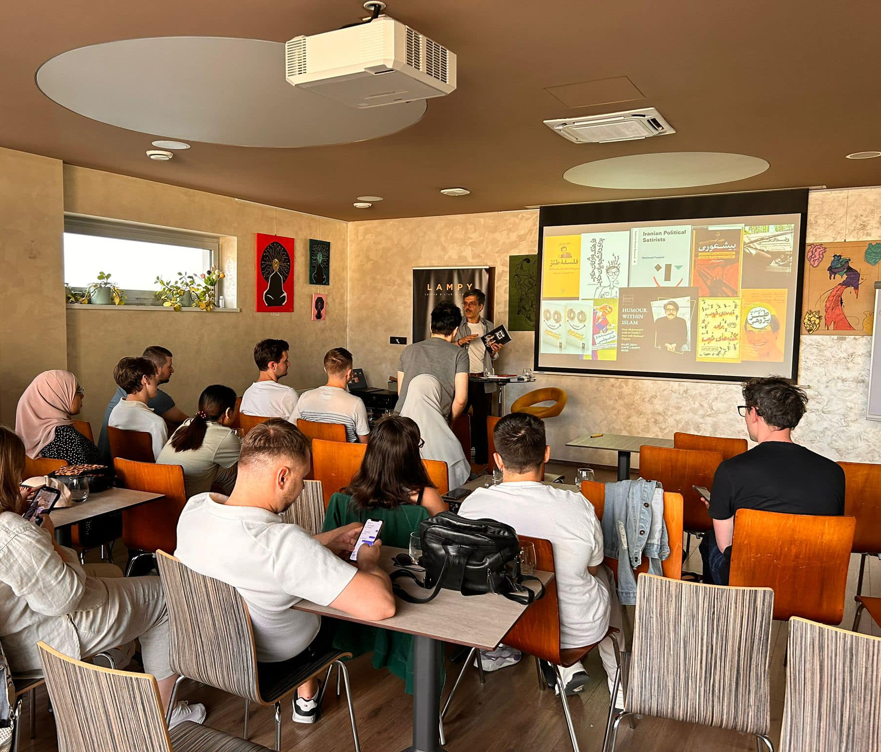
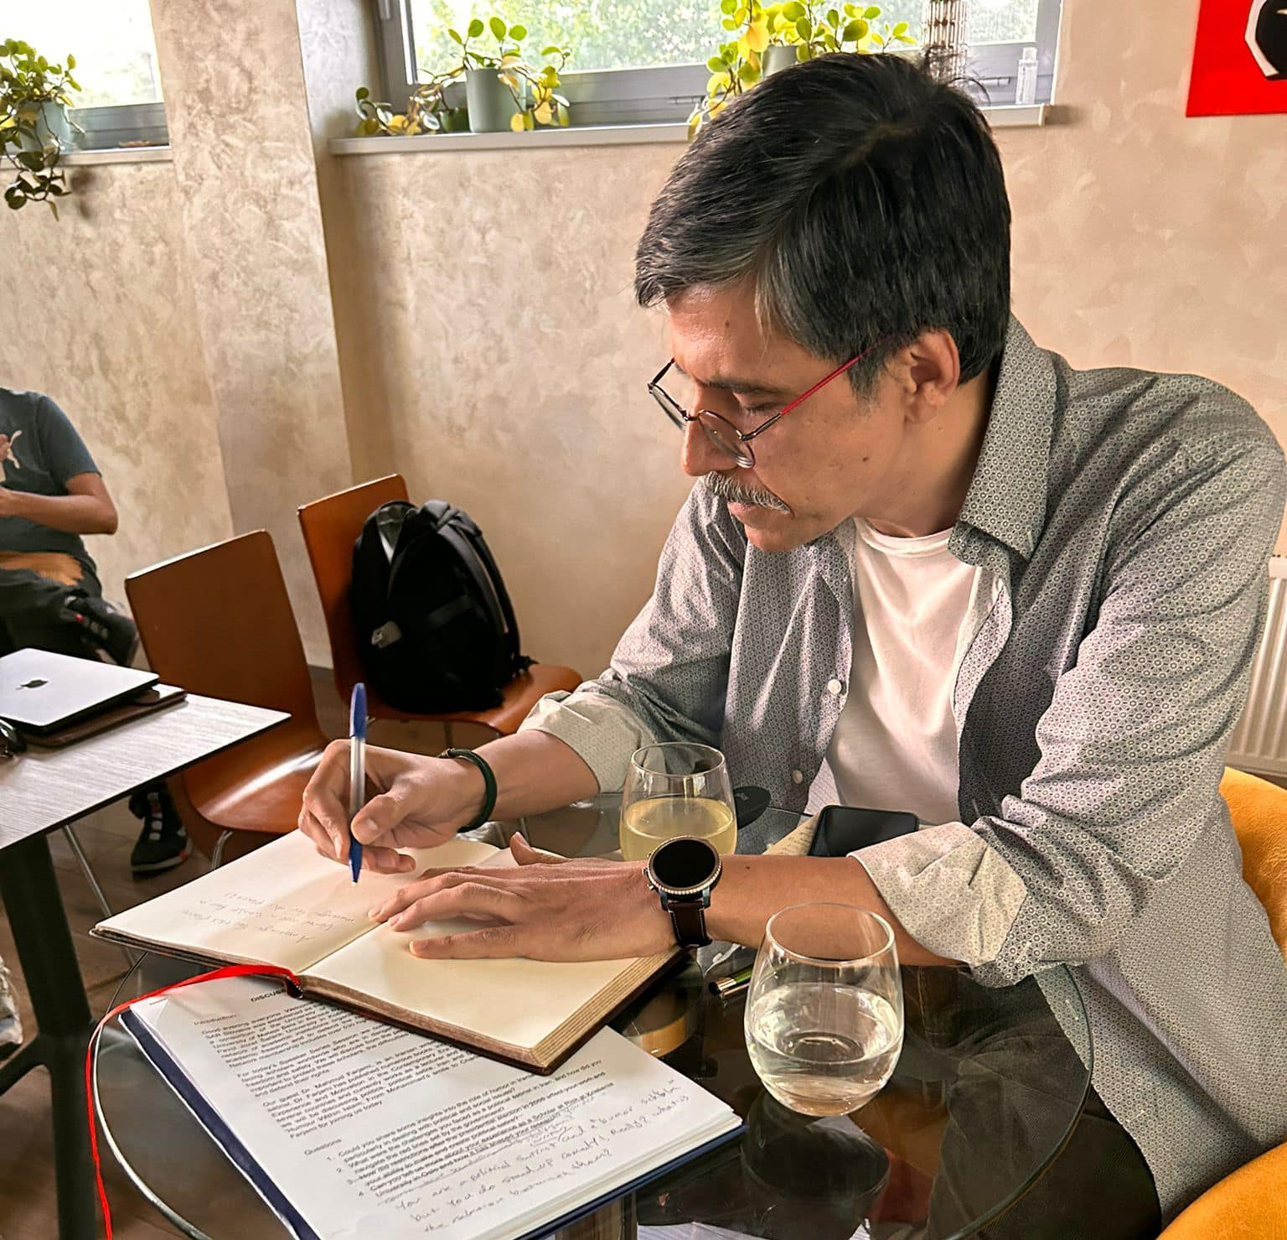
Youth Training Programs
Accredited under Erasmus+, focusing on human rights and academic freedoms
Hosts 3 annual trainings with 70-90 youth workers from across Europe
Workshops feature SAR scholars sharing their experiences
Example: Dr. Mahmud Farjami's Presentation on Humor with Islam

Slide 8
Key Challenges in Slovakia
Reluctance of population to accept migrants
SAR Slovakia emphasizes the positive contributions researchers at risk can bring to host countries
Example: "Focusing on Freedom" Conference (October 3, 2019) with 12 speakers from Central Europe
Current view of the NGO sphere as the rogue ones
Limited financial resources and reduced state support pose challenges

Slide 9
Academic Freedom Research
Identified doctoral students as a vulnerable group due to excessive workloads and administrative duties
Developed a questionnaire to assess academic freedom across universities
Findings will be published in a report with plans to expand the study to Visegrad countries

Slide 10
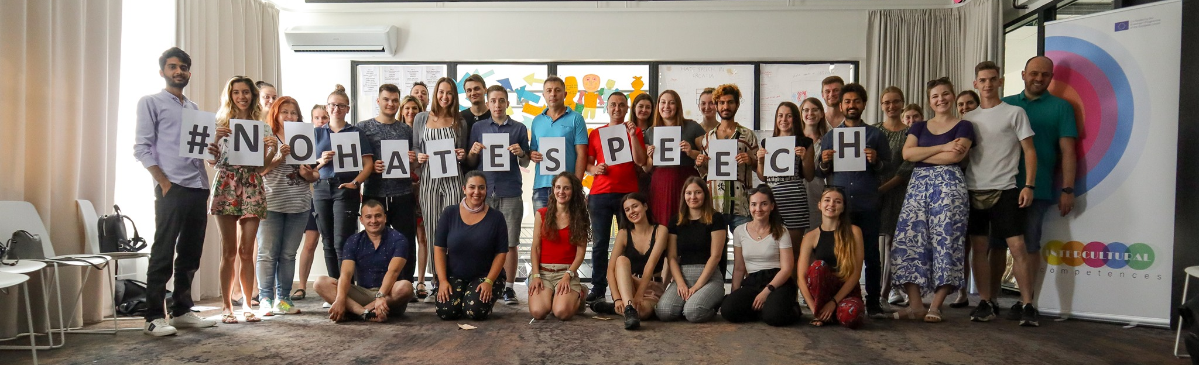
Conclusion
SAR Slovakia continues to promote academic freedom, support scholars at risk, and engage the Slovak public through awareness campaigns and educational initiatives.

