Slide 1



Building SAR Greece support through the years
Prof. Dr. Alexandros Triantafyllidis
Aristotle University of Thessaloniki
Chair of SAR Greece Section
Inspireurope+ Outreach Workshop Regional, Thessaloniki, Greece, March 13, 2025

Slide 2



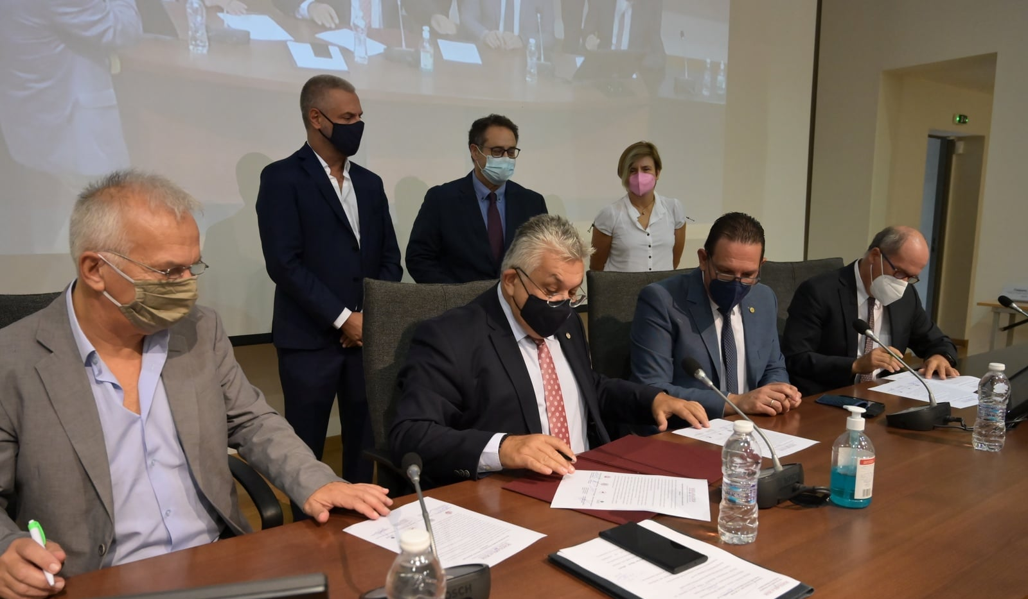

SCHOLARS AT RISK
Launch of SAR Greece, AUTh, Thessaloniki, October 2021

Slide 3
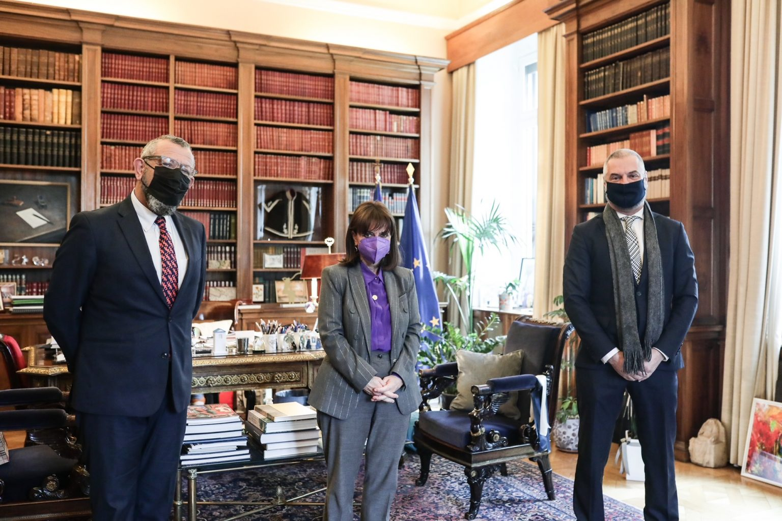
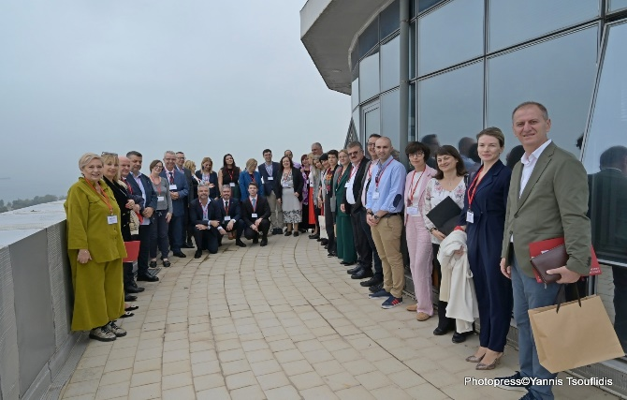
SAR Greece actions
Informing HE the President of the Hellenic Republic on SAR Greece and the Inspireurope project (March 14, 2022)
Ensuring support at the highest University level (Rectors of the joining Universities)
Presentation/raising awareness at the highest possible level (Rectors’ Synod – April 2021, July 2022, April 2023, June 2024; Cyprus Rector’s meeting - July 2022)
Presentation/collaboration with the Greek Vice-Minister of Education – May 2021, June 2022, August 2022, March 2023) to promote specific measures for the support of researchers at risk
Frequent Contact with Greek National Scholarship Agency – including the new Head Prof V Kinti (Dec 2024)
Personal communications with academics and HEIs’ administration at all levels (not just one time but with follow-ups) to develop/expand the network
Seeking external sources of funding (from National, European and private bodies)
Dedicated website at Ionian Univ. https://scholarsatrisk.ionio.gr
Dissemination of SAR Greece's work through participation in European events (EPICUR forum, Utrecht Network Task Force, PSI forum etc.) and through relevant publications (SAR network newsletters, Inspireurope project etc.)
Helping others – Inspireurope+ University Leaders Roundtable (Thessaloniki, 23/10/23) with representation from 30 Rectors/Vice Rectors/ Higher Level Officials from 12 countries mostly from SE Eeurope from 22 HEIs

Slide 4


Recent Actions in AUTh
https://www.maynoothuniversity.ie/sar-europe/events/inspireurope-outreach-workshop-thessaloniki-greece-september-30th-2020
Signing of Memorandum of Understanding with Ministry of Migration Policy (special regulatory decision to enable Greek HEIs to offer temporary positions for S@Rs beyond the regular procedures for academic posts/ work visa acceptance)
Creation of a Welcome Guide
For hosting S@Rs in AUTH https://inspireurope.auth.gr/welcomeguide/
Submission to both MSCA4Ukraine Calls
Push for Creation of A National Scheme for S@R (the National Agency is willing to fund a limited symbolic number of scholarships to warmly encourage Greek HEIs to independently establish temporary positions for Rs@R with partial funding from the HEI’s Research Committee and co-funding from the National Agency)
AUTh is Associate Partner of Consortium for Preparatory Action-European Fellowship Scheme for Researchers at Risk (SAFE project)
Supporting Scholar at Risk!!!
1^{η} Scholarship in AUTh through self funding – CALL OPEN
Funding
LEARNING

Slide 5




Email: inspire_auth@auth.gr
Website: https://scholarsatrisk.ionio.gr/en/greece/ ​

