Slide 1
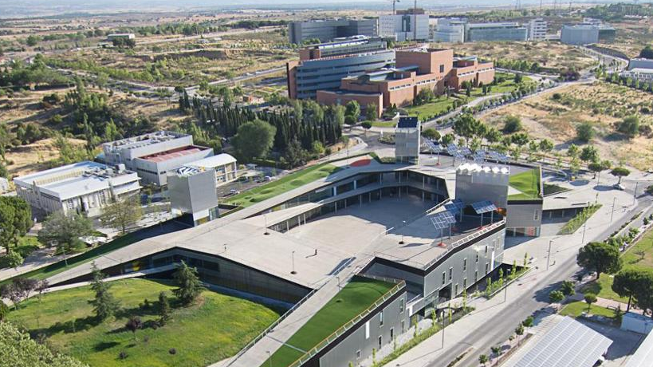
Some reflections about the state of SAR programs
in Spanish Universities
Irene Martín
Vice-rector for Internationalisation
Universidad Autónoma de Madrid
CURSO 2022-23
29 y 30 de junio de 2023
Inspireurope+ Outreach Workshop Regional
"European & National-level Actions/Support Networks for Researchers at Risk with a focus on Southeastern European HEIs"
Aristotle University of Thessaloniki. March 13, 12.00-14.00

Slide 2
2
|NATIONAL INITIATIVES
Conference of Spanish rectors (crue)

Slide 4
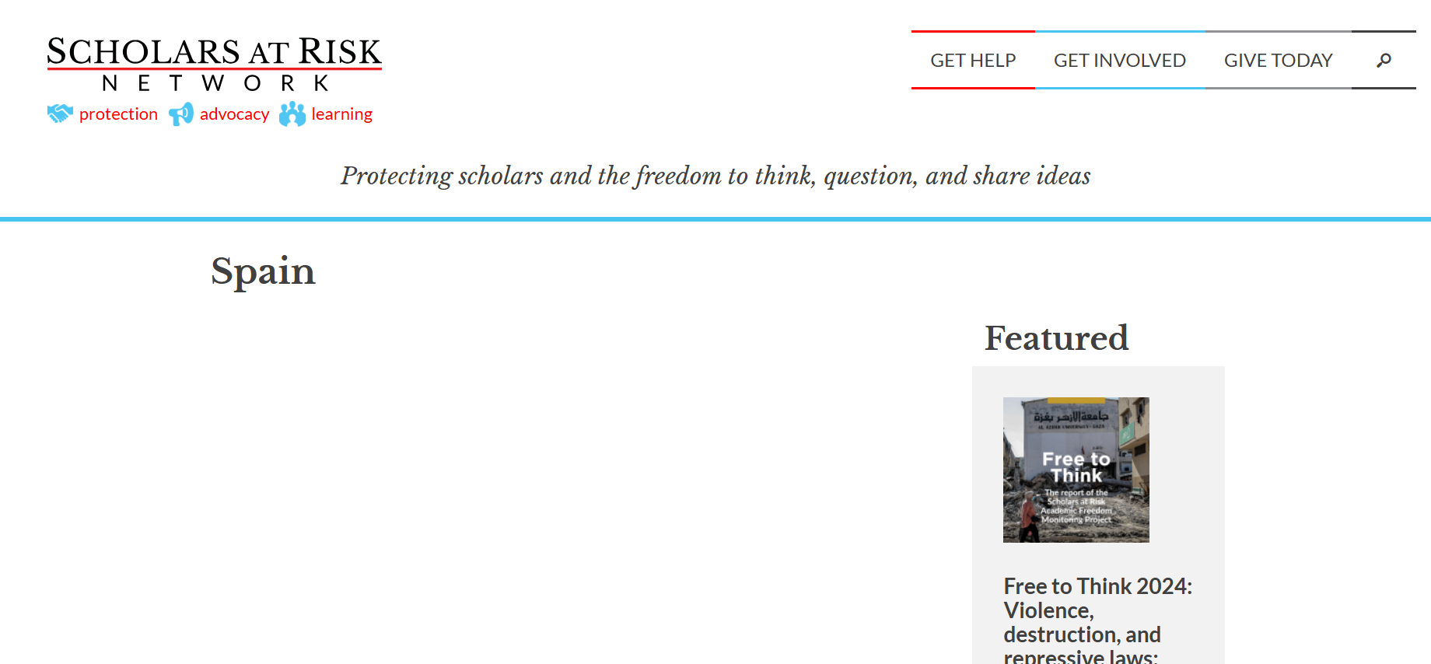

Slide 5
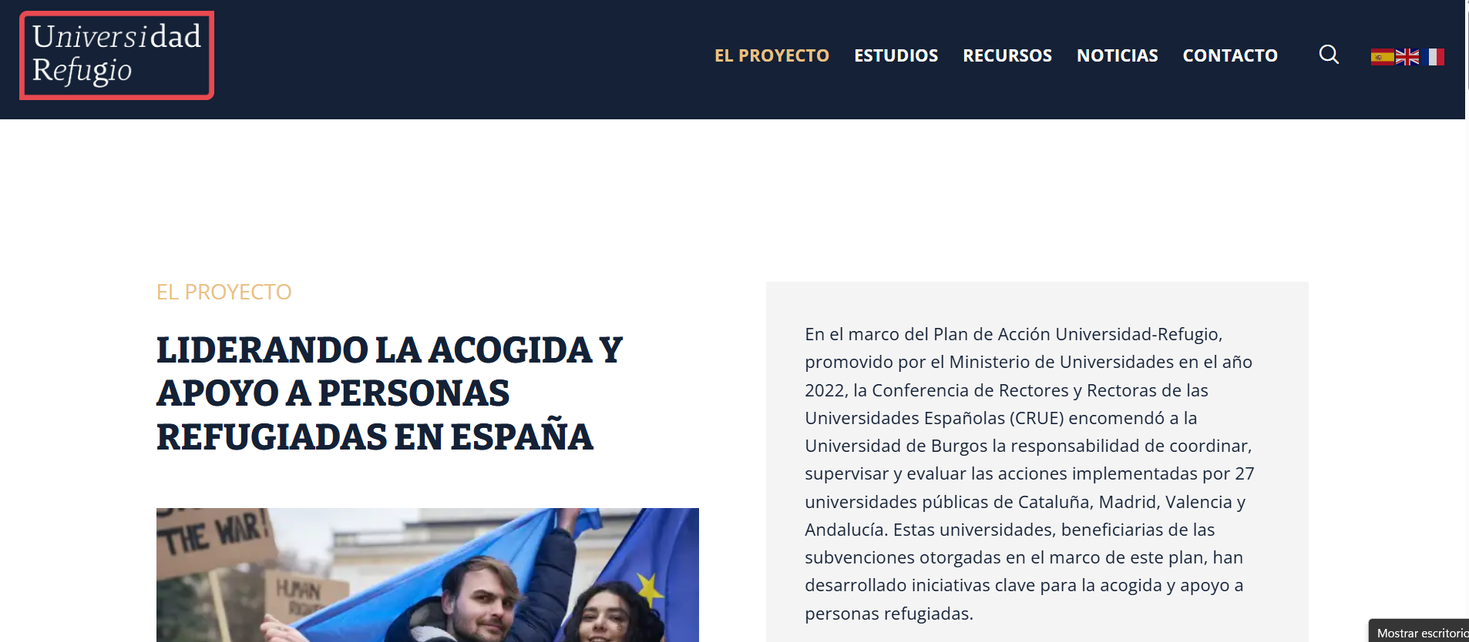
5
|NATIONAL INITIATIVES for INSPIRATION
Project led by former ministry of Universities + 27 public universities

Slide 6
6
|NATIONAL INITIATIVES for INSPIRATION
Project led by former ministry of Universities + 27 public universities

Slide 7
7
|NATIONAL INITIATIVES for INSPIRATION
LESSONS LEARNT FROM OTHER UNIVERSITIES…
Length of hosting period vs lenght of conflicts
Possibilities to integrate them into the system
Complementary programs to help their integration, installation, families…
Economic costs of big cities
Collaboration with institutions to regularize their residence

Slide 8
8
|CIVIS

Slide 9
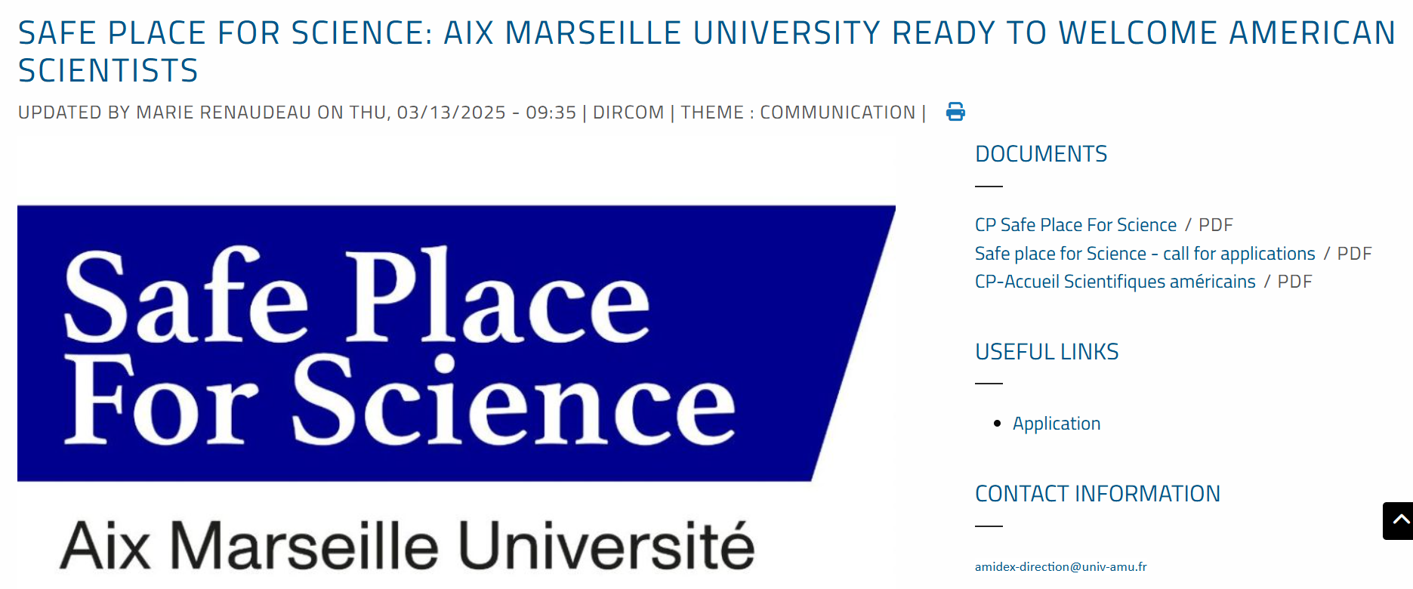
9
NEW INITIATIVE PROPOSED BY AMU THAT MAY BE PROPOSED TO OTHER EUROPEAN UNIVERSITY ALLIANCES
|CIVIS
https://www.univ-amu.fr/en/public/actualites/safe-place-science-aix-marseille-universite-ready-welcome-american-scientists

Slide 10
10
NEW INITIATIVE PROPOSED BY AMU THAT MAY BE PROPOSED TO OTHER EUROPEAN UNIVERSITY ALLIANCES
|CIVIS
https://www.univ-amu.fr/en/public/actualites/safe-place-science-aix-marseille-universite-ready-welcome-american-scientists

