Slide 1
INSPIREUROPE+
Expanding opportunities for researchers at risk
Regional Outreach Workshop, Thessaloniki, 13 March 2025
Henriette Stoeber – EUA European University Association
Notes:
MG

Slide 2
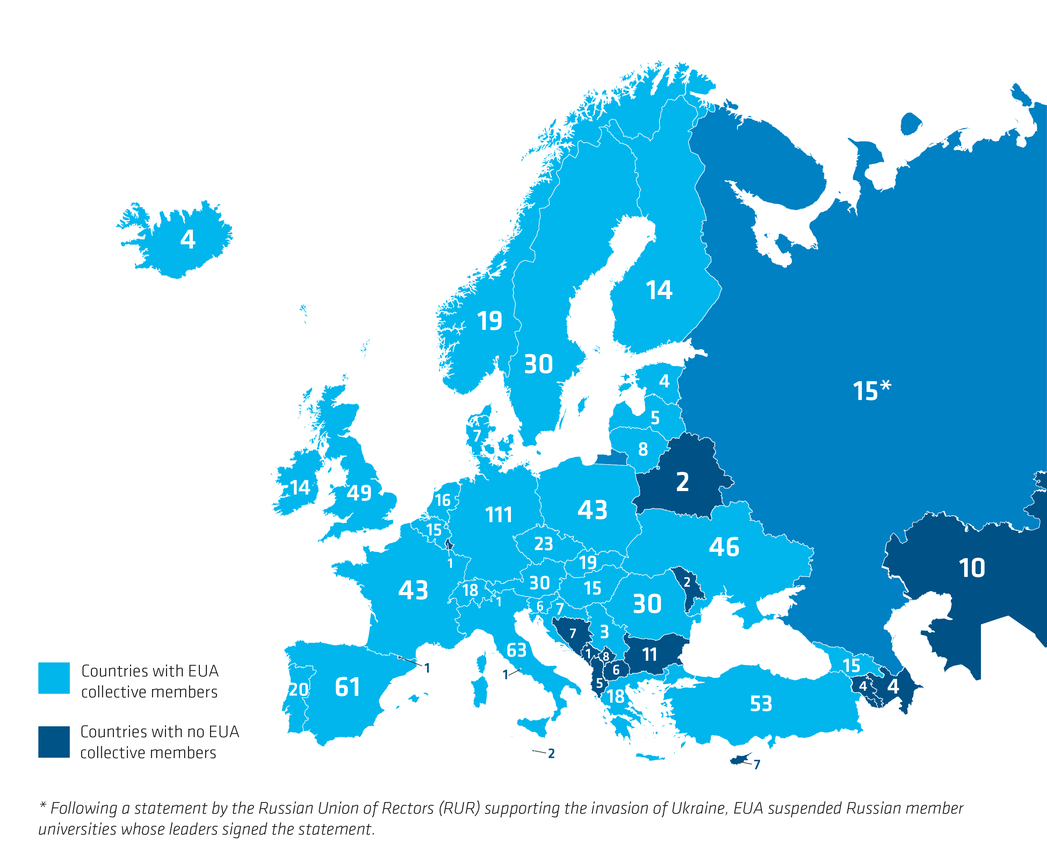
EUA Independent voice of the university sector
About 890 higher education institutions & National Rectors’ Conferences
48 countries in the European Higher Education Area (EHEA)

Slide 3
INSPIREUROPE+
project
Title: Initiative to Support, Promote and Integrate Researchers at Risk in Europe PLUS
Duration: September 2022 to August 2025
Coordinator: SAR Europe at Maynooth University, Ireland
Consortium: 7 project partners, 3 associated partners
Funder: European Union’s Marie Skłodowska-Curie Actions (MSCA), Horizon Europe

Slide 4
Inspireurope(+) Recommendations

Slide 5
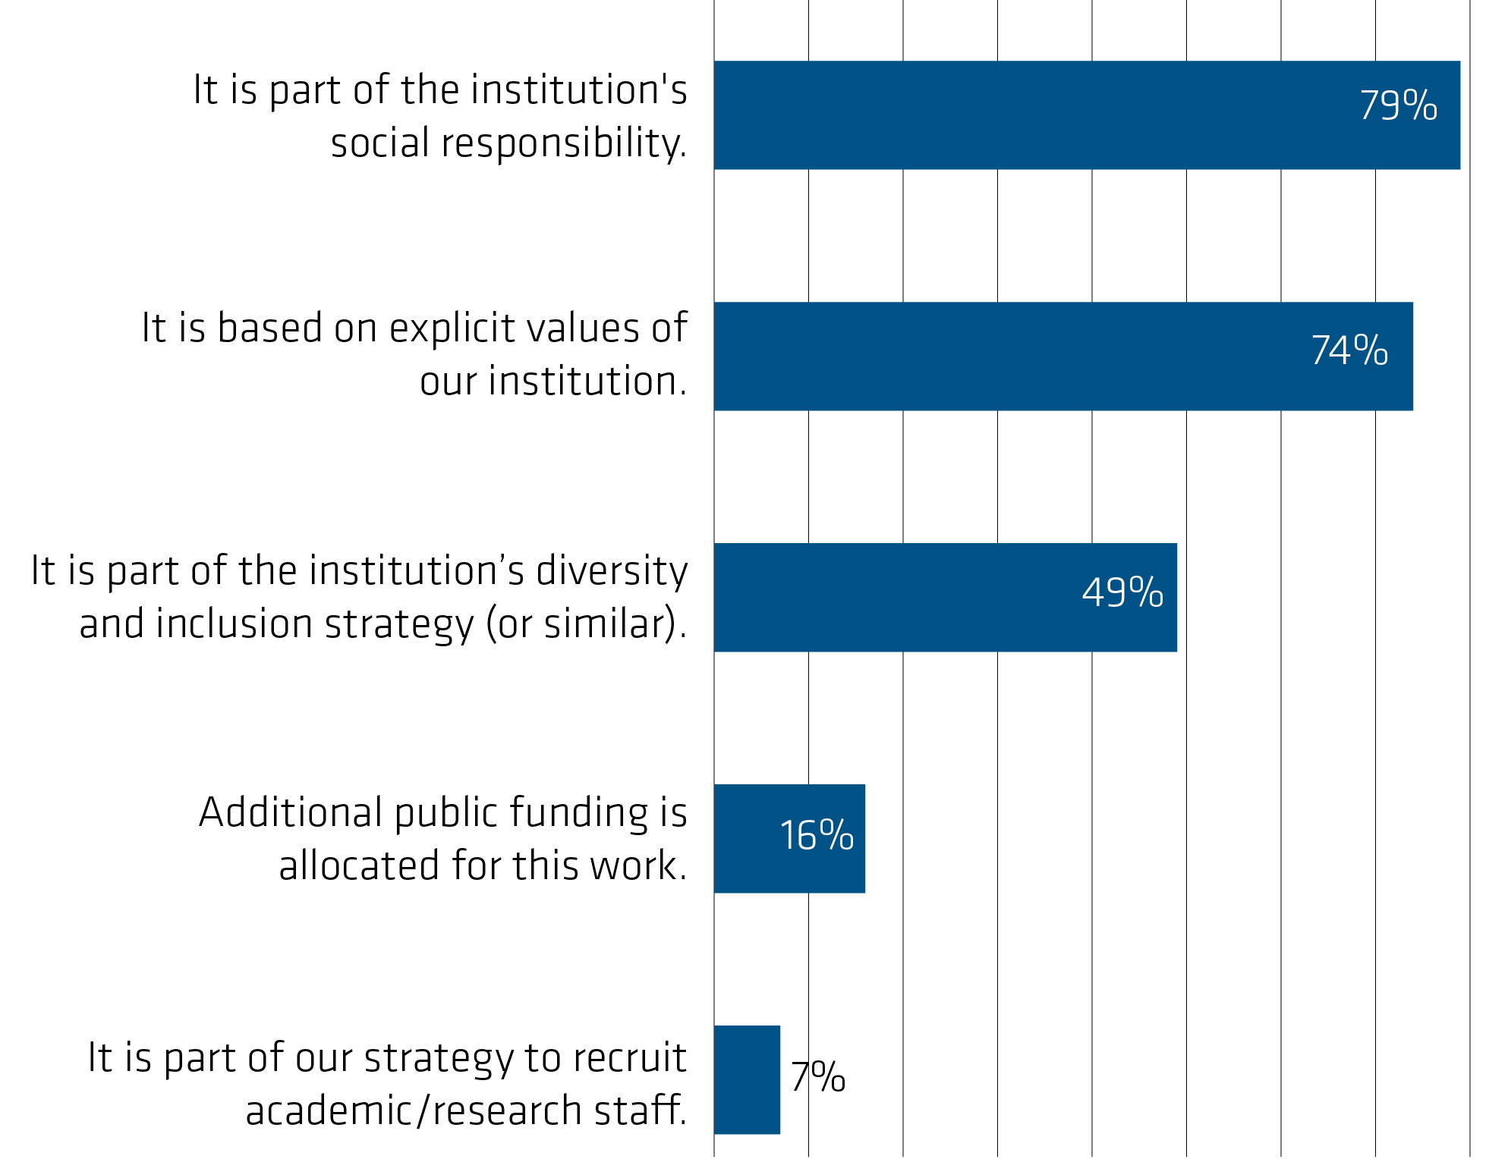
Why host?
Motives
Benefits
Strengthening the international dimension of research & teaching (55%)
Enhance our talent pool (38%)
Internationalisation at home (25%)

Slide 6
Expanding opportunities
Recommendations for
EU policy level
National policy levels
Higher education institutions
Other
Compendium of resources
Relevant policy links
Resources, reports, webinars, etc

Slide 7
Eight Inspireurope(+) recommendations
Acknowledge and support researchers at risk in higher education and research - as a matter of defending academic freedom, and as a contribution to diversity, equity, and inclusion
…

Slide 8
Recommendation 1: Policy levels
EHEA, EEA, ERA: academic freedom, institutional autonomy, and diversity and inclusion as core values of HE
Operationalise commitments
Synergy with various policy areas, from education & RI to foreign policy.
Acknowledge R@R’s contribution to EU talent pools
Demonstrate a European commitment to academic freedom, and related values, such as diversity, equity and inclusion

Slide 9
Recommendation 1: Higher education institutions
Reference in mission and strategies
Recognise contribution of researchers at risk
Promote solidarity
(Further) develop capacities of universities to act upon ‘HE values’
Share experience - peer learning, training activities, public outreach

Slide 10
Eight Inspireurope(+) recommendations
Acknowledge and support researchers at risk in higher education and research - as a matter of defending academic freedom, and as a contribution to diversity, equity, and inclusion
Establish a dedicated European fellowship scheme
Create national support programmes for researchers at risk
…

Slide 11
Recommendations 2&3 –support programmes: Policy levels
National:
Replicate national programmes
Ensure legal and framework conditions
European:
Establish permanent instrument, flexible, enhanced in times of crisis
Synergies between different EU funding sources and programmes

Slide 12
Recommendations 2&3 - support programmes: Higher Education Institutions
Showcase support for researchers at risk
Raise awareness of challenges of hosting
Advocate for establishment of European and national programmes

Slide 13
Eight Inspireurope(+) recommendations
Acknowledge and support researchers at risk in higher education and research - as a matter of defending academic freedom, and as a contribution to diversity, equity, and inclusion
Establish a dedicated European fellowship scheme
Create national support programmes for researchers at risk
Facilitate access of researchers at risk to existing European funding programmes
Build capacity to enhance long-term prospects for researchers at risk
Expand opportunities beyond academia for researchers at risk
Consider intersectionality in the support for researchers at risk
Enhance visa pathways for researchers at risk

Slide 14
Update of the recommendations for higher education institutions - good practise examples - geopolitical situation -> online consultation April 2025
Up next

Slide 15
Thanks for your attention
Henriette Stoeber
Policy Analyst
EUA - Higher Education Policy Unit
Henriette.Stoeber@eua.eu

Slide 16
Why are researchers at risk?
content of a scholar’s work, research, or teaching
individual’s status as academics/researchers
as a result of their peaceful exercise of basic human rights
as a result of conflict, situational violence, and natural disasters

