Slide 1









Ensuring Equality, valuing and celebrating Diversity and promoting Inclusion (EDI)
and Researchers at Risk (RAR)
Dr Gemma Irvine
(She/Her)
Vice President for Equality & Diversity
Notes:
Ensuring Equality, Valuing & Celebrating Diversity, and Promoting Inclusion (EDI)
This is just our day job (Teaching & Learning, Research and Engagement) made excellent through an EDI lens.
Individually we are unique, but collectively we are diverse
Running a university is like running a mini city (waste disposal, accommodation, transport, security, sports, hospitality as well as our many admin functions, and academic).
By necessity, our community is made up of many people from many different backgrounds, experiences and expectations and some with complex needs.
Empowering each of them to be as successful as they can be, is often a complex job.

Slide 2




Public Sector Duty
All public bodies in Ireland have responsibility to promote equality, prevent discrimination and protect the human rights of their employees, customers, service users and everyone affected by their policies and plans. This is a legal obligation, called the Public Sector Equality and Human Rights Duty.
Those in focus include people across the nine grounds in equality legislation:
  - gender - civil status
  - family status - sexual orientation
  - age - disability
  - race/ethnicity - religion
  - membership of the Traveller community
  and
  - those at risk of poverty or social exclusion.
Annual report to MU Joint Governing Authority/Academic Council Equality, Diversity, Inclusion, & Interculturalism Committee (EDIIC)
Notes:
In Ireland everything we do is underpinned by a national legislative lens of The Public Sector Equality and Human Rights Duty requirements with a key focus on 10 key groups of people in particular.
There are 3 steps to implementing this:
Assess A public body is required to set out in its strategic/corporate plan an assessment of the equality and human rights issues relevant to its purpose and functions, in a manner that is accessible to the public.
Address A public body is required to set out in its strategic/corporate plan the policies, plans and actions to address issues raised in the equality and human rights assessment, in a manner that is accessible to the public.
Report A public body is required to report annually on developments and achievements in regard to the equality and human rights issues and actions, in a manner accessible to the public, in its annual report.
In MU our annual reports go to our EDIIC.
2

Slide 3

Our MU Community
Individually we are unique, collectively we are diverse
Students
- gender balanced, 55%F:45%M*
- from over 100 countries
- increasing ethnic diversity
- 12% new entrants from disadvantaged areas
- 10.6% new entrants report a disability
Staff
  - gender balanced, 59%F:40%M*
  - 45 nationalities
  - c.7% of staff have a disability**
Our diversity is our strength
Equality, diversity and inclusion is a key enabler in the MU Strategic Plan 2023-2028
*Not including non-binary, <1% ** From EDI Staff Survey, 2024
Notes:
Our MU student and staff community almost equals the population of Maynooth town 17,259 (census 2022), so we have a big impact on the culture and feel of the area.
Both our student and staff cohorts are gender balanced (min 40% of female & male)
*We also have non-binary students and staff, although %s are not shown here as they are less than 1% in each cohort.
We are proud of our increasing diverse scholarly community in MU, e.g. students from over 100 countries and in the 1st year Equal Access Survey which is voluntary, our students reporting African/Any other Black background has increased from 3.6% in 2018/19 to 7.8% in 2023 as a snapshot of our increasing ethnic diversity.
We also have c.12% of our student body from the most disadvantaged areas with about the same from the most affluent postcodes.
Our staff are gender balanced and we have 7% reporting a disability.
We see this diversity as our strength, as we come together to study and research ‘to imagine and create better futures for all’ and EDI is a key enabler in the MU Strategic Plan 2023-2026.
Student data, 2022/23
- HEA Deprivation Index Scores 2020/21
Staff data, 2022/23
**from EDI staff survey, 2024

Slide 4
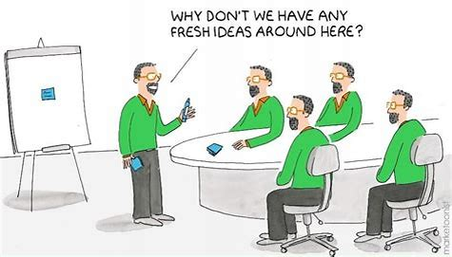
Diversity is linked to increased creativity and innovation.
Therefore, diversity is intrinsic to the spirit of a university, where we deliberately come together, with our different backgrounds, perspectives and hopes, in a learning/research community.

Slide 5




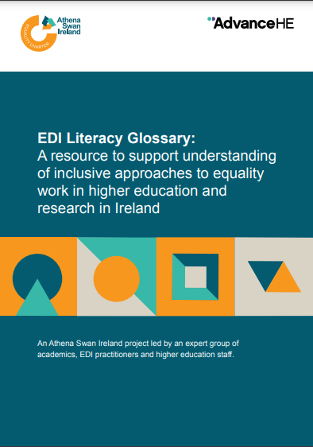

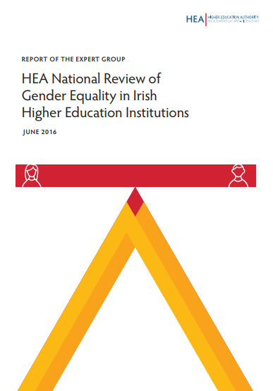

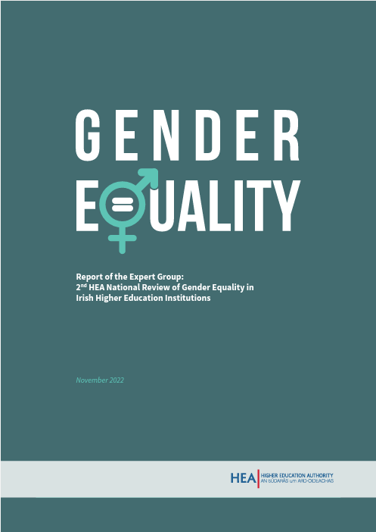


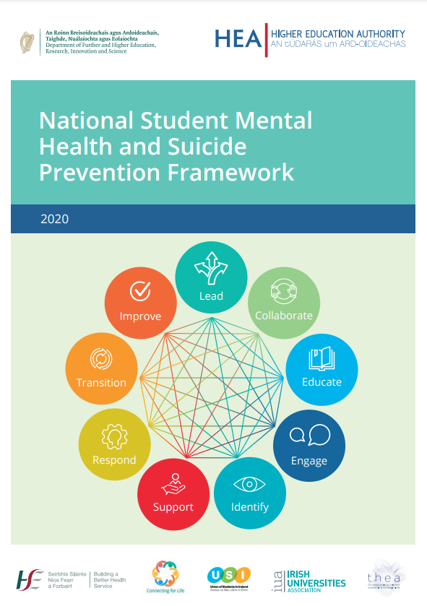



Equality, Diversity and Inclusion (EDI) is everyone’s responsibility
Access & Widening Participation
Gender Equality
Intersectionality
Excellence in Exile Refugees, Asylum Seekers & Migrants
EDI
LGBTQIA+
EDI
Race Equality
Disability
Other New Areas:
- Neurodiversity
Age Friendly
Belonging & Wellbeing
Notes:
What do we mean by EDI? We’ve taken a unique approach in MU, we’ve brought staff EDI, and student access/widening participation together, so we just talk about people. Our EDI portfolio relates to all of our community and the areas that it covers has exponentially expanded over recent years in Ireland…
MU is a national leader in widening participation and we’re ranked in the top 100 institutions globally (#84) for our work on SDG 10 - Reducing Inequalities (2024). We’re a trusted destination for many groups traditionally the furthest from higher education.
‘Talent is equally disturbed across gender, race and class, but opportunity and access are not’. So, we are effectively a first-mover on identifying new talent from groups currently under-represented in higher education.
In 2024 MU was ranked in the top 30% of universities globally for its research on the study of gender equality, policies on gender equality and commitment to recruiting and promoting women SDG5-Gender Equality.
We’ve also been recognized by the European Commission as a Gender Equality Champion, one of the first four universities in Europe to be awarded this status. For example, we’ve shifted the % of our professors who are female from just 28% in 2018 to 37% now. Our approach has been to focus on ‘fixing our organization and culture’ rather than the historical ‘fix the women approach’.
We’re taking the learnings from this work, to develop further our Race Equality, Disability and Intersectionality focus.
We have national reporting requirements and frameworks to adhere to, EDI is highly structured and monitored in Ireland. Core grant funding and research funding is linked to our progress.
I work closely with all my colleagues across the university to achieve change, and in particular with Student Services & HR on ‘Belonging & Wellbeing’ through the Healthy Campus Charter, Consent Framework and the Mental Health Framework.
This portfolio could sit anywhere in the University, as it spans Students, Staff, Research, International Education, Governance, Finance etc. It is not important where it sits, but rather that someone in the University has responsibility for bringing it all together and coordinating it so that a strategic holistic approach is taken. In MU, that responsibility rests with me as VPED, but it is everyone’s responsibility to implement in their day job.
We use our community as a living lab, where data and research informs our policy and practice, which then feeds back into new data and research. We’ll be launching a new National Centre of Inclusive Higher Education later this year, providing a place to gather all this expertise together.
But I’d like to turn now to how all of this can be used to support Excellence in Exile….
5

Slide 6

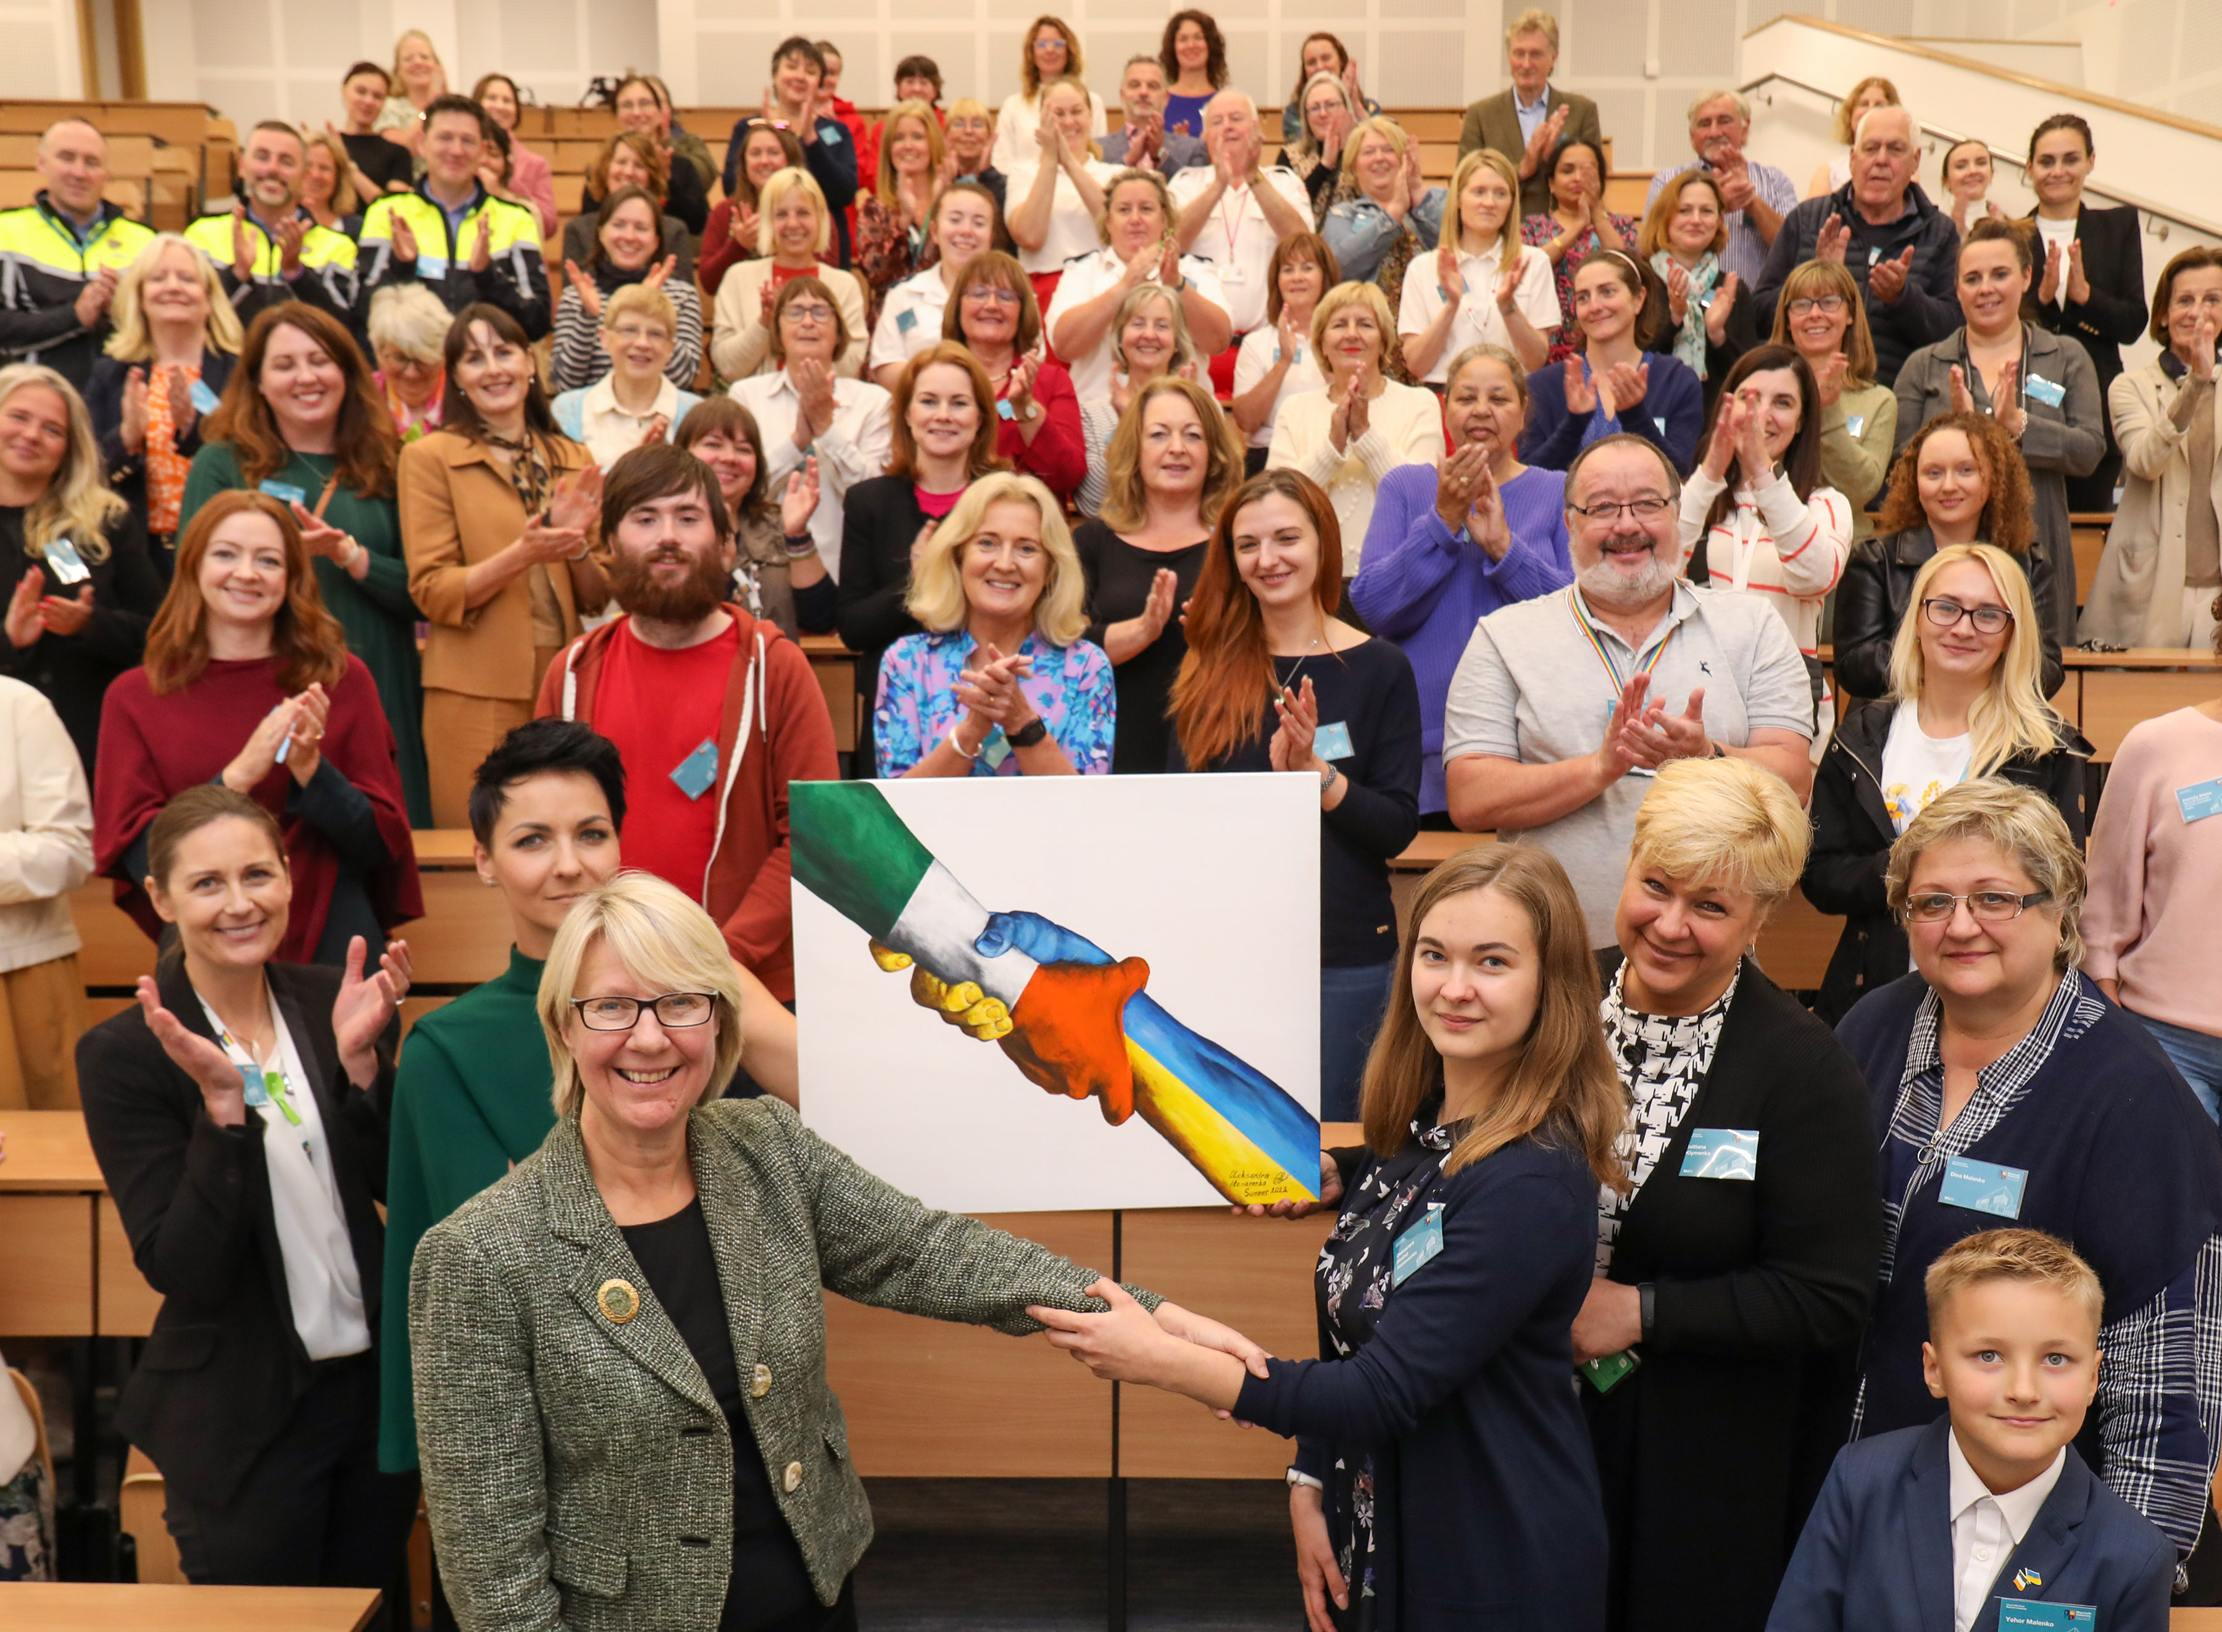
Excellence in Exile
Refugees, asylum seekers & migrants
  - Designated University of Sanctuary with student scholarships for international protection applicants in Ireland.
  - MU hosts Scholars At Risk Europe, the European office of the Global Scholars at Risk (SAR) network.
  - MU SAR Fellowship, currently held by an Afghanistan Fellow.
  - MU ran the National Student and Researcher Helpdesk for displaced people from Ukraine in 2022 and hosted 1,200 Ukrainians in campus accommodation.
Presentation of painting to MU President by Ukrainian student, resident on campus summer 2022. Surrounded by the 20+ support agencies & community groups that participated in the Maynooth Ukrainian Action Group
Notes:
We have developed a new pillar of work called ‘Excellence in Exile’ which includes:
being designated as a University of Sanctuary with specific student scholarships for those applying for international protection in Ireland (who are not eligible for state supports)
We are an active member of the Global Scholars at Risk Network
and we host Scholars at Risk Europe, the European office of the Global Scholars at Risk Network, on campus.
We have a dedicated MU SAR Fellowship, for staff/researchers fleeing their home country and currently this is held by an Afghanistan Fellow.
We are proud of the work we carried out to support the c.100k people displaced from Ukraine who arrived into Ireland in 2022, MU was asked by the Government to run the National Student & Researcher (NSR) Helpdesk to assist people looking to access higher education and research while they were in Ireland, and we hosted c1,200 on campus in student accommodation over the summer of 2022 and we setup and chaired a Maynooth Ukrainian Action Group coordinating c20 support agencies to assist our guests while they stayed on campus with us. Painting by 16 year old Sasha which she presented to the MU President.
This work was transformational for everyone involved.
------------------------------------------------------------
Under the pressures of our current Higher Education Context, it might be easy to think ‘its hard enough to support our own students and staff, let alone people fleeing their home countries, why should we think about extending ourselves to do this.
But take a moment now, to imagine yourself at home eating dinner and a neighbour runs in and says you have 10mins and you have to leave and not come back! What would you take with you?
If someone shut down your university today, where would you go, who would take you in, how would your research and students continue to be supported if you had no place to go back to from here, to teach or work?
We have a duty of care to our colleagues in higher education across the globe. When someone attacks their academic freedom, they attack the academic freedom of all of us.

Slide 7

University of Sanctuary Ireland
University of Sanctuary Ireland (UoSI) is an Irish initiative to encourage and celebrate the good practice of universities, colleges and other education institutes welcoming refugees, asylum seekers and other migrants into their university communities and fostering a culture of welcome and inclusion for all those seeking sanctuary.
Across the Island of Ireland, many universities and colleges, public and private, have pledged to support those newcomers seeking sanctuary in Ireland.
Universities - Places of Sanctuary Ireland (cityofsanctuary.org)
Notes:
In Ireland, we’ve come together to support each other with taking in people who have no where else to go.
I wanted to explain a bit more about what the University of Sanctuary Ireland initiative is and how it, and Schools of Sanctuary, fit within the wider Places of Sanctuary Ireland which is closely to the charter adopted by the UK City of Sanctuary organisation.
Across the Island of Ireland, many universities and colleges, public and private, have pledged to support those newcomers seeking sanctuary in Ireland. And ensure that wherever people seeking sanctuary go they will feel safe, find people who welcome them and understand why they are here, and have opportunities to be included in all activities.
To become a University of Sanctuary, you have to:
Learn - about what it means to seek sanctuary. Training staff, teaching students, or holding events to raise awareness. e.g Inviting refugees and people seeking asylum to come and talk about their experiences and raise awareness ● Identifying the issues that refugees, people seeking asylum, and other migrants face in settling into a new country.
Embed - a culture of welcome, safety and inclusion within the institution and the wider community with sustainable actions including offers of scholarships, fee waivers, bursaries to study). Open up facilities on campus, such as sports centres, computer labs and libraries. Find ways to help refugees to re-establish themselves and integrate, through language support, work placement, volunteering opportunities , accrediting prior learning, re-skilling and up-skilling career workshops.
The actions need to be coordinated through the creation of a sanctuary steering group that is representative of stakeholders across the board. Stakeholders include: senior management, representation from all faculties, academic and support staff, the Students’ Union and student volunteers, international protection applicants and refugees, and NGO representatives.
Share - Sharing your vision, achievements, what you have learned and your good practice with other education institutions, the local community and through media, website, and events.
And apply for certification, get assessed and approved. Helps to ensure minimum standards across different HEIs, and a place to go to get support from your peer HEIs.
That’s for students, now what about for staff……..
Currently Dublin City UniversityUniversity of Limerick, University College Cork, University College Dublin, NUI Galway, Maynooth University and Trinity College Dublin have received the University of Sanctuary Award, and Athlone IT is the first College of Sanctuary in Ireland. Many other colleges across the island are working on obtaining the designation of the title, too.

Slide 8
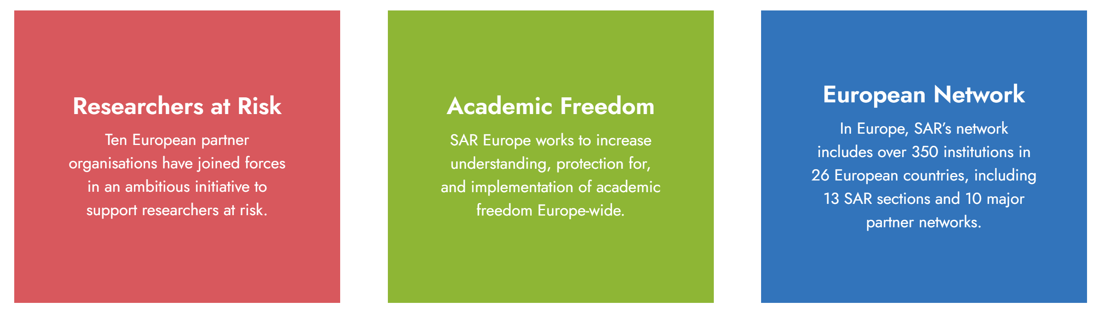



Scholars at Risk Europe
Scholars at Risk Europe, hosted at Maynooth University, is the European office of the global Scholars at Risk network.
Notes:
Scholars at Risk Global protects scholars suffering grave threats to their lives, liberty and well-being by arranging temporary research and teaching positions at institutions across the world as well as by providing advisory and referral services. Based in New York. There are national sections of Scholars at Risk across the world, and there is a European Office of the Scholars at Risk, SAR Europe, which is hosted by Maynooth University in Ireland.
SAR Europe has three main areas of supporting ‘Researchers at Risk’, ‘Promoting Academic Freedom’, and supporting the ‘SAR European Networks’ and organisations of which there are 350 institutions in 26 European Countries.
How can SAR Europe support you?
Inspireurope is an ambitious Europe-wide initiative to support researchers at risk. Partners include the Alexander von Humboldt Foundation, Collège de France, the European University Association, as well as universitites in Sweden and Greece. It is funded under the European Commission’s Marie Skłodowska-Curie Actions
has many supports for host institutions including webinars, guidance materials, and leadership roundtables. These activities have covered themes such as welcoming researchers at risk: considerations for new employers and host institutions, and supporting researchers at risk to make the most out of their stay which touch upon the coordinated approach that Maynooth has implemented so well. I would also point to the resources for host institutions and employers which contains publications, guides, and reports on hosting researchers at risk. SAR has a ‘How to Host’ handbook which contains good practices that we encourage HEIs to implement.
MSCA4Ukraine which funds Fellowships for staff to continue their research in another country. Funded by the European Commission, the MSCA4Ukraine Programme is implemented by a consortium comprised of Scholars at Risk Europe hosted at Maynooth University, Ireland (project coordinator), the German Alexander von Humboldt Foundation and the European University Association, with the French national PAUSE programme,hosted by the Collège de France, and the global Scholars at Risk Network participating as associated partners.
Increasing understanding about Academic freedom, freedom of expression (free speech), and protest which are important but distinct concepts. Each serves a particular function in a healthy democratic society, and each is protected to varying degrees by international human rights standards. But they all do not cross the line into where it becomes discrimination, harassment, direct or threatened harm to others.
- Informing Policy making: SAR Europe is supported in its work by members of the European Coordinating Committee for Academic Freedom Advocacy. It publishes reports on where attacks of academic freedom are occurring.
So how have we organized ourselves in MU…

Slide 9
MU SAR Fellowship
  Based on international best practice, fully funded 1-2year research Fellowship, with the option for an additional extension.
Includes:
Gross salary, employers pension and PRSI; research, training and networking costs; mobility allowance; family allowance if applicable.
Academic Mentor – a MU academic mentor will be nominated by the host department/institute to provide academic support (and will act as Principal Investigator for the purposes of managing the Fellowship post-award by the RDO).
Office space in the host department/institute
Admin Mentor – a single point of contact for administration queries will be provided by the EDI Office, the admin mentor will help signpost services and seek guidance from across the organisation and nationally in relation to visas, tax, accommodation, signposting English language courses, schools, and general admin support.
Additional Supports: Support will also be provided by the Research Development Office, HR, Finance, EDI Office, International Office, and the Access Office.
Notes:
We have set up a Maynooth University SAR Fellowship.
Based on international best practice (Germany & France), this is a fully funded 1-year research Fellowship (€75,000) being offered under the ‘Excellence in Exile’ pillar of the Equality, Diversity, Inclusion and Interculturalism (EDI) Office.
Potential candidates: include researchers at all stages of their research career (excluding doctoral students), from all around the world who are experiencing threats to their life, liberty, or research career, and those who are forced or have been forced to flee because of such threats.
Identification of potential candidates: Candidates could emerge bottom-up through MU contacts or could be offered to MU via international networks (e.g. SAR, IIE-SRF) and require a top-down call to MU departments/institutes to gauge their interest in hosting candidates from particular areas.
Details of the Fellowship: The Fellowship will be for one-year up to the value of €75,000 with the potential for an additional one-year extension. This will include for example: gross salary, employers pension and PRSI; research, training and networking costs; mobility allowance; family allowance if applicable. The host department/institute will liaise with the Fellow to determine appropriate duties/expectations while they are here taking into account their individual situations/experience etc. The initial focus will be on research, but this could be reviewed during the period of the Fellowship and may involve elements of teaching & service as appropriate thereafter.
MU supports to be provided by host department/institute:
Academic Mentor – a MU academic mentor will be nominated by the host department/institute to provide academic support (and will act as Principal Investigator for the purposes of managing the Fellowship post-award by the RDO).
Office space in the host department/institute
Identification of HEI supports available
Admin Mentor – a single point of contact for administration queries will be provided by the EDI Office, the admin mentor will help signpost services and seek guidance from across the organisation and nationally in relation to visas, tax, accommodation, signposting English language courses, schools, and general admin support.
Additional HEI Supports: Support will also be provided by the Research Development Office (RDO), HR, Finance, EDI Office, International Office, and the Access/WP Office.
Sponsor: to write references for opening bank accounts, provide character references for accommodation/school places etc.
Community of Practice / Social partnership Network 'it takes a village to support a scholar’, practicing local language, creating network of business contacts, social contacts
Accommodation The Admin Mentor will support scholars to identify suitable rental accommodation thereafter.
There are a number of places that offer financial aid to match fund us, including the IIE-Scholarship Rescue Fund, and we have partnered with them to support our Fellow.

Slide 10
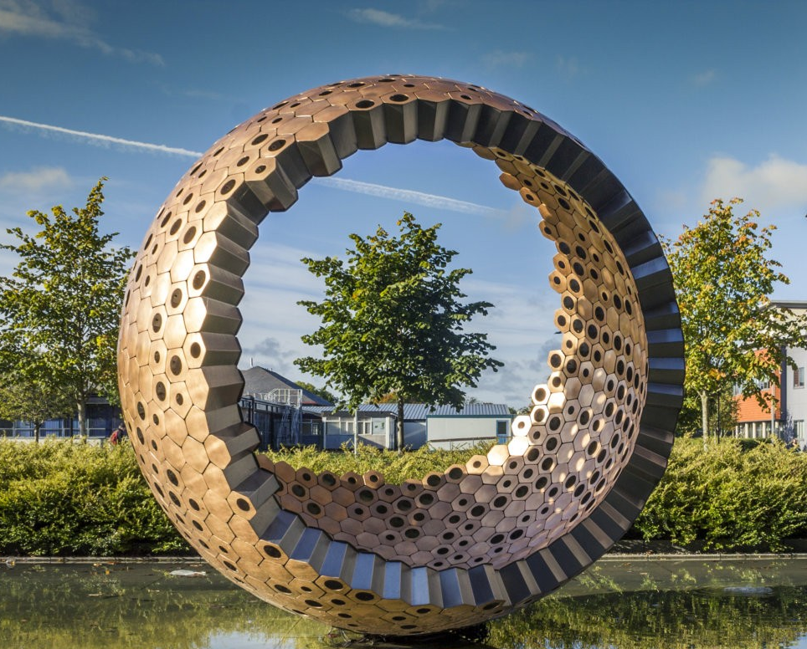
EDI is a Practice, not an End Goal
Culture is created by each of us…..
In what we: say, and don’t say,
  do, and don’t do,
  tolerate, and don’t tolerate.
Notes:
10

Slide 11


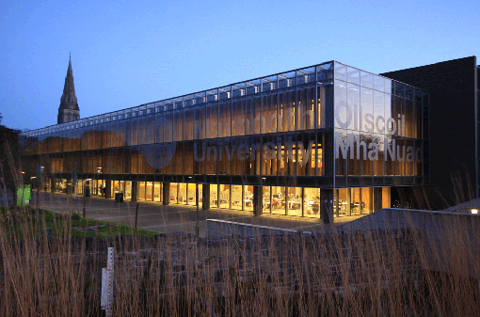








Dr Gemma Irvine (she/her)
Vice-President for Equality & Diversity
vicepresident.equality@mu.ie
Equality, Diversity and Inclusion Office
equality@mu.ie
Maynooth University Access Programme
access.office@mu.ie
maynoothuniversity.ie/edi
@maynoothuniversityedi8121
maynoothuniversity.ie/athena-swan
@EqualityMU
facebook.com/EqualityMU
@maynoothuni_edi
@MU_AthenaSwan

